Slide 1
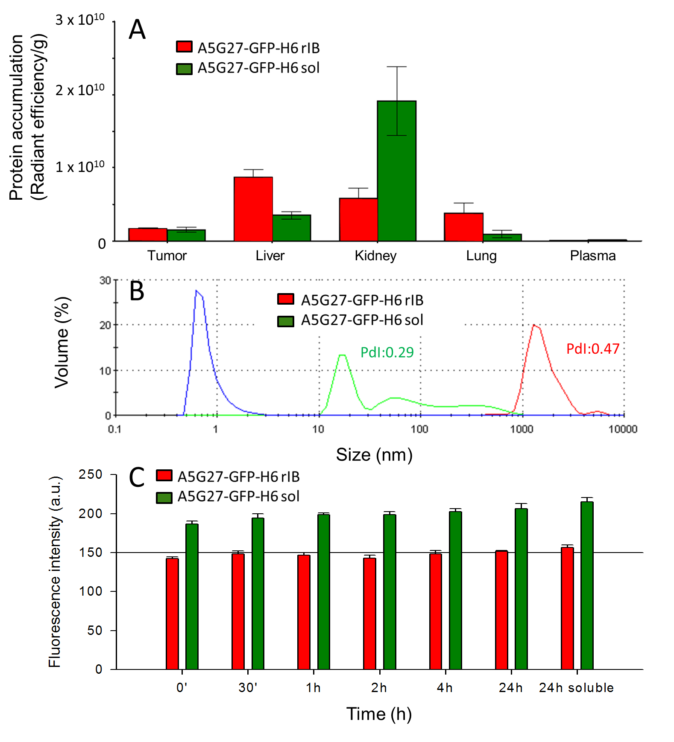
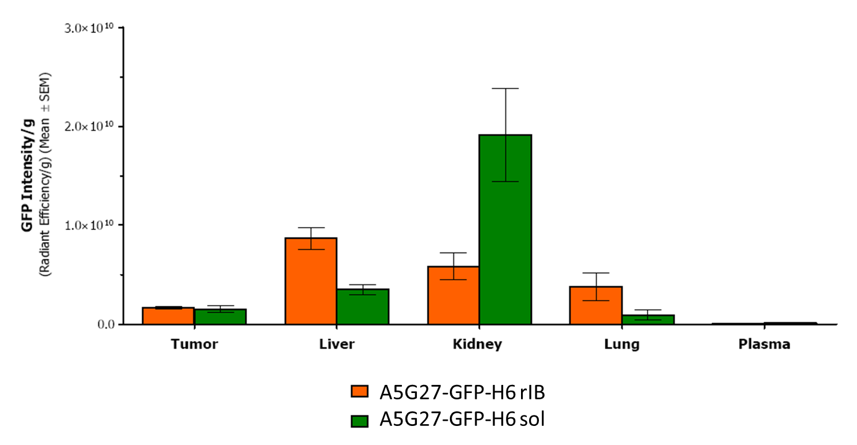
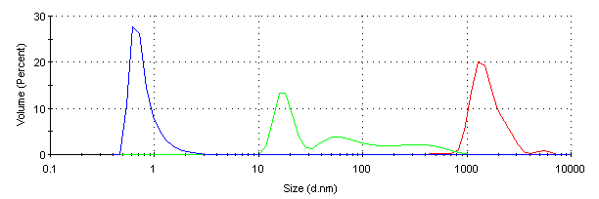
A
B
C
3 x 10¹⁰
2 x 10¹⁰
1 x 10¹⁰
0
Tumor Liver Kidney Lung Plasma
Volume (%)
PdI:0.29
PdI:0.47
Size (nm)
0 0.5 1 2 4 24 24 soluble
Time (h)

Slide 2
3 x 10¹⁰
2 x 10¹⁰
1 x 10¹⁰
0
A
B
C
3 x 10¹⁰
2 x 10¹⁰
1 x 10¹⁰
0
A
B
C
3 x 10¹⁰
2 x 10¹⁰
1 x 10¹⁰
0
A
B
C
Protein accumulation
(Radiant efficiency/g)
Protein accumulation
(Radiant efficiency/g)
Protein accumulation
(Radiant efficiency/g)
Tumor Liver Kidney Lung Plasma
Tumor Liver Kidney Lung Plasma
Tumor Liver Kidney Lung Plasma
Volume (%)
Volume (%)
PdI:0.47
Volume (%)
PdI:0.29
PdI:0.47
PdI:0.29
PdI:0.47
PdI:0.29
Size (nm)
Size (nm)
Size (nm)
Time (h)
Time (h)
Time (h)

