Slide 1
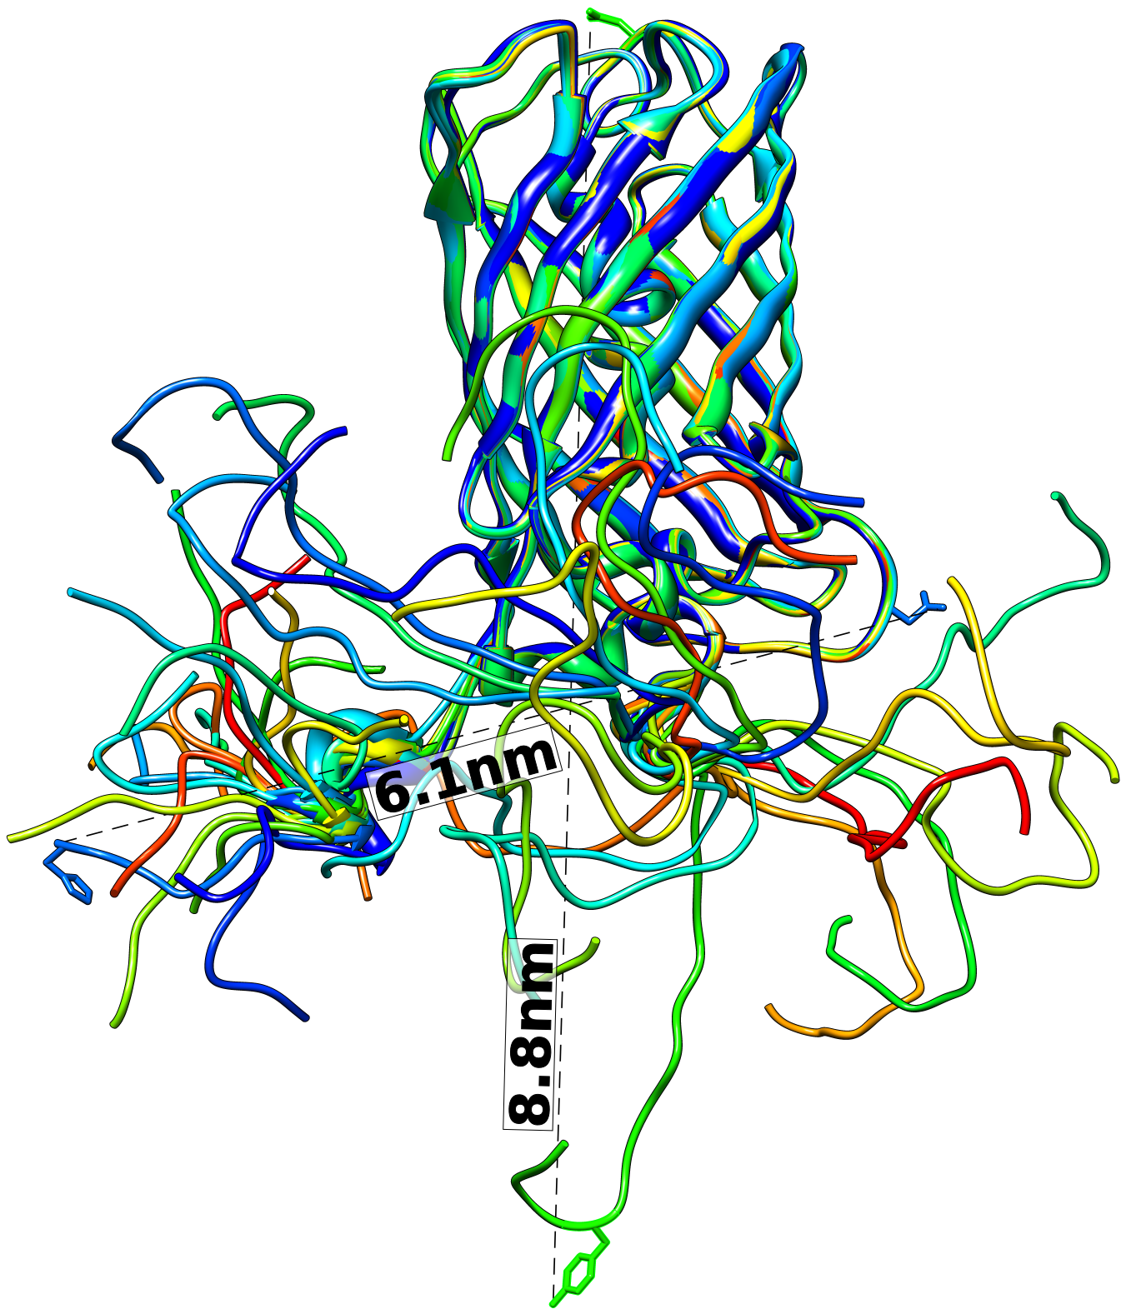
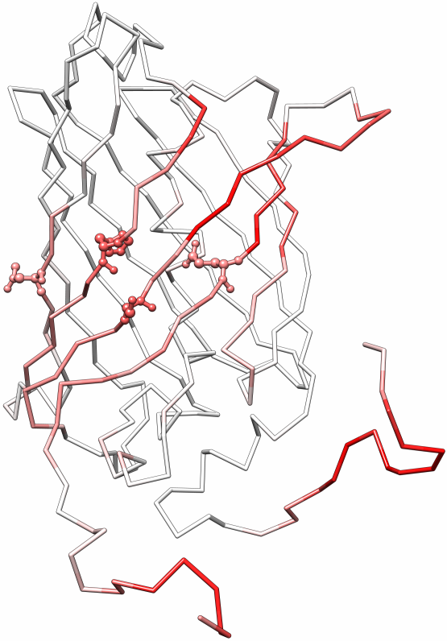
A B C
Potential protein binding sites
Monomer
14 nm 30 nm
A5G27-GFP-H6 sol A5G27-GFP-H6 rIB

