Slide 1
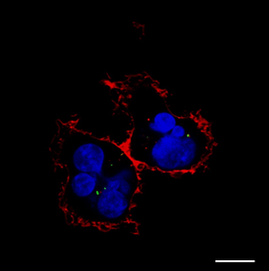
A B
FNI/II/V-GFP-H6 sol
FNI/II/V-GFP-H6 rIB
FNI/II/V-GFP-H6 deg
A5G27-GFP-H6 sol
A5G27-GFP-H6 rIB

