Slide 1
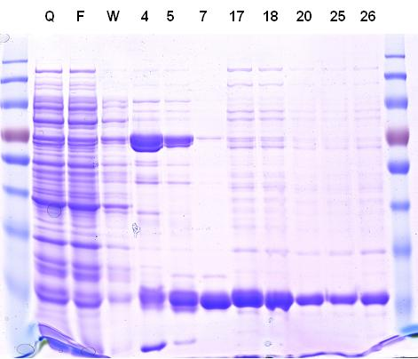
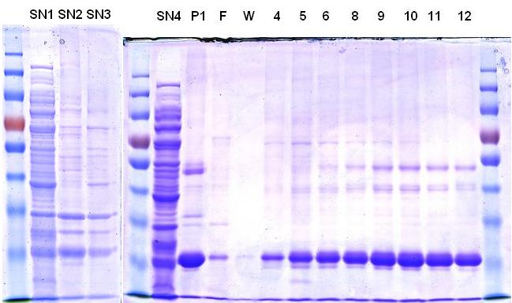
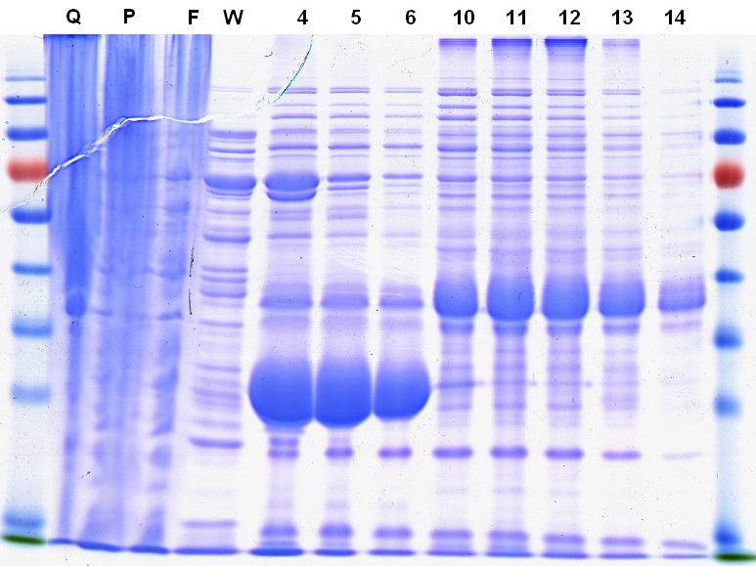
A B
SOLUBLE PROTEIN
rIB PROTEIN
Cell pellet
Purification of soluble protein (sol)
Lysis (French Press)
Recovery of IB protein (rIB)
A5G27-GFP-H6
Centrifugation 10.000 g
45 min
Supernatant Filtration
Wash pellet with H₂O
x2
Pellet resuspend with solubilizing buffer (40 mM TrisHCl with 0.2 % N-lauroyl sarcosine for 24 h at RT.
FNI/II/V-GFP-H6
Centrifugation 10.000g 45’
C
Truncated protein Full-length protein
Supernatant Filtration
His affinity purification
29636
A5G27-GFP-H6 sol
Wash buffer: 20 mM TrisHCl, 500 mM NaCl, 10 mM Imidazol pH 7
Elution buffer: 20 mM TrisHCl, 500 mM NaCl, 500 mM Imidazol pH 7
Wash buffer: 20 mM TrisHCl, 500 mM NaCl, 10 mM Imidazol , 0.1 % N-lauroyl sarcosine pH 7
Elution buffer: 20 mM TrisHCl, 500 mM NaCl, 500 mM Imidazol, 0.1 % N-lauroyl sarcosine pH 7
29626
A5G27-GFP-H6 rIB
35792
FNI/II/V-GFP-H6 sol
Intensity [a.u.]
35806
FNI/II/V-GFP-H6 rIB
FNI/II/V-GFP-H6 deg
Dialysis against 166 mM NaCO₃H pH 7.4
22000
24000
26000
28000
30000
32000
34000
36000
38000
40000
42000
m/z
Notes:
Figura B) he canviat el color de la indicació “truncated protein” a vermell perque fos més fàcil distingir ja que s’havien queixat d’aixó. Faltava afegir el MALDI de la GFP-H6 i l’he demanat a la Silvia peró tenim un problema...dijous t’ho explico

