Slide 1
Peak: 10.90 nm
Pdi: 0.361 ± 0.013
Peak: 10.10 nm
Pdi: 0.444 ± 0.012
T22-GFP-H6
Peak: 11.17 nm
Pdi: 0.223 ± 0.0024
Peak: 11.4 nm
Pdi: 0.42 ± 0.055
Volume (%)
Peak: 10.10 nm
Pdi: 0.403 ± 0.016
Peak: 7.531 nm
Pdi: 0.778 ± 0.133
T22-GFP-H5T
Peak: 13.54 nm
Pdi: 0.40 ± 0.044
Peak: 8.72 nm
Pdi: 0.58 ± 0.089
Volume (%)
Control
Storage at -80ºC
24 h, 37ºC, in human serum
Size (nm)

Slide 2
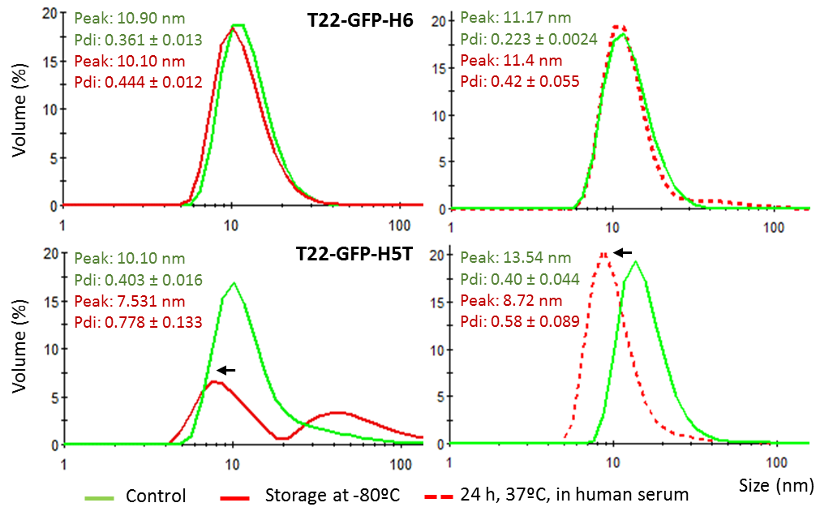
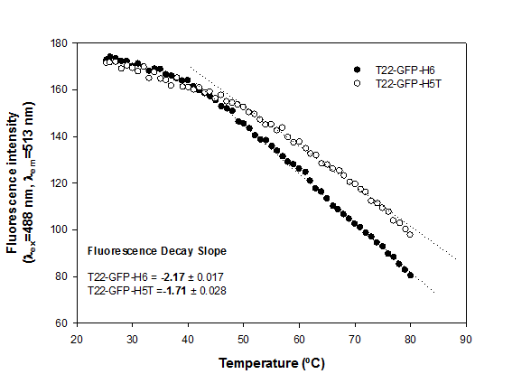
A B
T22-GFP-H6
T22-GFP-H5T
C D E
no incubation
48 h incubation

