Slide 1
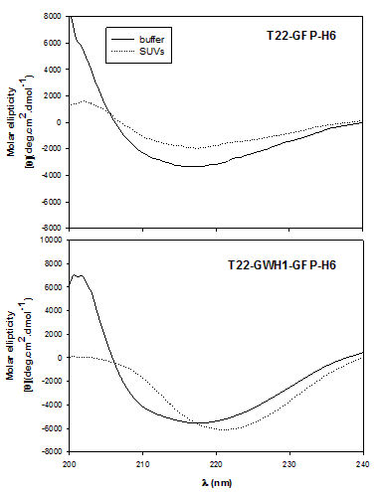
8000
4000
0
-4000
-8000
A B
T22-GFP-H6
T22-GFP-H6+SUVs
100
80
60
40
20
0
Molar elipticity
[θ](mdeg.cm^{2.}dmol-¹)
Cytotoxicity (%)
8000
4000
0
-4000
-8000
T22-GWH1-GFP-H6
T22-GWH1-GFP-H6+SUVs
λ (nm)
Subletal levels
Threshold concentration for cytotoxicity
Concentration (μM)
200 210 220 230 240
λ (nm)

