Slide 1
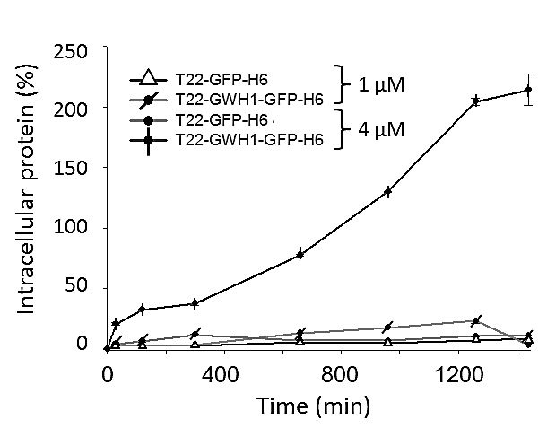
Concentration (µM)
A B
250
200
150
100
50
0
100
80
60
40
20
0
1 μM
1 μM
4 μM
4 μM
Intracellular protein (FU)
Endosomal release (%)
*
*
*
*
0 400 800 1200
0 400 800 1200
Time (min)
Time (min)

