Slide 1
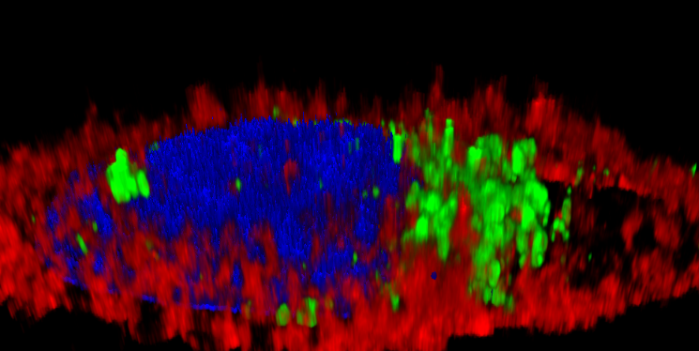
A
B
5 µm
10 µm
25 µm
T22-GWH1-GFP-H6
5 µm
T22-GFP-H6

