Slide 1
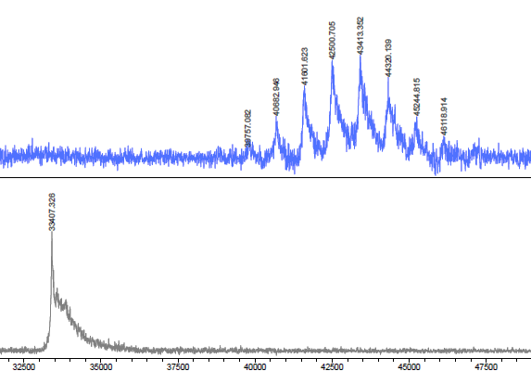
T22-GWH1-GFP-H6
Size: 29 nm +/- 0.125 pdI: 0.10 +/- 0.001
100
50
0
T22-GWH1-GFP-H6
T22-GFP-H6-A
T22-GWH1-GFP-H6-A
A B C
T22-GWH1-GFP-H6-A
T22-GWH1-GFP-H6-A
Size: 34.5 nm +/- 0.135 pdI: 0.23 +/- 0.003
*
46.118
39.757
10
5
0
AU
T22-GWH1-GFP-H6
33.407
T22-GWH1-GFP-H6
Cell viability (%)
Volume (%)
*
32.5 35.0 37.5 40.0 42.5 45.0 47.5
10 100
1 μM 4 μM
Molecular mass (KDa)
Size (nm)

