Slide 1


Module 0 : Setting the stage

Slide 2
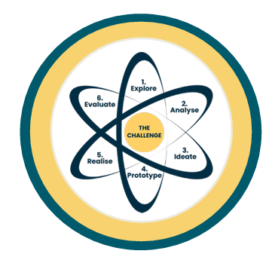
Module 0 : content
Setting the stage:
- Planning of the CBL
- Finding a challenge
- Setting up the teams
Learning spheres (social & mental)
Present the challenge

Slide 3
The location
When facilitating digitally, the location of the students is beyond your control. This refers to what stimuli are present, but also to what is available to the student.
The reason is that you cannot predict in which room the students will be located.
This creates the possibility of external stimuli, which you as a facilitator, cannot account for
(D-EMIND methodology p. 9)

Slide 4
A digital social proces?
A facilitated process to achieve this is therefore important, especially in the digital domain, where the interactions which happen naturally in the physical space, won’t happen the same way in the digital environment.

Slide 5
Guidance in the session
Facilitating a digital learning process is:
understanding when you can let the students complete the task on their own
to let the students, use the learned tools and own intuition to work on the project
to be aware of the fact that phenomena like “awkward silence” and “small talk” do not occur in the same way digitally.
Start with a high degree of guidance.

Slide 6
Why facilitation and not teaching?
An entrepreneurial mindset is not something you can learn/be taught in the traditional sense. It’s not just learning how e.g. to add two number or knowing how to structure a sentence.
Your role therefore shifts from being a teacher/lecturer, where you are conveying specific knowledge to the students, to a facilitator where you and the students sometimes are on the same level in the process.
The process therefore becomes a joint effort between the facilitator and the students for what is learnt and taught and creates a space where you are equals as knowledge bearers, in regard of finding solutions to the challenge at hand.
When dealing with real world challenges, where no solution is found in advance, the process traverses into uncharted territory, where you hunt the best solution to the challenge.

Slide 7
Alignment of expectations
As human beings, it’s easier for us to cooperate when we know what’s expected of us!
Important that the facilitator together with the students:
create a sense of commitment between the students, make them engaged in the process
create a “Code of Collaboration”, in which the students negotiate what is to be expected from them in the process to come.
point out some of the expectations you have towards the students.
(D-EMIND Methodology p. 11)

Slide 8
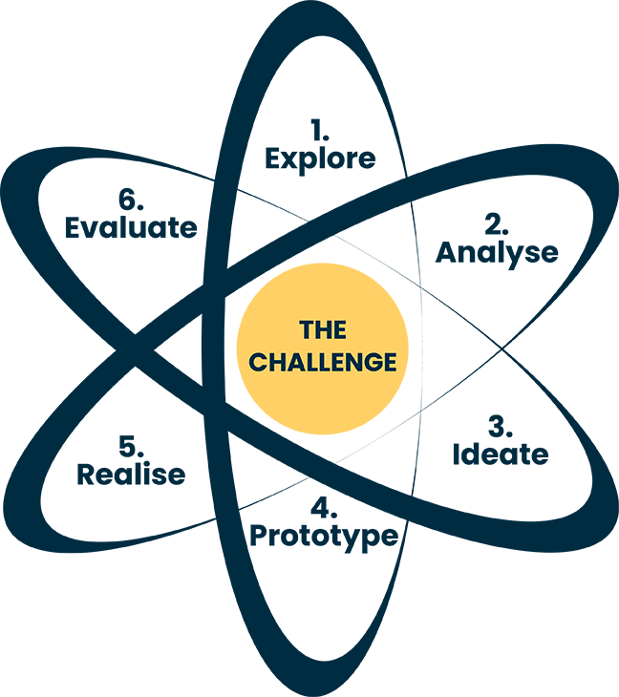
The sphere around the Atom model
Learning Sphere:
The Learning Sphere circulates around the 6 elements in the atom.
The spheres are social and mental, and they influence the atom and the 6 elements within.
This sphere is important for the atmosphere that fosters the 6 elements of innovation.
Social
Mental

Slide 9
Social sphere
The social learning sphere is primarily perceived as the social relation and the collaboration between students.
Social

Slide 10

Social – D-EMIND
The social learning Sphere is primarily perceived as the social relations and the collaboration between students.
Aim is to strenghten the feeling of security and mutual trust among group members.
Spend some time to create these relations through tasks and objectives throughout the class. This can be longer facilitated activities which, sole purpose is to strengthen these social bonds, but also minor discussion tasks, where the students are put into smaller groups and where they must use both personal experiences, as well as the academic content they are taught in relation to the subject.
(D-EMIND, p. 10)
Social

Slide 11
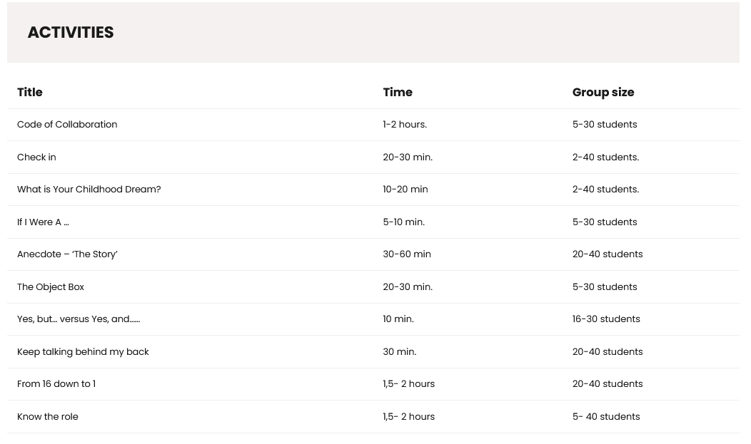
Social Sphere

Slide 12
The object box
https://www.demind.eu/atom_model/the-object-box/
You each take one object from the room where you are sitting. (You have 30 sec).
The facilitator demonstrates how to present oneself based on the object chosen from the room.
The participants are given 2 minutes max. each to present themselves based on the thing they have chosen.
The rest must listen attentively to their colleague.
The facilitator subsequently asks the participants how they experienced this exercise.

Slide 13






The object box: alternative
Adobe: K. Yuganov
1) Add your nickname on one of the speech bubble at the bottom and place it next to the picture that best describes you
2) A (random) participant must select an image and think about which colleague it might belong to.
3) The person who selected that image identifies him/herself and explains why he/she identifies with that image.
Adobe: Art of Life
Adobe: Skarie
Adobe: TiA
Pxhere. #1517273
Adobe: Vectorwin
---
---
---
---
---

Slide 14
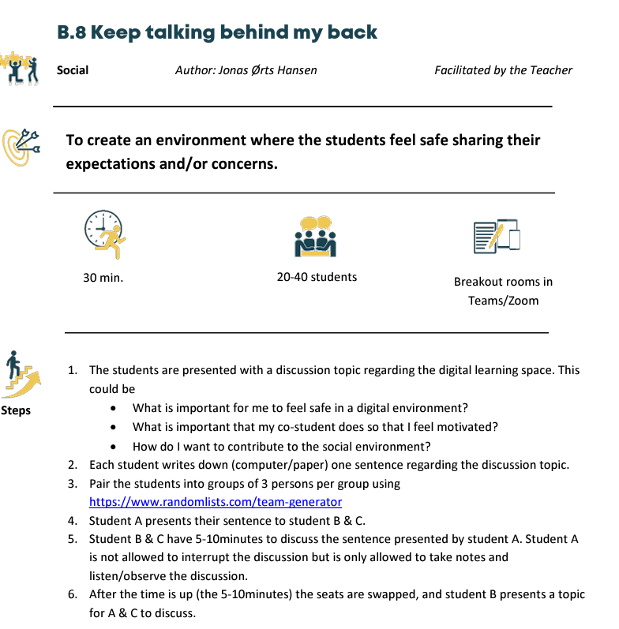
Keep talking behind my back
https://www.demind.eu/atom_model/keep-talking-behind-my-back/
(D-EMIND methodology p. 34)

Slide 15

Check in
Do you have any particular questions concerning today's topic?
Do you have any information or knowledge you wish to share regarding today’s topic?
Do you have any concerns about joining the workshop?
- http://alphastockimages.com/

Slide 16
Questions
Write down individually:
1. What is important for me to feel safe in a digital environment?
2. What is important that my co-student does so that I feel motivated?
3. How do I want to contribute to the social environment?

Slide 17
Breakout Room for students
Ask the youngest student in the room to give letters to all of them and time the different aspects of this exercise.
Student A presents her/his sentence to student B & C.
Student B & C have 5-10minutes to discuss the sentence presented by student A.
Student A is not allowed to interrupt the discussion but is only allowed to take notes and listen/observe the discussion.
After 5-10minutes the roles shift, and student B presents a topic for A & C to discuss.

Slide 18
Mental
Mental
The mental spheres includes an entrepreneurial mindset to work on the 6 elements of innovation and in the end find a solution for the challenge in the core of the model:
a creative mindset​
a ‘possibility’ thinking ​
a desire to act​
a part of this ‘possibility’ mindset is to act when dealing
with problems.

Slide 19
Mental
Mental
Alignment of expectations: As human beings, it’s easier for us to cooperate when we know what’s expected of us. ..​
​
Note here that this negotiation does not occur naturally as it might in the physical space, hence it’s important that you, as a facilitator, explicitly help the students with this process. We highly recommend that you, together with the student, create a “Code of Collaboration”, in which the students negotiate what is to be expected from them in the process to come. Also, you as a facilitator have to point out some of the expectations you have towards the students.

Slide 20
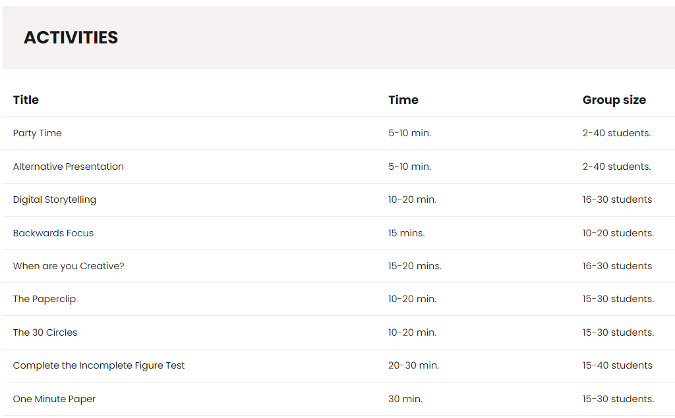
Mental Sphere

Slide 21

YES – I made a mistake
https://www.foremlink.com/activities/yes-ive-made-mistake
Adobe: NicoElNino

Slide 22
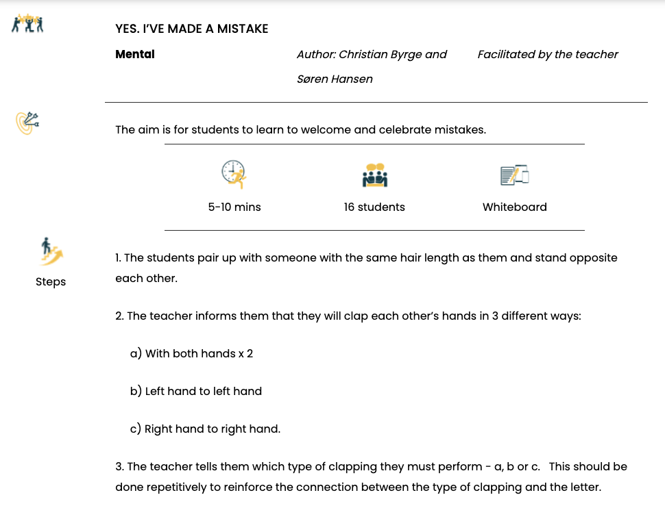
Yes, I made a mistake

Slide 23
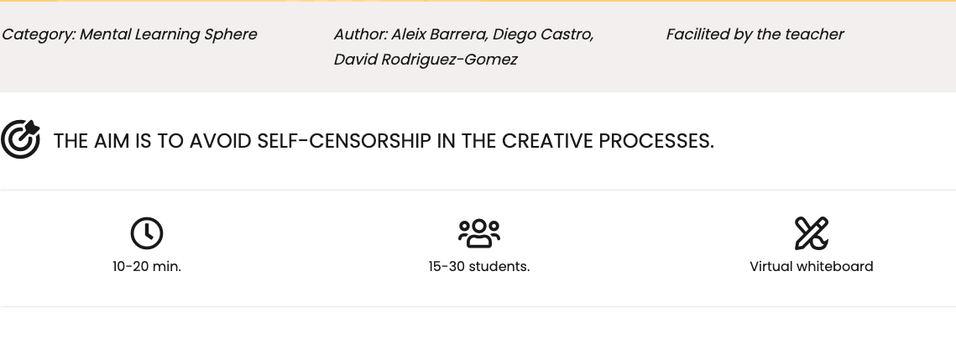
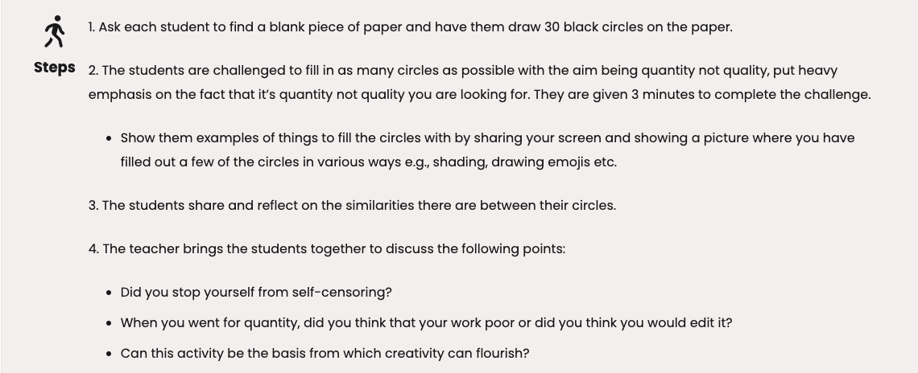
The 30 circles

Slide 24






The 30 circles
https://www.demind.eu/atom_model/the-30-circles/

Slide 25
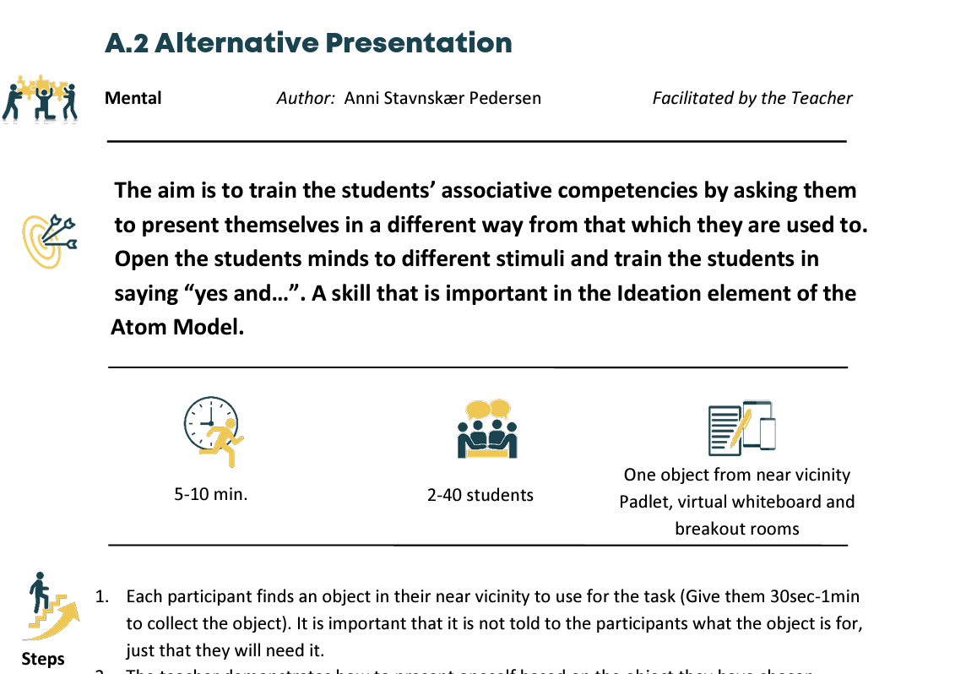
Alternative Presentation
https://www.demind.eu/atom_model/alternative-presentation/
D-EMIND methodology p. 18

Slide 26

Alternative Presentation
Each of you grap a random thing in the room. ​ You have 30 sec.​ ​
Present yourself with that thing, when I say
your name.
I will show you how ☺
Adobe: ruchuda

Slide 27
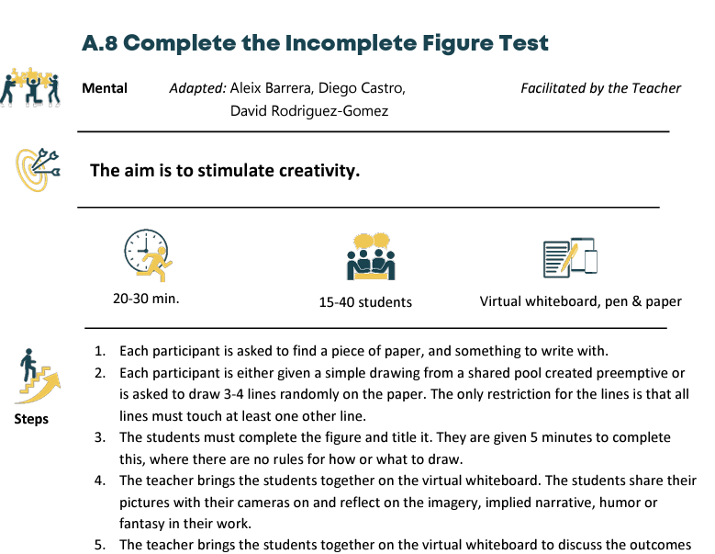
Complete the Incomplete Figure Test
https://www.demind.eu/atom_model/complete-the-incomplete-figure-test/
D-Emind methology p 94

Slide 28
Extra: Figur(ing) out
Find a piece of paper, and something to write with.
Draw 3-4 lines randomly on the paper. The only restriction for the lines is, that all lines must touch at least one other line.
Title the drawing.
5 minutes to complete this
I will now bring you together on the virtual whiteboard.
You should all turn on your camera and share your pictures with the rest. Take turns and explain what you see in your drawing? Let the rest reflect on your drawing and take turns
You as a teacher bring the students together on the virtual whiteboard to discuss the outcomes of the activity.

Slide 29
The challenge
The core or nucleus of the model is the challenge.
The challenge is what the students and teachers throughout the whole process of working with the Atom model must initiate from and return to. That’s why it has a central placement in the model.
THE
CHALLENGE

Slide 30
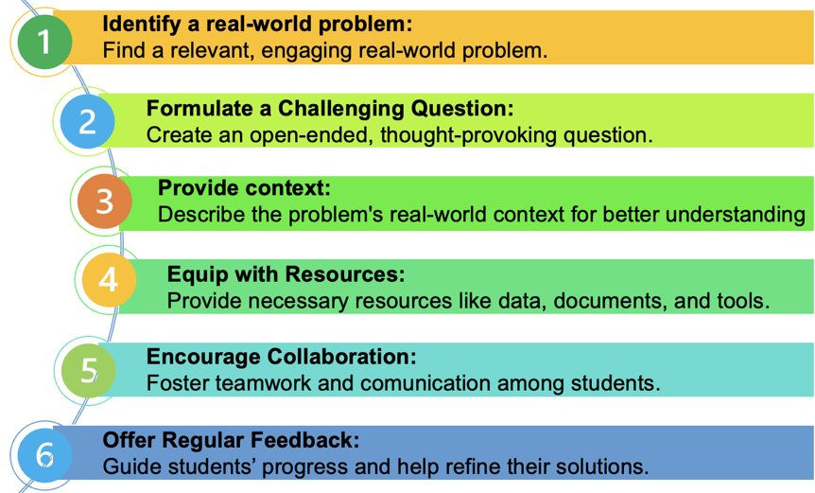
Designing the challenge

Slide 31
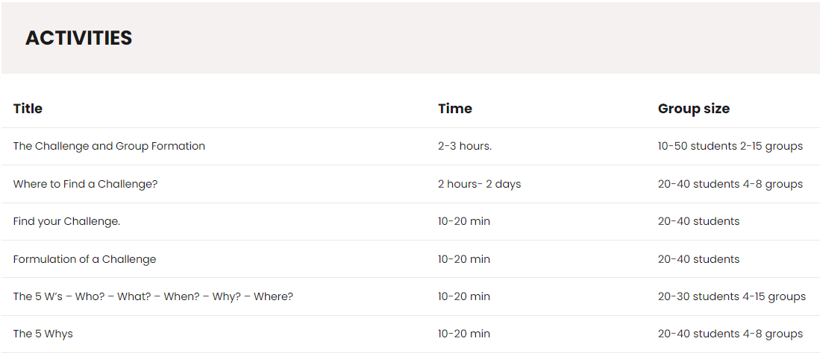
Activities for the challenge

Slide 32
The 5 Why’s
Write the challenge in 1 clear sentence
Now rewrite the challenge, rephrasing it in a ‘why question’
Answer to this question
Question your answer
Keep on asking the ‘why question’ to every answer untill you’ve reached the real problem
Now read all your answers to the why questions. On which of these causes are you going to focus in your next steps? Discuss with your teammembers

