Slide 1


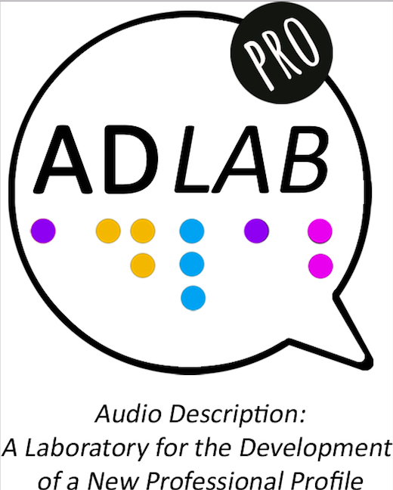




Easier audio description: An easy listening and easy understanding access service
Rocío Bernabé & Pilar Orero
ARSAD 2019

Slide 5
My fear of long words during ARSAD makes me uncomfortable
During ARSAD I have burgeoning hippotomonstrosesquippedaliophobia resulting in sesquipedalian discombobulation

Slide 14
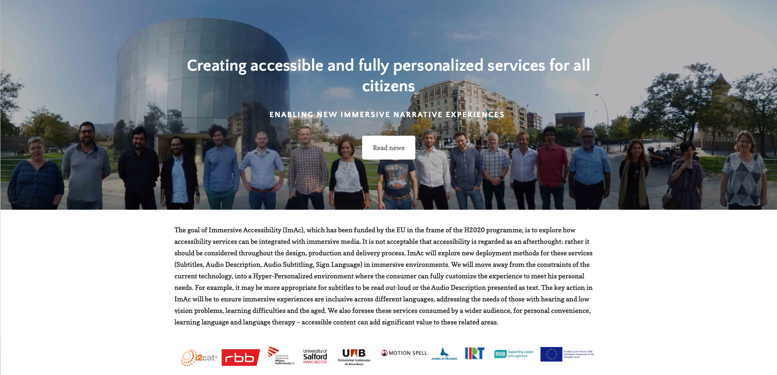

https://lab.irt.de/demos/object-based-audio/interactive/
https://lab.irt.de/demos/object-based-audio/personalization/
https://lab.irt.de/demos/object-based-audio/RadioDrama/

Slide 15
https://lab.irt.de/demos/object-based-audio/interactive/
https://lab.irt.de/demos/object-based-audio/personalization/

Slide 17
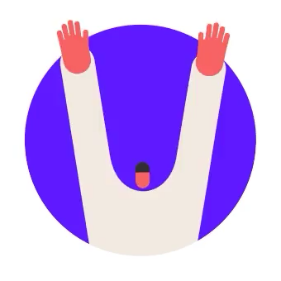
Thank you

Slide 18



Immersive
Accessibility
TransMedia Catalonia is a research group funded by Secretaria d’Universitats i Recerca del Departament d’Empresa i Coneixement de la Generalitat de Catalunya, reference code 2017SGR113.
The project Immersive Accessiblity ImAc has received funding from the European Union Horizon 2020 Research and Innovation Programme, grant agreement No 761974.
The project Easy Access For Social Inclusion Training EASIT has received funding from the European Union ERASMUS+ 2018-1-ES01-KA203-050275
The Project ADLAB PRO has received funding from the European Union ERASMUS + 2016-1-IT02-KA203-024311
Texts, marks, logos, names, graphics, images, photographs, illustrations, artwork, audio clips, video clips, and software copyrighted by their respective owners are used on these slides for personal, educational and non-commercial purposes only. Use of any copyrighted material is not authorized without the written consent of the copyright holder. Every effort has been made to respect the copyrights of other parties. If you believe that your copyright has been misused, please direct your correspondence to: pilar.orero@uab.cat stating your position and we shall endeavour to correct any misuse as early as possible.
This document and its contents reflect the views only of the authors. TransMedia Catalonia and the European Union H2020 Research and Innovation Programme , and ERASMUS + KA2 cannot be held responsible for any use which may be made of the information contained therein.
This work is licensed under a Creative Commons Attribution-NonCommercial-NoDerivatives 4.0 International License.

