Slide 1

Born-digital Texts in the Foreign Language Classroom
Collaborative authorship: Publishing E-Books on Fantasy and Science Fiction with BA and MA students
Sara Martín Alegre
Universitat Autònoma de Barcelona
16 January 2021

Slide 2

“Producing E-books on Fantasy and Science Fiction with University Students: Classroom Projects”. Mapping the Imaginative II, Christian Ludwig and Elizabeth Shipley (eds.). Heidelberg: Universitätsverlag Winter, 2020, 163-184.

Slide 3
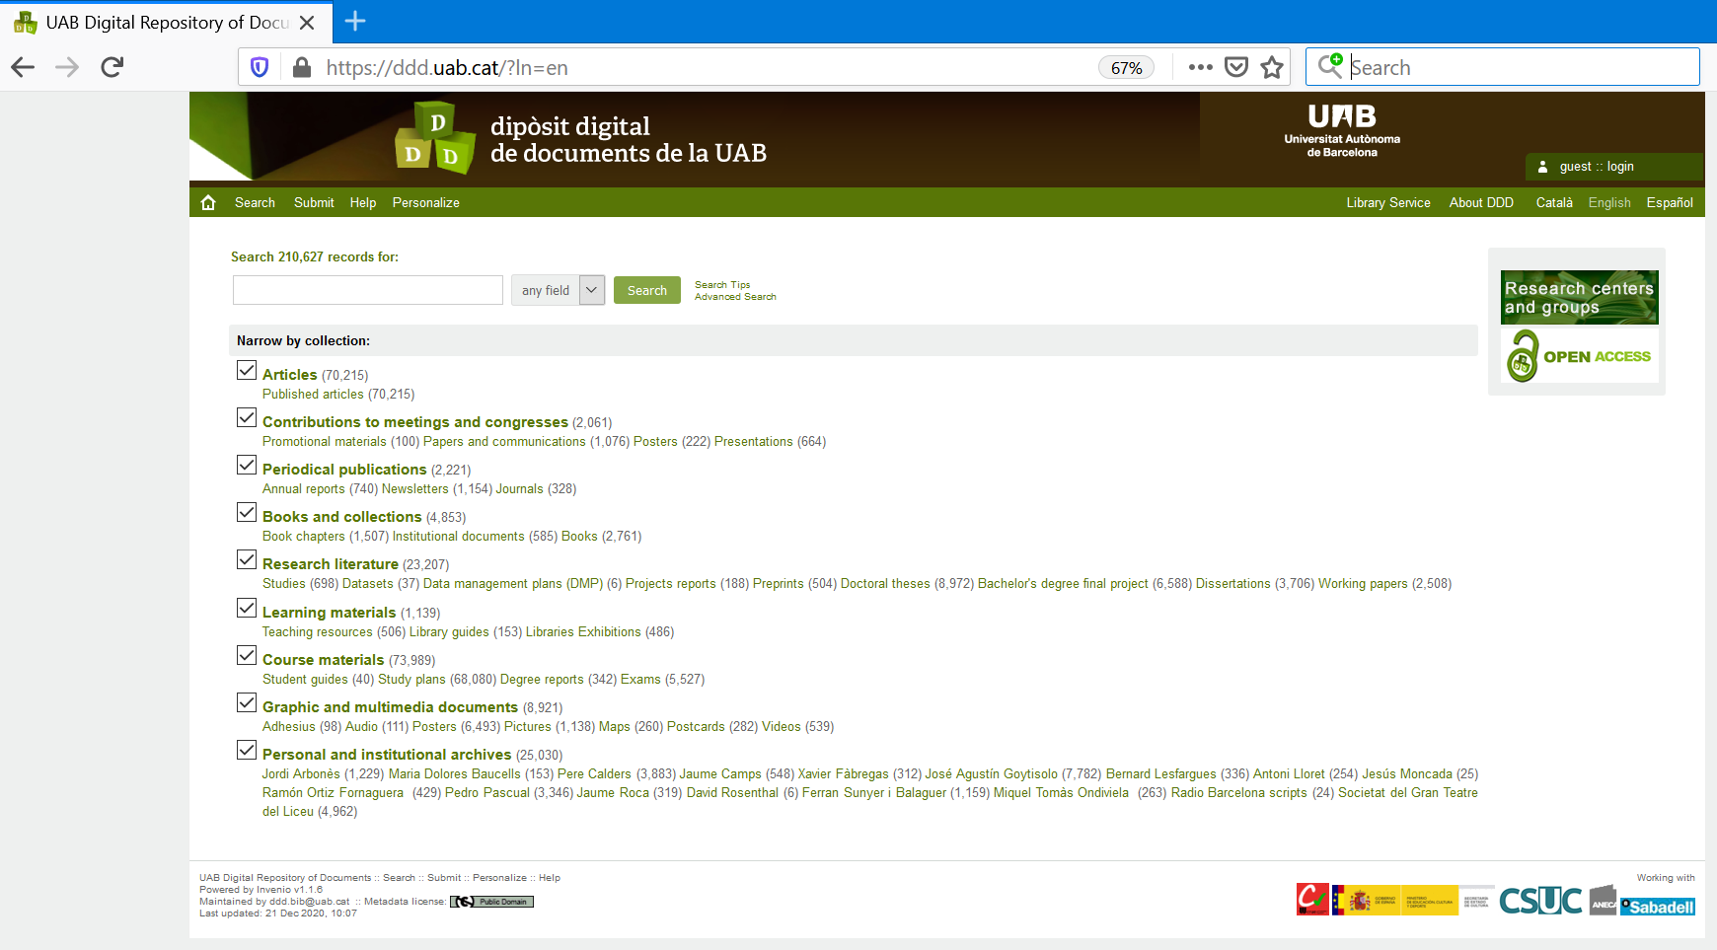
The Digital Repository, www.ddd.uab.cat

Slide 6


Slide 8
Downloads (21 December 2020, 2014-2020)
Focus on the USA: Representing the Nation in Early 21st Century Documentary Film (2020): 744
Frankenstein's Film Legacy (2019): 820
Gender in 21st Century Cinema: 50 Titles (2019): 1318
Reading SF Short Fiction: 50 Titles (2016): 9663
Gender and Feminism: The Students' View, Vol 2. (2018) + Gender and Feminism: The Students' View (2015): 4118
Charming and Bewitching: Considering the Harry Potter Series (2014): 3975
Addictive and Wonderful: The Experience of Reading the Harry Potter Series (2014): 1732
TOTAL: 22370

Slide 9
MA Advanced English Studies, Universitat Autònoma de Barcelona
Course: Gender Studies: New Sexualities/New Textualities (September 2020-January 2021)
13 students (8 Spanish, 2 China, 1 USA, 1 Vietnam, 1 Italian / 10 women, 3 men)
C1/C2 level, or native
10 weeks, 30 hours (3 hours a weeks face-to-face, 2 90 minute sessions; the rest online semi-synchronous)
4 introductory sessions (introduction to Gender Studies, introduction to animation)
All other sessions based on students’ presentations (2 to 4 15’ presentations per session, based on my own sample presentation)
All sessions included a mini-lecture (15-20 minutes) or a narrated PowerPoint presentation by the teacher

Slide 10
Presentations = draft of the essay (teacher’s sample presentation)
Sample essay: credits, reasons to see the film, essay (1500 word, focus on gender issues)
3 works cited: reviews, academic work (research assistant)
Draft (no grade); second draft > e-book publication
Each student in charge of 4 films (teacher’s participation, 3 films)
Self-assessment: 50% essays, 30% presentations, 20% forum contributions
Total films examined: 55 (the e-book will consist of 55 essays)

Slide 11
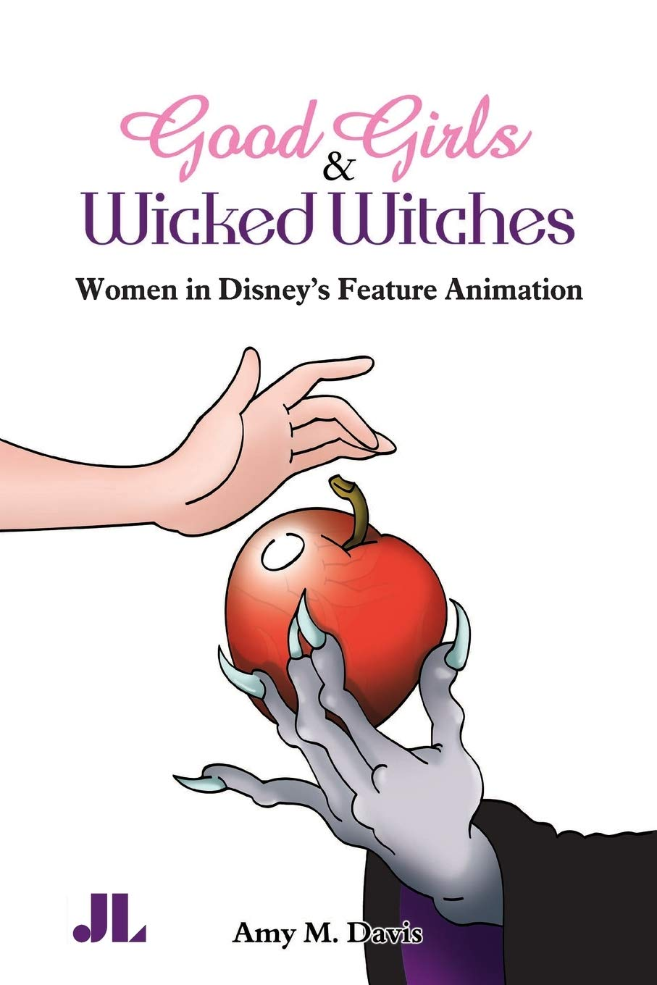
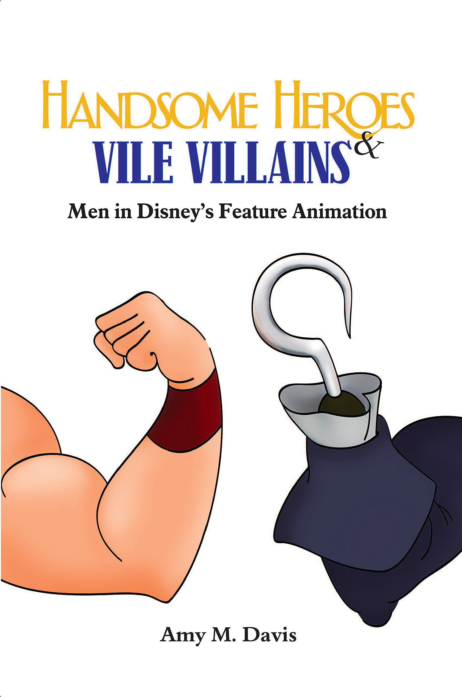
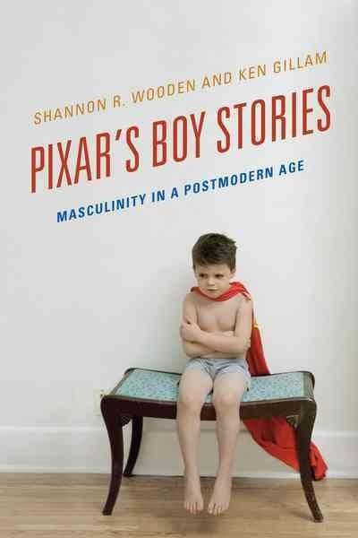

Slide 12
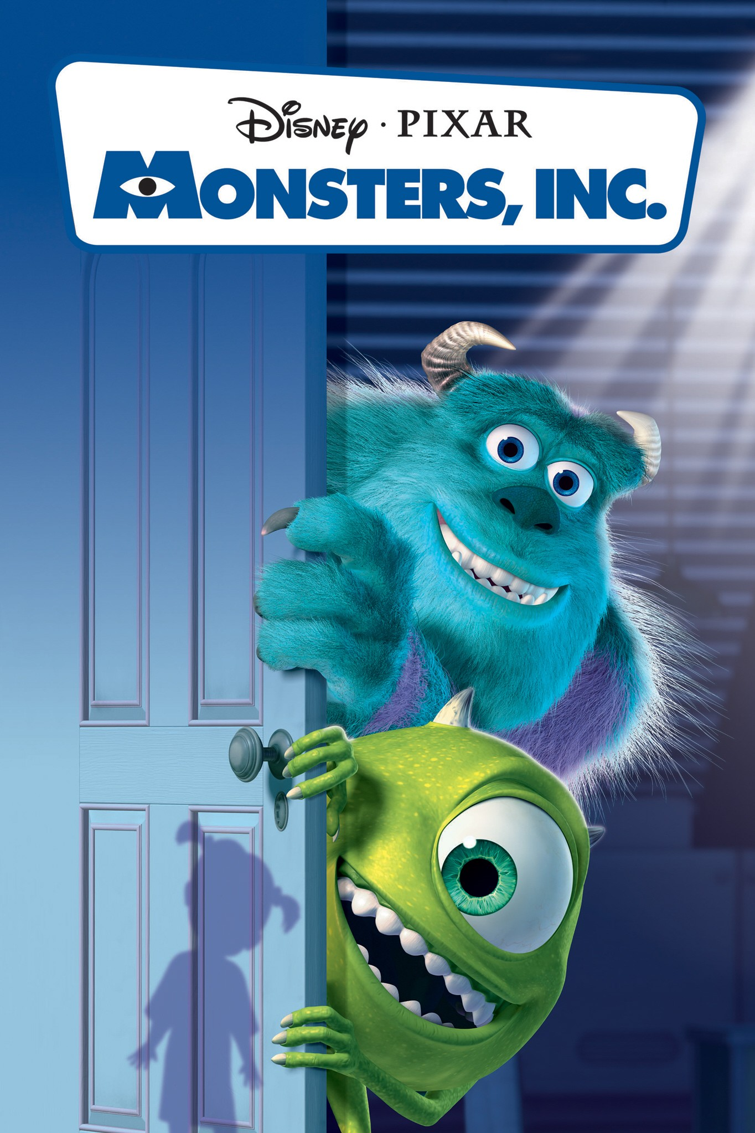
NOTE: all the films can be labelled fantasy, some are SF, some Gothic; all are 21st century
Session 5: Monsters, Inc. (2001), Monsters University (2013)
Session 6: Shrek (2001), Shrek 2 (2004), Shrek III (2007)
Session 7: Ice Age (2002), Ice Age: The Meltdown (2006), Ice Age: Dawn of the Dinosaurs (2009), Ice Age: Continental Drift (2012) [Ice Age: Collision Course (2016)]
Session 8: Lilo & Stitch (2002), The Powerpuff Girls Movie (2002), Finding Nemo (2003), Finding Dory (2016)
Session 9: The Incredibles (2004), The Incredibles 2 (2018)
Session 10: Cars (2006), Cars 2 (2011), Cars 3 (2017)
Session 11: Kung Fu Panda (2008), Kung Fu Panda 2 (2011), Kung Fu Panda 3 (2016)
Session 12: Ratatouille (2007), Bolt (2008), WALL-E (2008), Coraline (2009)
Session 13 Monsters vs. Aliens (2009), The Princess and the Frog (Tiana) (2009), Up (2009)

Slide 13
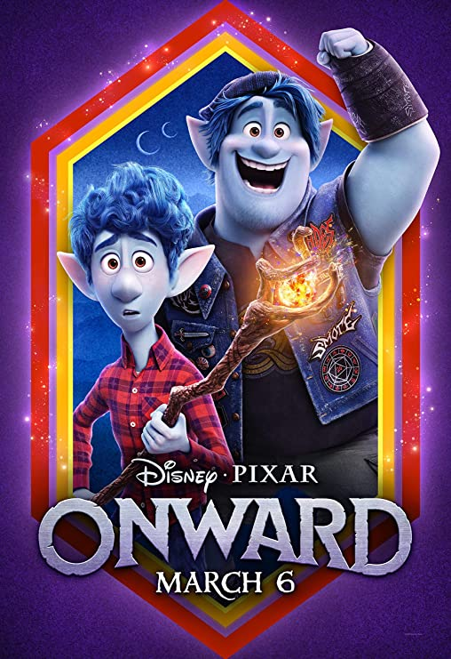
Session 14: Toy Story 3 (2010), Toy Story 4 (2019)
Session 15: Megamind (2010), Despicable Me (2010), Despicable Me 2 (2013)
Session 16: How To Train Your Dragon (2010), How to Train Your Dragon 2 (2014), How to Train Your Dragon: The Hidden World (2019)
Session 17: Tangled (2010), Brave (2012), Frankenweenie (2012)
Session 18: ParaNorman (2012), Wreck-it Ralph (2012), Ralph Breaks the Internet (2018)
Session 19: Frozen (2013), Frozen 2 (2019)
Session 20: Big Hero 6 (2014), The Lego Movie (2014), The Lego Batman Movie (2017)
Session 21: Inside Out (2015), Moana (2016)
Session 22: Trolls (2016), Trolls: World Tour (2020), Zootropolis (2016)
Session 23: Coco (2018), Klaus (2019), Onward (2020)

Slide 14
Skills brought to the course
Having seen many of the films and appreciating them
Expressing personal ideas about Gender Studies
Using PowerPoint, doing class presentations
Skills acquired
Learning to value animated films in general, and particularly for children, as valid objects of research
Learning to identify key gender issues in the fantastic (SF, Gothic, fantasy) for children
Producing narrated PowerPoint presentations (and interacting with peers about them on the forum) > teaching each other
Producing written work for publication (not just course assessment) > understanding the importance of revision and re-writing
Working with reviews (and academic sources)

Slide 15
Thank you for your attention!!
Skills required from the teacher
Being familiar with the corpus analyzed
Good planning skills (number of texts analyzed, number of presentations per session)
Providing sample work (presentation, essays)
Willingness to correct each essay twice (draft, final publication)
Having minimally good edition skills to make the e-book look nice (Word > .pdf)
Most importantly: Giving students the confidence to think they are ready for publication
Willingness to employ time on the edition of the e-book

