Slide 1
The Pending Issue of Making Video Games Accessible for Cognitively Disabled Players
Miguel Ángel Oliva-Zamora
TransMedia Catalonia Research Group
Universitat Autònoma de Barcelona

Slide 2
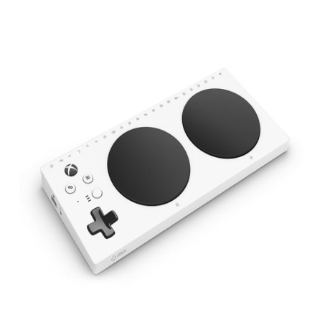
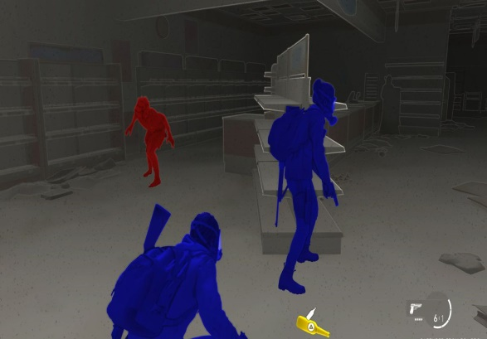
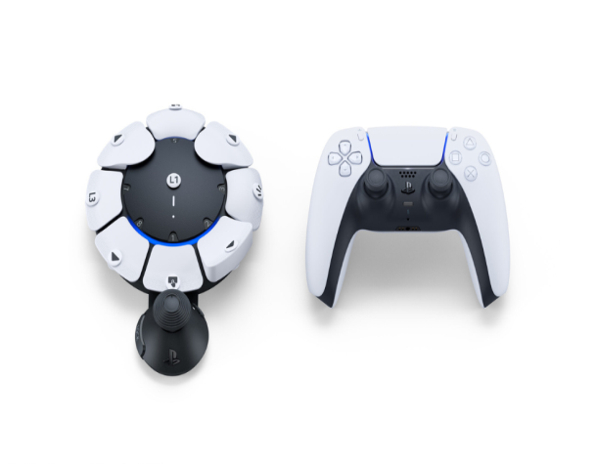
Introduction
Video games as the main form of entertainment
⇩
Accessibility on the rise
A disability is the presence of a physical, sensory or mental impairment that limits a person’s life activity

Slide 3
Game accessibility
Avoiding a conflict between the abilities of a player
and the barriers of a video game
Three barriers:
Receiving stimuli (seeing the screen, hearing the audio)
Determining a response (knowing how to solve a puzzle)
Providing input (moving the stick or pressing a button)

Slide 4
Objectives and methods
State of the art
of accessibility in video games
Systematic search
Recommendations
for cognitive accessibility
Content analysis

Slide 5
Analysis
Research questions | How can we ensure cognitive accessibility in video games? Is there any mention of the easy-to-understand language?
Search | Databases: Web of Science, Scopus, Google scholar, SAGE Journals and ProQuest No. of documents: 323 Inclusion criteria: Less than 10 years English or Spanish Full text Refers to cognitive accessibility

Slide 6
Analysis
Results | 6 guidelines from academic research vs. 6 guidelines from industry
Coding | Mechanics (category) Rules (code) Rewards Dynamics Choice Narrative | Interface Controls Feedback Help
E2U language | Are there mentions to a «simple», «easy» or «understandable» language?

Slide 7
Easy-to-understand language
What is it? | For whom is it? | Why in video games?
Language varieties that can be used to enhance comprehension IFLA Inclusion Europe | People with cognitive disabilities or learning difficulties (memory, problem solving, attention, comprehension…) People with low reading skill People who are illiterate | Determine a response Video games are interactive: understand and act Story-driven video games

Slide 8
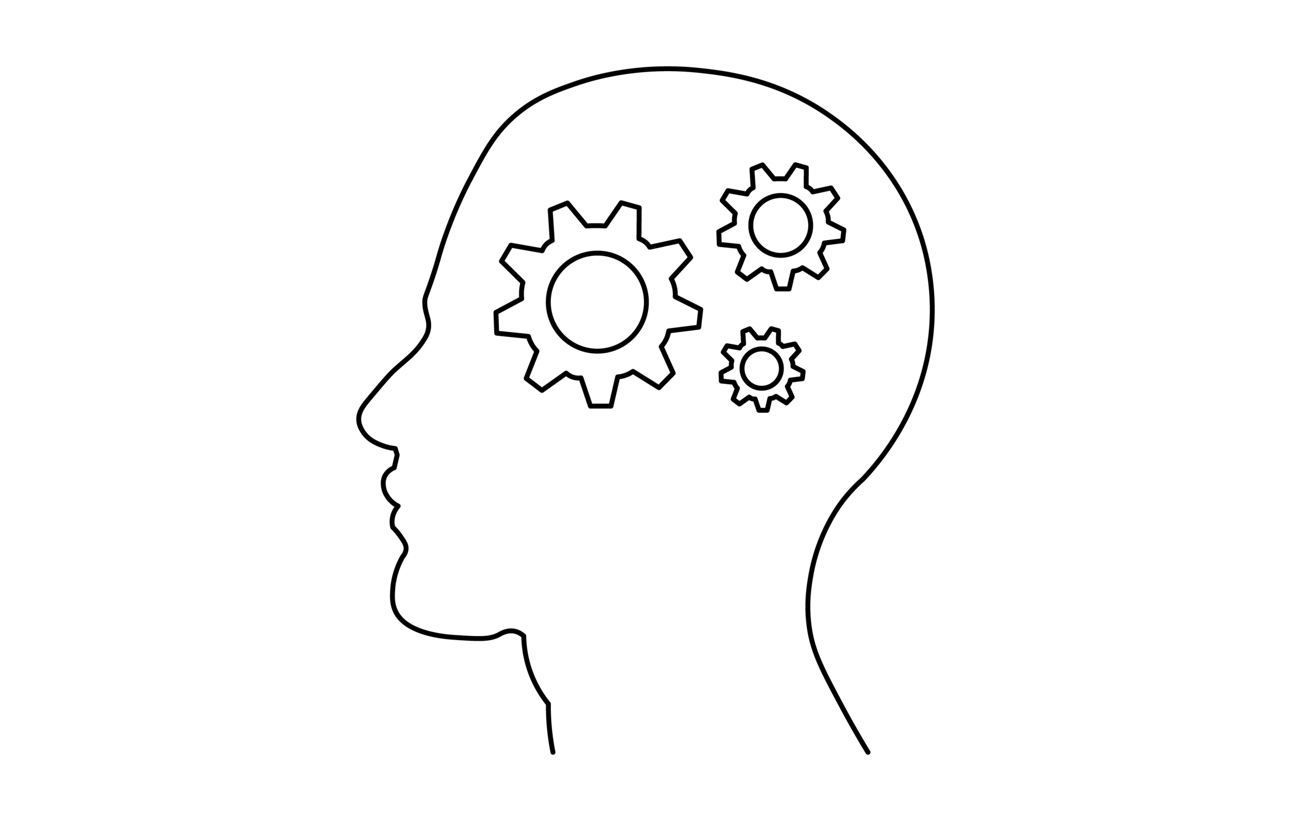
Conclusions
Targeted design vs. inclusive design
Many recommendations for playability,
but fewer for comprehension
References to a «simple» language,
but lack of specificity

Slide 9
Thank you!

Slide 10
Disclaimer
TransMedia Catalonia is a research group funded by Secretaria d’Universitats i Recerca del Departament d’Empresa i Coneixement de la Generalitat de Catalunya, under the SGR funding scheme (ref. code 2021SGR00077).
Texts, marks, logos, names, graphics, images, photographs, illustrations, artwork, audio clips, video clips, and software copyrighted by their respective owners are used on these slides for personal, educational and non-commercial purposes only. Use of any copyrighted material is not authorized without the written consent of the copyright holder. Every effort has been made to respect the copyrights of other parties. If you believe that your copyright has been misused, please direct your correspondence to: MiguelAngel.Oliva@uab.cat stating your position and we shall endeavour to correct any misuse as early as possible.
This document and its contents reflect the views only of the authors. TransMedia Catalonia cannot be held responsible for any use which may be made of the information contained therein.
This work is licensed under a Creative Commons Attribution-NonCommercial-NoDerivatives 4.0 International License.

