Slide 1

Communicating Across Cultures: Mastering International Job Interviews in English.
A workshop
Servei de Llengües UAB
28.05.2025
Dr. Anya Doherty

Slide 2
INTERVIEW
Prefix “inter,” meaning between or among + “view,” meaning a seeing, looking, or inspection.
“An interview is the intermingling of distinct ways of seeing; this is especially clear in a cross-cultural context. We must ask ourselves how our knowledge or lack of knowledge of people from a given culture affects the interview process.”
(Aronson Fontes, L. Interviewing Clients across Cultures: A Practitioner's Guide 2008.)

Slide 3
Objectives
By the end of this workshop, students will:
1. Understand cultural differences that affect international job interviews: formality, gesture, tone, authority.
2 Identify and adapt to communication styles in different cultural contexts.
3. Understand some common language challenges and identify tools to deal with possible communication difficulties.
4. Handle misunderstandings with tact and respect.
5. Gain confidence in presenting themselves professionally in English.

Slide 4
AGENDA
Ice-breaker – introductions
Intercultural knowledge quiz
Cultural dimensions maps – discussion
Videos - intercultural communication
Group matching activity
Roleplay cards – cultural sensitivity
Linguistic challenges in interview
Activity – solving communication issues
Your elevator pitch – roleplays
Interview questions - roleplays
UAB
28.05.2025
Dr. Anya Doherty

Slide 5


INDIVIDUAL
CULTURAL GROUP IDENTITY

Slide 6
Intercultural knowledge ...
This class offers a glimpse into cultural tendencies based on the work of experts like Geert Hofstede and Erin Meyer, but it's crucial to remember that people are individuals first and foremost.
Not everyone from a given country will act as described, and personal traits often far outweigh cultural generalizations.
I present scenarios to highlight specific patterns, but real-life interactions are far more nuanced.
Understanding these cultural tendencies can give you valuable insights, yet true understanding always comes from seeing people as individuals.

Slide 7
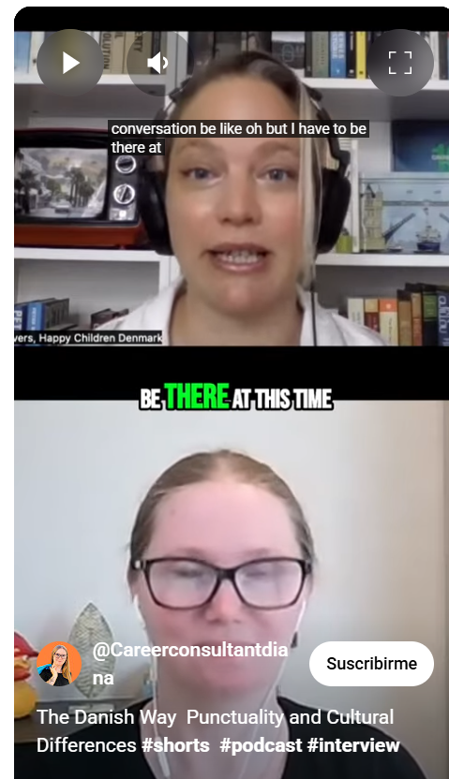
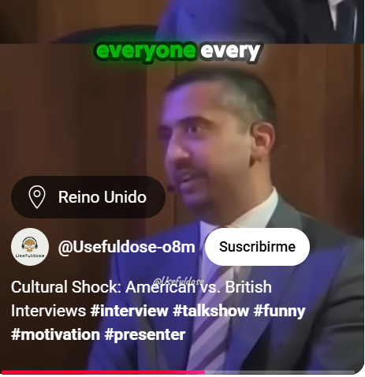
Brainstorm – list intercultural differences in communication
British and American friendliness
Danish attitudes to time
Notes:
https://www.youtube.com/shorts/dXkH1T_PwDM
https://www.youtube.com/shorts/hDeWY0AS3IE

Slide 8

Ice-breaker activity (3 mins)
Introduce yourself briefly to the group (name, studies, hobby) and and mention one country you’d like to work in.
What do you know about communication in that culture? (formal/informal, direct/indirect).

Slide 9



Test your intercultural savvy!
In pairs choose ...
Quiz 1 or
Quiz 2
Notes:
https://www.londonschool.com/young-adults/resources/intercultural-quiz/
https://www.dataart.team/articles/intercultural-communication-quiz

Slide 10
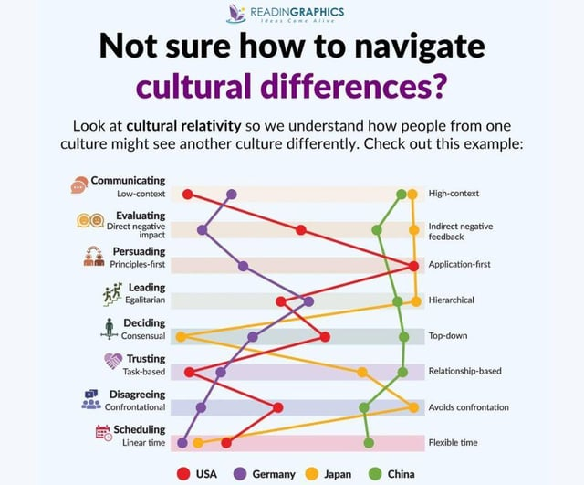
Erin Meyer's 'The Culture Map'
Notes:
Could use article from Commisceo-global & project summary slide

Slide 11
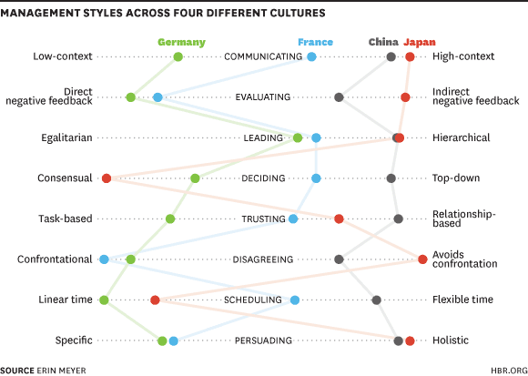

Slide 12
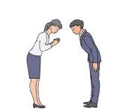
Cultural Dimensions in Job Interviews
  Power Distance: How hierarchical or egalitarian different cultures are.
  Formality & Politeness: Different greetings, handshakes, titles (e.g., Mr./Ms. vs. first names).
  Communication Styles: Direct vs. indirect, use of eye contact, gestures.

Slide 13
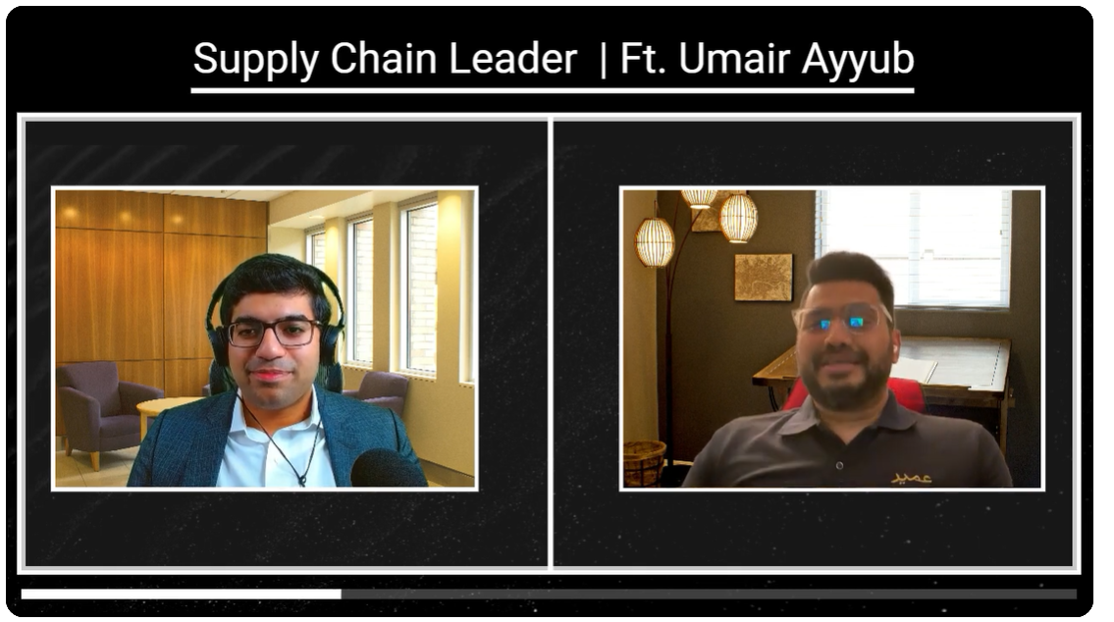
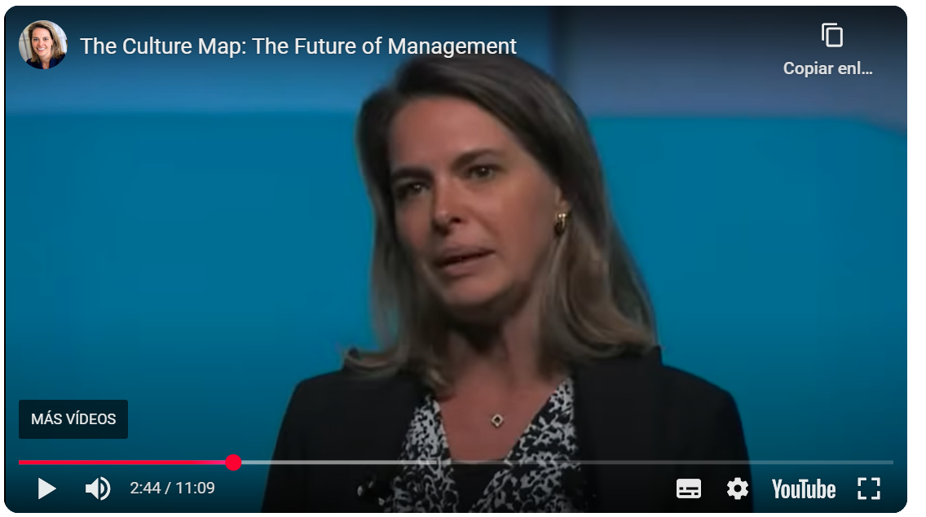
Cultural differences in interactions
  Understanding Cultural Differences in Job Interviews
  Pakistanis líving in Canada.
  Min 01-2.15
The Culture Map: The Future of Management
Japan: Eye contact and directness
Erin Meyer min 0.10-03.16
Notes:
https://www.youtube.com/watch?v=XknEzHaxZRM&ab_channel=EastMeetsWest%3APakistaniProfessionalJourneys
https://www.youtube.com/watch?v=qf1ZI-O_9tU&ab_channel=ErinMeyer

Slide 15
The Subtle Way Cultural Bias Affects Job Interviews
https://greatergood.berkeley.edu/article/item/the_subtle_way_cultural_bias_affects_job_interviews
Job applicants who want to appear calm and collected might be at a disadvantage. According to a new Stanford study, American employers are more likely to favor excited over relaxed candidates.
But as Tsai has found in prior research studies, the emotions people value and, in turn, display vary across culture. How might these cultural differences influence candidates and their hiring managers on job interviews?
In one experiment, participants were asked to imagine they wanted a competitive internship. They were then asked to fill out an application, including a video introducing themselves. At the end of their application, they were asked which emotions they wanted to convey.
The researchers found that what is interpreted as the “best impression” varies from person to person and from culture to culture.
European Americans were more likely to convey excitement and enthusiasm than Hong Kong Chinese, who desired calm and even-tempered states.
These values were also reflected in their applications. For example, European Americans were more likely than Hong Kong Chinese to show their excitement with phrases like “I’m really enthusiastic about this position” and “I am passionate about the work.”

Slide 16
How do Cultural Assumptions Impact the Interview Process?
The basis of incorporating a cross cultural framework of understanding in interviews is in overcoming 'assumptions'.
Assumptions refer to several inter-related elements. Interviewers assume what should or should not happen, what is normal and abnormal, and what is correct or wrong.
Assumptions also refer to what someone's physical appearance says about them, what their body language says about their confidence, how people communicate and how they present themselves.
For example, imagine a cross cultural interview is taking place between an English interviewer and a German interviewee.
Fairly early on in the interview the interviewer starts to make assumptions regarding the person's character, personality and suitability for the post based on misperceptions of the German candidates appearance, behaviour and communication style.
Although the interviewee is rather high-brow, blunt in conversation, formal and academic in demeanour this does not mean he/she is rigid, inflexible or reserved as the interviewer assumes. Rather, this is how the play is acted out in Germany. If the interviewer had been a bit more aware of German theatre (i.e. culturally aware), then possibly such assumptions would not have been made.
As we can see from the above example, assumptions can lead to interviewers making the wrong decision based on their cultural assumptions. In this case, they could have potentially lost a genuinely positive addition to their company.
In addition to the areas mentioned in the example above, interviewers must also be aware of culturally ingrained assumptions made about areas such as eye contact, tone of voice, gestures, posture, showing emotions, the giving out of information and the use of language to name but a few.
All have a cross cultural element that needs to be understood properly.
https://www.commisceo-global.com/blog/how-culture-impacts-job-interviews

Slide 17
Body Language –cultural norms
If we habitually shake hands with interviewees before we speak with them, not realizing that this is offensive to certain religious groups, we would sabotage our effort to establish rapport with people from those groups.
(From Interviewing Clients across Cultures: A Practitioner's Guide by Lisa Aronson Fontes. 2008)

Slide 18

Group activity - scenarios
How might interactions vary? Discuss with examples.
Interviewers are from the USA / Japan / the Netherlands / Qatar / Argentina / Britain / Italy / Nigeria
Interview quotes or situations and matching activity.
How can the individual balance their natural communication style with cultural sensitivity?
Scenarios (handouts)

Slide 19
Roleplay
Q’s on Cultural Sensitvity
Roleplay cards
Practice answering interview questions on cultural sensitivity
Pair-work

Slide 20

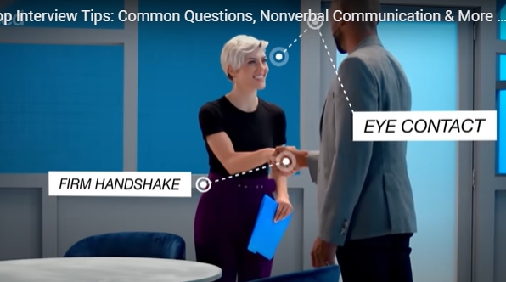
General Interview etiquette.
Formality, politeness, non-verbal communication
An interview is formal. It requires politeness, social and emotional intelligence.
What does this imply? (Behaviour and speech)
Watch and identify the top tip for you.
Video 1 Experts on body language and job etiquette
Video 2 on body-language, non-verbal communication
Notes:
https://www.youtube.com/watch?v=M2NFhwHyNhc&ab_channel=WIRED
https://www.youtube.com/watch?v=HG68Ymazo18&ab_channel=Indeed

Slide 21
Linguistic challenges in an interview
How does Language affect confidence and clarity?
Have you ever had difficulties understanding someone due to accent, vocabulary? (Give examples)
Have you ever been misunderstood due to accent or vocabulary?
What if the interviewer speaks really fast?
What strategies can you use to overcome language difficulties?
If you don’t understand every word, what should you do?

Slide 22
ASK FOR CLARIFICATION / PARAPHRASE / CONFIRM MEANING / CONTROL YOUR NERVES.

Slide 23
Clarifying and checking understanding
Pair activity:match the beginning, end & function
 | Beginning |  | End of sentence/question
a | Sorry, could you say ... | 1 | ... you say ‘end user’.
b | I’m sorry, I didn’t ... | 2 | ... that again please?
c | I don’t understand what you mean when ... | 3 | ... catch that.
d | Could you be a little ... | 4 | ... more specific?
e | So, in other words, you felt isolated is ... | 5 | ... that right?
f | Are you ... | 6 | ... put it another way.
g | Perhaps I didn’t explain very well. Let me ... | 7 | ... what I meant.
h | No, sorry, that’s not really ... | 8 | ... saying ...?
Functions
Using your own words to check.
Asking for more information.
Asking for repetition.
Replying, apologizing then clarifying.

Slide 24
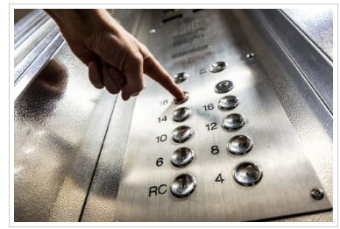
Your personal elevator pitch
Tell your story.
Make a really strong first impression.
Respond to the question “Tell me about yourself.”
An overview of your experience, skills, strengths, accomplishments, and goals
All in 30 seconds!
Example ONE
Example
Notes:
https://www.youtube.com/shorts/3w6L-YncmwI

Slide 25
Your personal elevator pitch
A compelling introduction of yourself, what you do, and what sets you apart from others in your field.
It’s intended to quickly captivate your audience and help open up a dialogue.
A professional 30-second pitch for graduates should be concise and highlight key skills and career goals.
It should include a brief introduction, a summary of relevant experience or skills, and a clear statement of your desired role or next step.

Slide 26

What is a personal elevator pitch?
THE CHALLENGE – TO STAND OUT, TO BE COMPELLING.
DON’T BECOME A SALESPERSON!
CREATE A CONVERSATION, PERSON TO PERSON.
THE OLD PITCH, THE NEW.
LIKE WHEN ON SOCIAL MEDIA, YOU NEED TO GRAB PEOPLE’S ATTENTION.
THE FOCUS IS ON YOUR LISTENER.
YOUR AIM IS TO GET THEM TO SAY “TELL ME MORE!”

Slide 27
Structure
Introduce yourself, as appropriate.
Discuss your experience. As a student, this would include your major field of study. If you have practical experience in the field you could include that as well.
State a strength or skill the employer would be interested in.
Follow that with an accomplishment (or two) that proves you have that skill. It can be related to school, work, a volunteer experience, an activity (Scouts), etc.
Describe your employment goal—what are you looking for now and/or in the future?
Most importantly, tell how you can immediately benefit the company.

Slide 28
DO ...
Make it meaningful to the person you’re speaking with. Consider not just what you do, but how what you do could help the person you’re pitching to.
Tell a story. Paint a picture of what you do in order to help your pitch get noticed. This might involve highlighting an interesting accomplishment or simply sharing your unique perspective on your profession.
Be specific. Future employers want to understand what your particular area of expertise is.
Be authentic. Give potential employers a sense of who you really are. After all, you’re looking for a career opportunity that is a good fit for you, so giving some insight into who you are and what motivates you is important.
Use a conversational tone. Avoid using language that’s too rigid or formal, and be wary of your statement coming off like a sales pitch. Even though your elevator pitch is, at its core, a way to sell yourself and your worth, it’s important to strike a balance between confident and casual.

Slide 29
DON’T ...
Go into too much detail. Your pitch should have only enough information to pique someone’s interest; it is not meant to be an exhaustive list of all you have to offer.
Use jargon or industry language. Articulate what your skills are and what your value is using simple terms so that professionals from any field can see and understand your value.
Take too long. Aim to get your point across in less than 30 seconds.
Put too much focus on your years of experience. It’s not your longevity in a job that will make you noticeable but what you did with that time.
Use cliché terms. Phrases like “state of the art” and “thinking outside the box” are overused and can make a pitch seem dull.

Slide 30

OVER TO YOU!
Write your elevator pitch
Speed-dating with your classmates
Present 30 secs, move on, present 30 secs, move on

Slide 31
ROLEPLAY ACTIVITY IN PAIRS
Common interview questions
& How to answer them!
Tell me about yourself.
What are your strengths / weaknesses?
Describe a challenge you dealt with at work, and how you handled it.
Why do you want to leave your current job?
Where do you see yourself in five years?
What are your salary requirements?
Why should we hire you?
Why do you want to work at this company?
Walk me through your resumé.
Tell me about a challenge or conflict and how you handled it.
https://graduate.northeastern.edu/knowledge-hub/common-interview-questions-and-how-to-answer/
or
https://www.themuse.com/advice/interview-questions-and-answers
(now check the link for suggestions)

Slide 32
Homework Activity: Micro-roleplays using Sesame.com
Practice 3 tricky situations:
  You didn’t understand a question due to accent. (students brainstorm some experiences; common language issues in foreign speakers: l/r Japanese, Chinese; r sound French; no article Russian; non-pronunciation of schwa;
  You were asked a question you find too personal.
  You realize you misinterpreted a gesture or tone; eye contact; personal space

Slide 33
References and sources
https://myinterviewpractice.com/blog/cultural-sensitivity/
https://www.youtube.com/watch?v=M2NFhwHyNhc&ab_channel=WIRED
https://graduate.northeastern.edu/knowledge-hub/job-interview-etiquette/
https://www.youtube.com/watch?v=HG68Ymazo18&ab_channel=Indeed
https://careerhub.students.duke.edu/resources/develop-a-30-second-elevator-pitch/
https://www.dataart.team/articles/intercultural-communication-quiz
https://www.londonschool.com/young-adults/resources/intercultural-quiz/
https://www.themuse.com/advice/interview-questions-and-answers
https://www.indeed.com/career-advice/interviewing/how-to-give-an-elevator-pitch-examples
https://youtu.be/lwuk7vq8Yfo?si=9uxaj5iZVIljl1Ly
https://careerhub.students.duke.edu/resources/develop-a-30-second-elevator-pitch/
https://graduate.northeastern.edu/knowledge-hub/elevator-pitch-example/#:~:text=Tell%20a%20story.,in%20less%20than%2030%20seconds.

Slide 34

Thanks for your participation!
Good luck in your next interview!
Dr. Anya Doherty
Annya.Doherty@uab.cat anyadoherty@gmail.com

Slide 35
