Slide 1

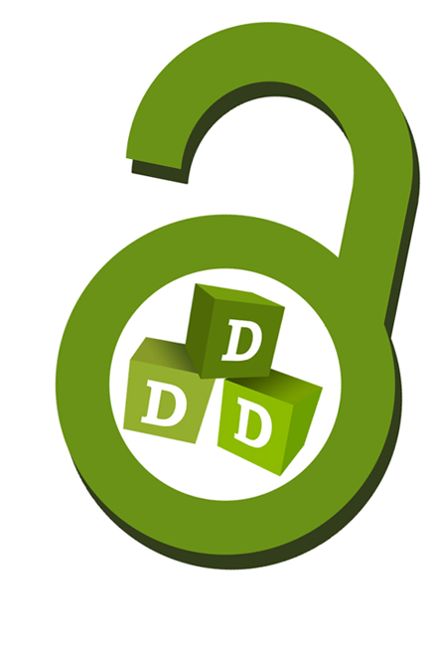
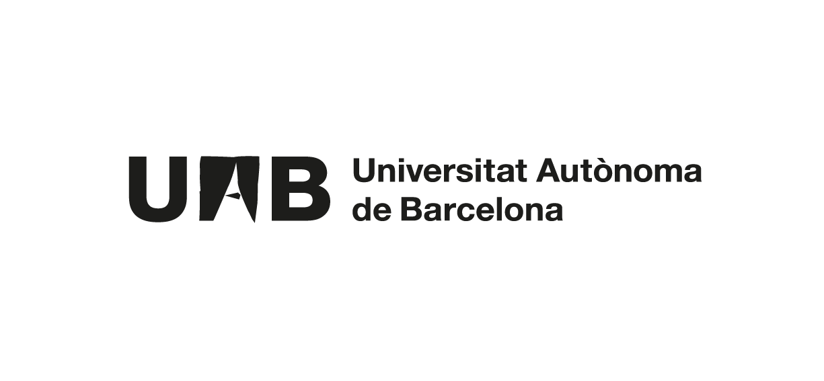


Open Access publishing
Contents prepared by the UAB Library Service staff:
David Barri, Carme Besson, Virtudes Guzmán

Slide 2

We will talk about…
Text
Open Access
Open Access publishing
Identification systems
Scholarly networks
Recommendations

Slide 3
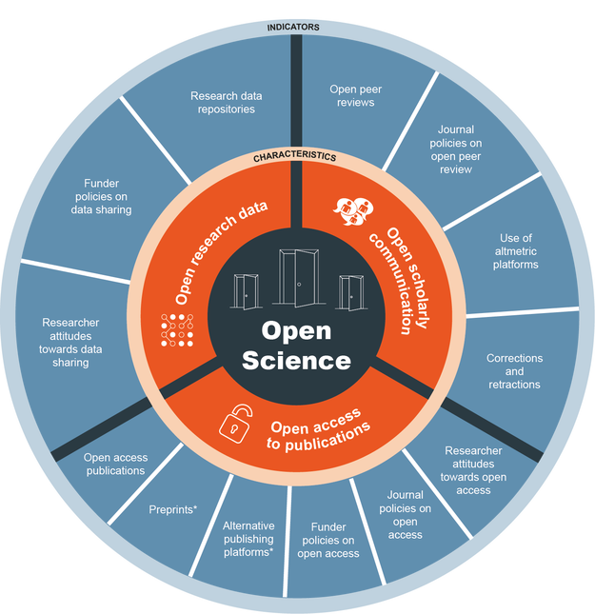
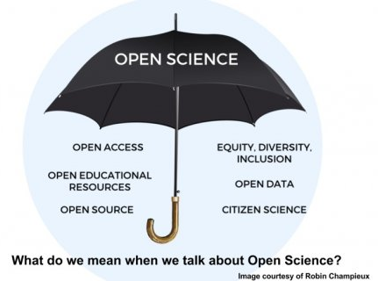
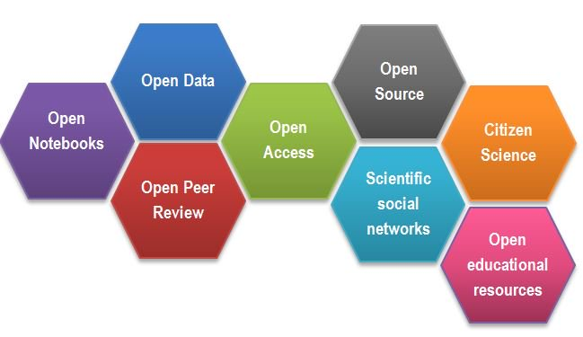
Open Science
New approach to scientific research based on cooperative workflows and new ways of dissemination through digital technologies and collaborative tools
Stronger interaction between researchers and society
Higher productivity, efficiency, transparency and response to research needs in all areas

Slide 4
Open Access: what is it?
“Free availability on the public Internet, permitting any users to read, download, copy, distribute, print, search or use for any other lawful purpose, without financial, legal or technical barriers.”
Budapest Manifesto, February 2002
Open Access ≠ Free Access

Slide 5
Open Access: benefits
Increases visibility and, consequently, dissemination and impact of scientific production. Increase in citations
Increases the accessibility of research papers without further expense
Allows authors to decide the rights to be kept or transferred and the conditions
Gives back to society the investment made in research
Preserves research results in the long term

Slide 6



Open Access: obligatory nature
Real decreto 99/2011, de 28 de enero, por el que se regulan las enseñanzas oficiales de doctorado.
Ley 14/2011, de 1 de junio, de la Ciencia, la Tecnología y la Innovación. Artículo 37
Plan Estatal de Investigación Científica y Técnica y de Innovación 2017-2020 (des de 2013)
Horizon 2020 (2014-2020): EU framework programme for research and innovation
Horizon Europe (2021-2027)
UAB Institutional Open Access Policy (2012)
UAB Institutional Open Data Policy (to be approved in 2020)

Slide 7
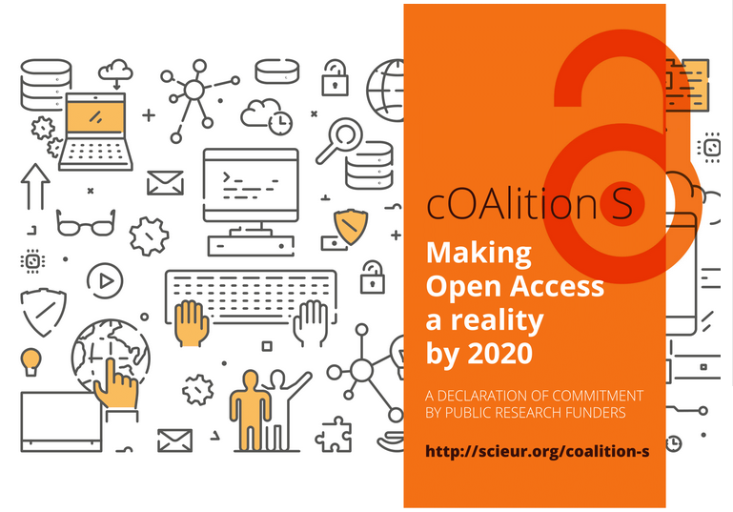
Insert Image

Slide 8

Plan S
What’s it? An initiative born in September 2018 that aims to accelerate the transition to Open Access publishing
What support does it have? cOAlition S: an international consortium launched by major national research agencies and funders
How to align with Plan S? Following
its 10 principles
MAIN PRINCIPLE
“With effect from 2021, all scholarly publications on the results from research funded by public or private grants provided by national, regional and international research councils and funding bodies, must be published in Open Access Journals, on Open Access Platforms, or made immediately available through Open Access Repositories without embargo.”
DDD fulfills the mandatory requirements of Plan S.

Slide 9

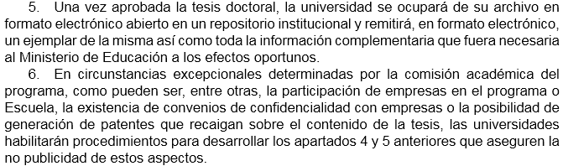
Real decreto 99/2011, de 28 de enero, por el que se regulan las enseñanzas oficiales de doctorado Artículo 14. Evaluación y defensa de la tesis doctoral
Insert Image
Further information: Online thesis deposit (UAB)

Slide 10
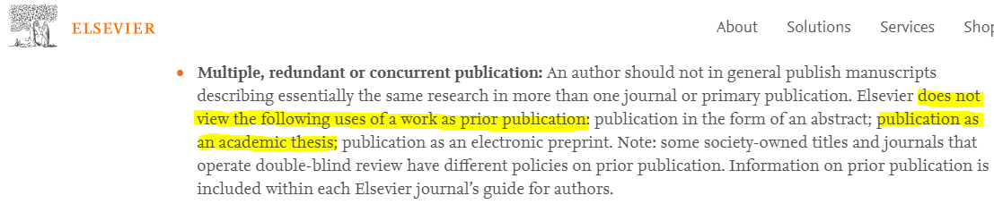
Thesis embargo?
Publication of articles derived from doctoral theses is allowed by most publishers. See information from publishers.
https://www.elsevier.com/authors/journal-authors/policies-and-ethics

Slide 11






UAB doctoral theses
Open Access consultation
Creative commons licenses recommended in the UAB
Mention of author rights (kept or transferred)
Optional embargo
Further information: Intellectual property in the preparation of the thesis

Slide 12
We will talk about…
Text
Open Access
Open Access publishing
Identification systems
Scholarly networks
Recommendations

Slide 13
Prior to publishing
Find out about:
Expertise and reputation
Subject scope
Publishing deadlines
Peer review system
Geographical scope (international, national, local)
Instructions for authors
Publisher’s policy on copyright and Open Access

Slide 14
Choose where to publish
Cofactor Journal selector (publishers and freelance consultants) cofactorscience.com/journal-selector
Edanz Journal selector www.edanzediting.com/journal-selector
Quality Open Access Market. Evaluations by researchers www.qoam.eu
“Big publishers” selection by the Biblioteca Universidad de Sevilla bib.us.es/estudia_e_investiga/investigacion/estrategias/dondepublicar
DLP, researcher-oriented www.dondelopublico.com

Slide 15
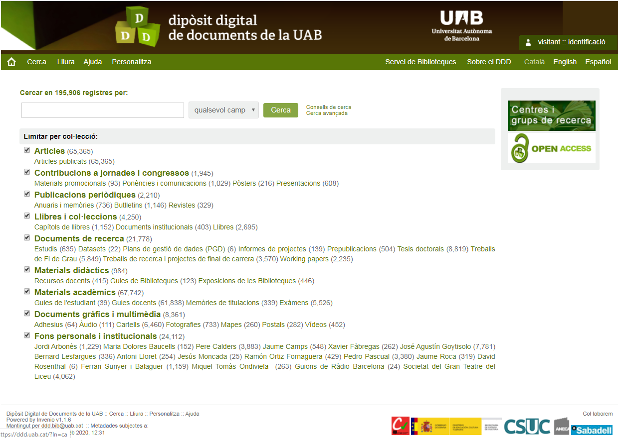
ddd.uab.cat

Slide 16
What does DDD provide you with?
Network visibility
Permanent URL (to be linked from personal websites, social networks...)
Usage statistics
Alerts, customisation and 2.0 tools
Full-text search
Platform for any documents and formats
Contact your library for advice on Open Access publication.

Slide 17
What can be published in DDD?
While you are UAB members you can publish:
Journal articles
Studies, reports not yet published
Research data extracted from your doctoral thesis (up to 5GB and ORCID)
Contact your library.

Slide 18
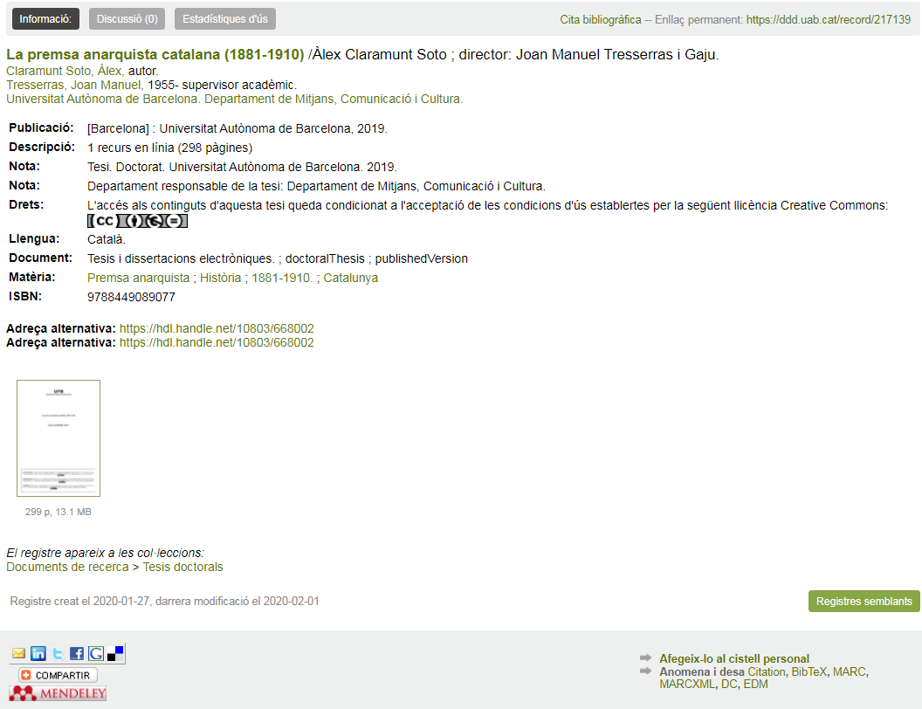
STATISTICS
BIBLIOGRAPHIC CITATION
PERMANENT LINK
MENTION OF RIGHTS
FULL TEXT
SOCIAL NETWORKS

Slide 19
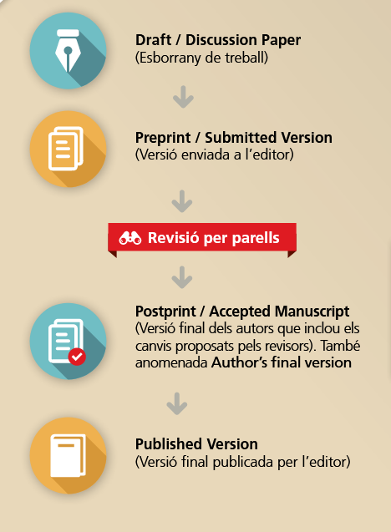
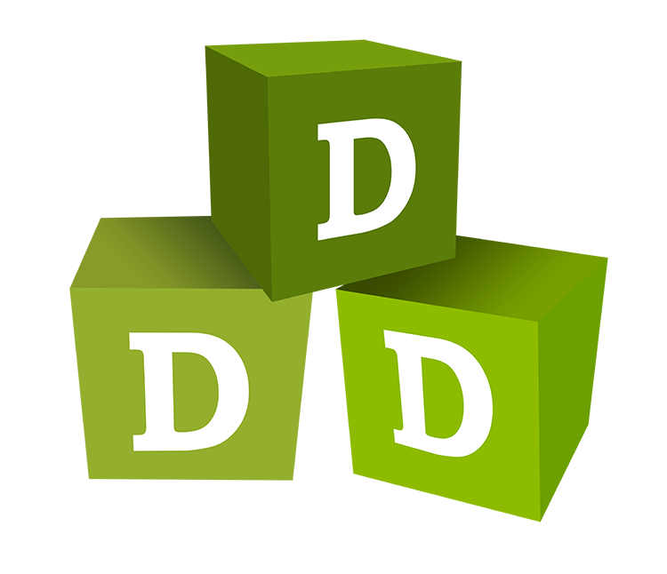
Article versions
Text

Slide 20
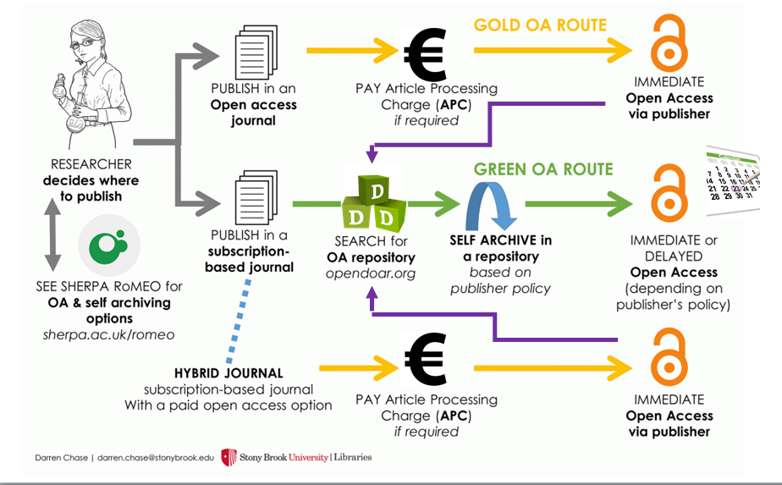

Slide 21

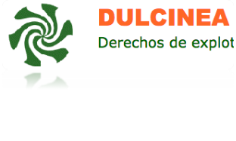

Where to find publishers’ self-archiving policies
Sherpa-Romeo - Publisher copyright policies & self-archiving
Dulcinea - Derechos de explotación y permisos para el auto-archivo de revistas científicas españolas
Heloïse - Service d’information sur les politiques des éditeurs en matière de dépôt des articles

Slide 22
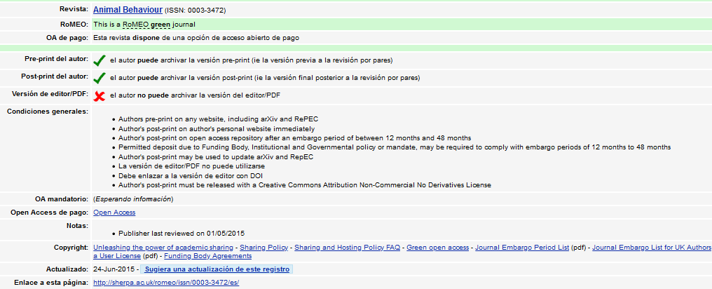
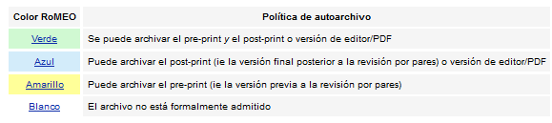

Slide 23
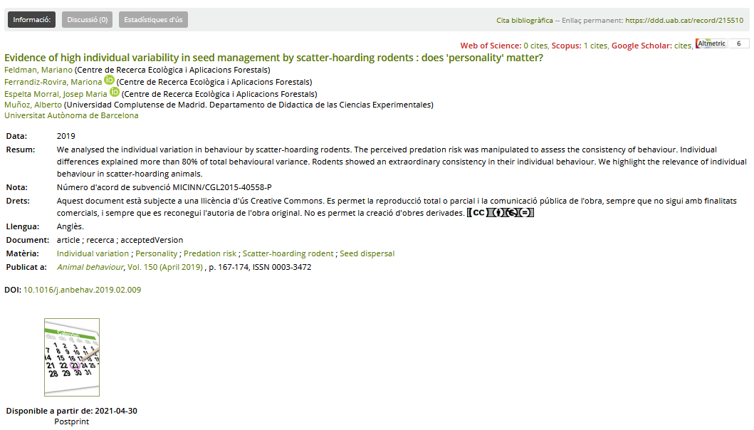

Slide 24
We will talk about…
Text
Open Access
Open Access publishing
Identification systems
Scholarly networks
Recommendations

Slide 25

Digital identity
It is made up of all we publish on the Internet and the way we are seen in cyberspace.

Slide 26

Digital identity
Hobbies
Friends
News
Tastes
Personal data
Comments
Images
Since this identity is built up it may not fit exactly an analogue identity.
Scientific reputation is essential for researchers in order to gain progress, recognition and grants for academic research.

Slide 27
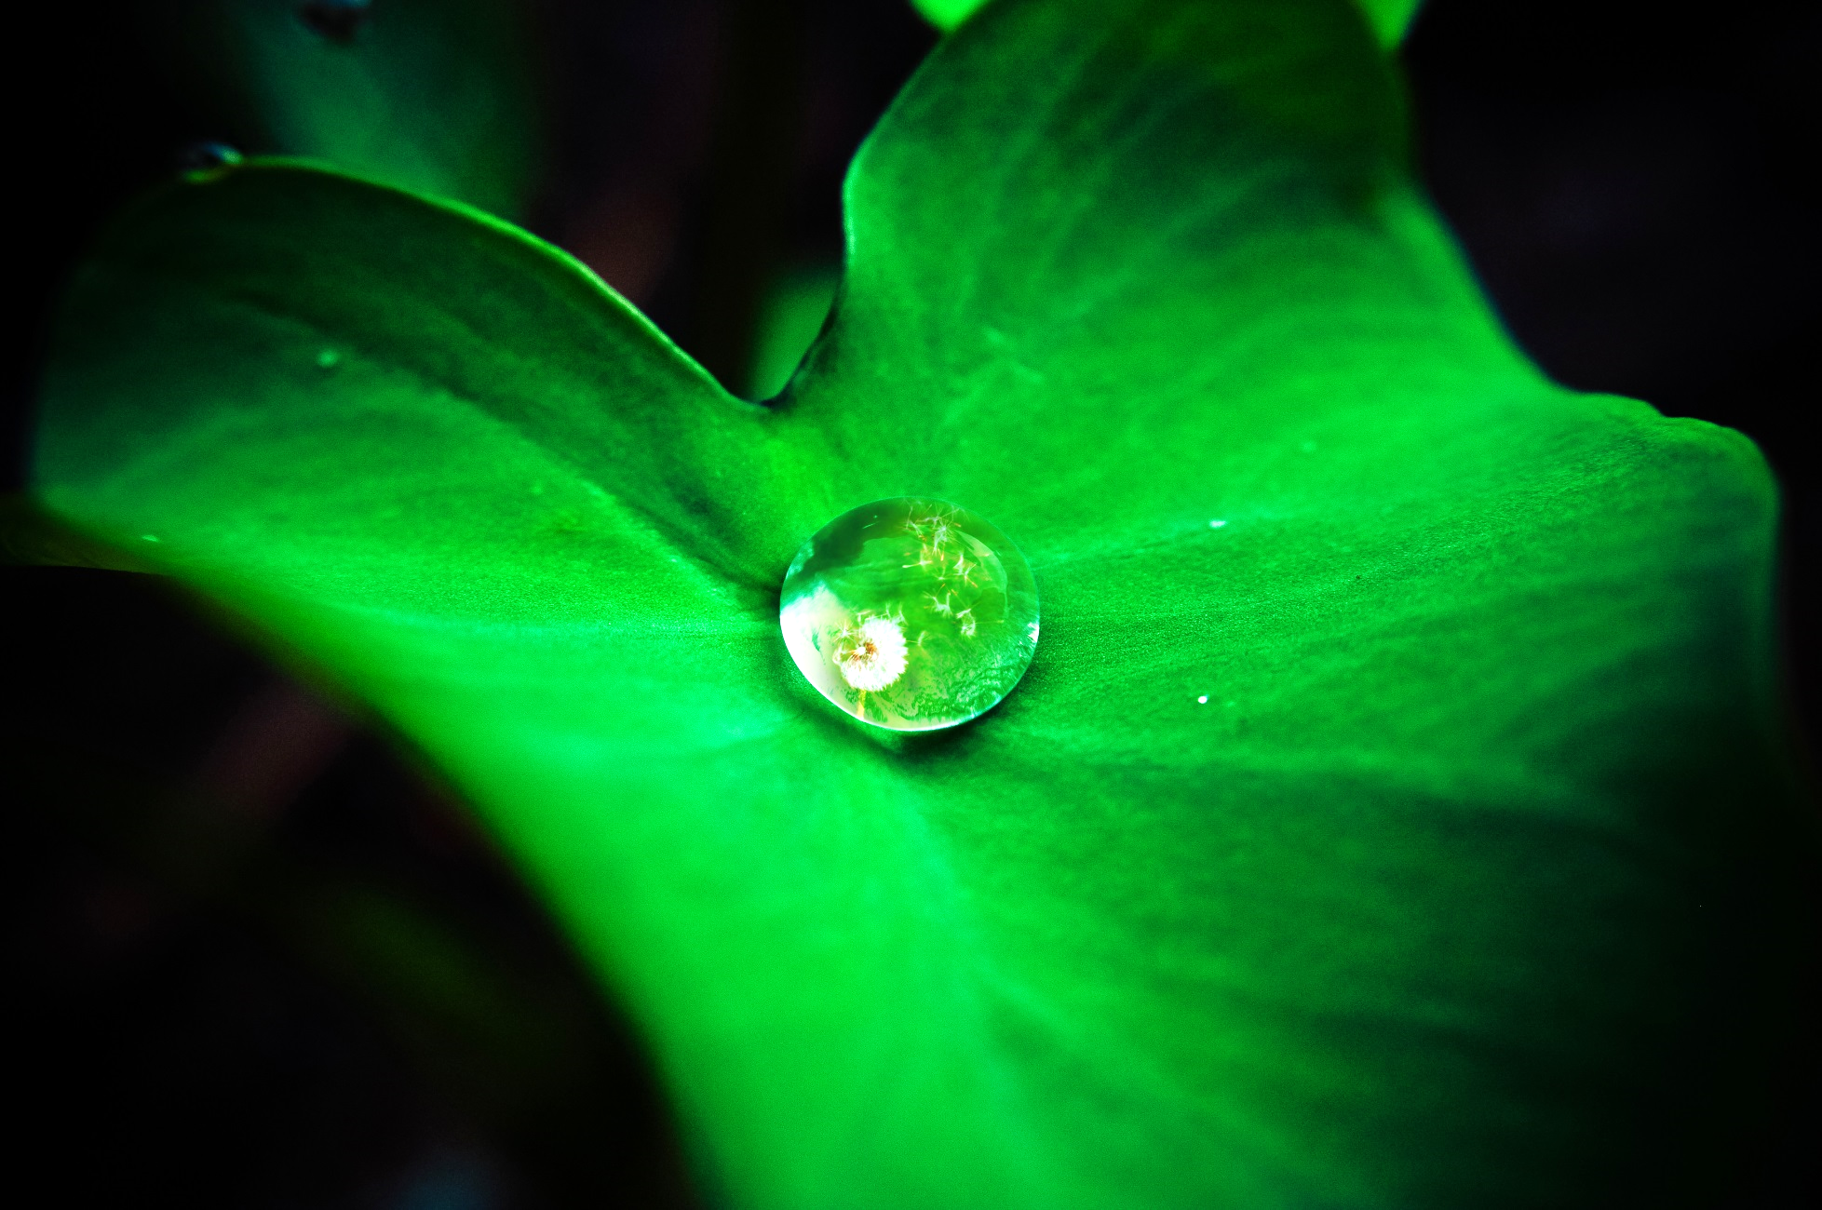
Author identification systems
A professional name and a standard signature are strongly recommended so that your scientific production has good retrieval and a greater visibility.
A permanent code helps to avoid ambiguities in personal names.

Slide 28

Information about ORCID
https://orcid.org
This is a 16-digit code that identifies unequivocally and over time all the scientific production by one single author. It is universal and free of charge.
Adopted by UAB, other universities, journal publishers and research evaluation agencies.

Slide 29
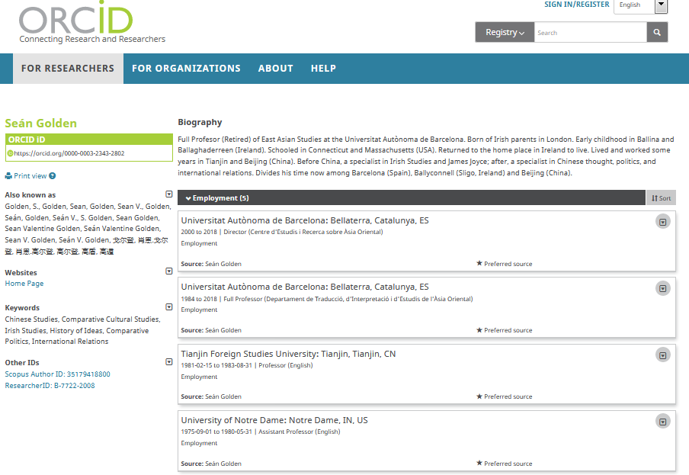

Slide 30
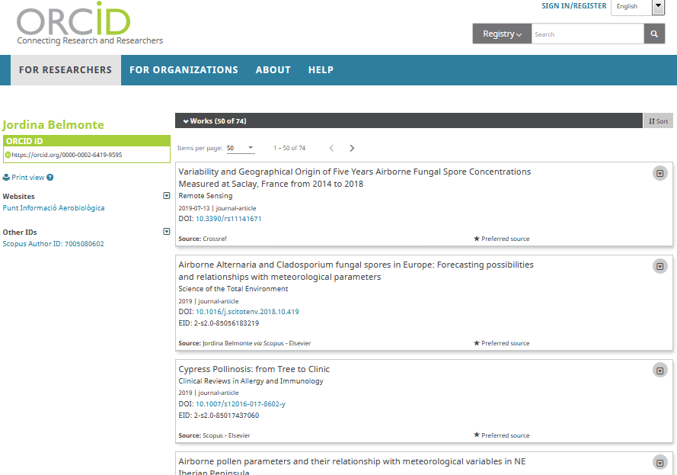

Slide 31
Other identification systems
SCOPUS-ID (Scopus)
PUBLONS (WoS)
Identification system of the Scopus database.
It gathers all the variant names and assigns one single code to each author or institution.
It allows information transfer from ORCID and bibliographic reference managers (Endnote, Zotero, Mendeley...).
This identifier is automatically assigned. Author profile can be modified.
How do I correct my author profile?
Identification system of the Web of Science (WoS) database.
It gathers all the variant names and assigns one single code to each author or institution.
It allows information transfer from ORCID and bibliographic reference managers (Endnote, Zotero, Mendeley...).
This identifier is not automatically assigned, unless you have previous articles in Web of Science or you previously had a Researcher-ID code.
How to get a Publons identifier?

Slide 32
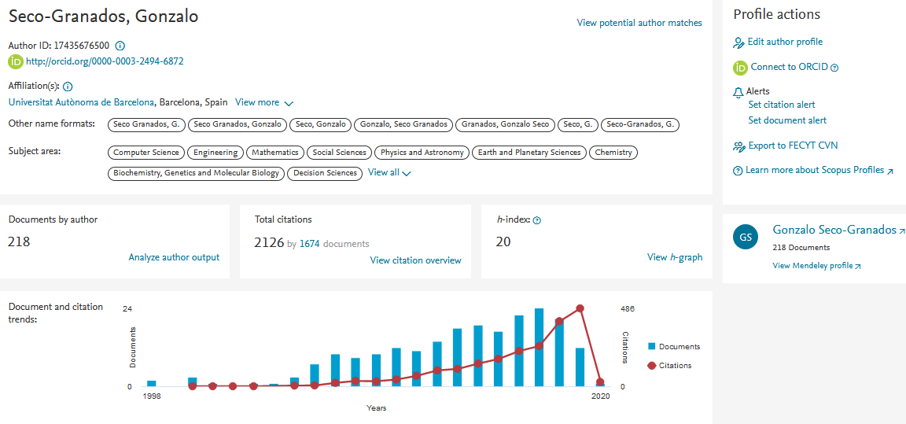
Scopus-ID

Slide 33
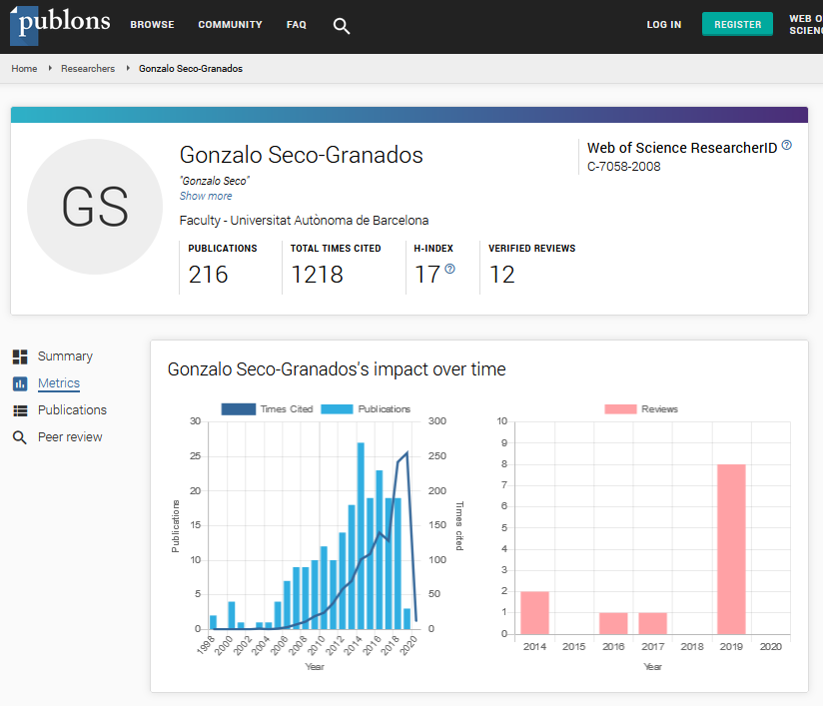
Publons

Slide 34
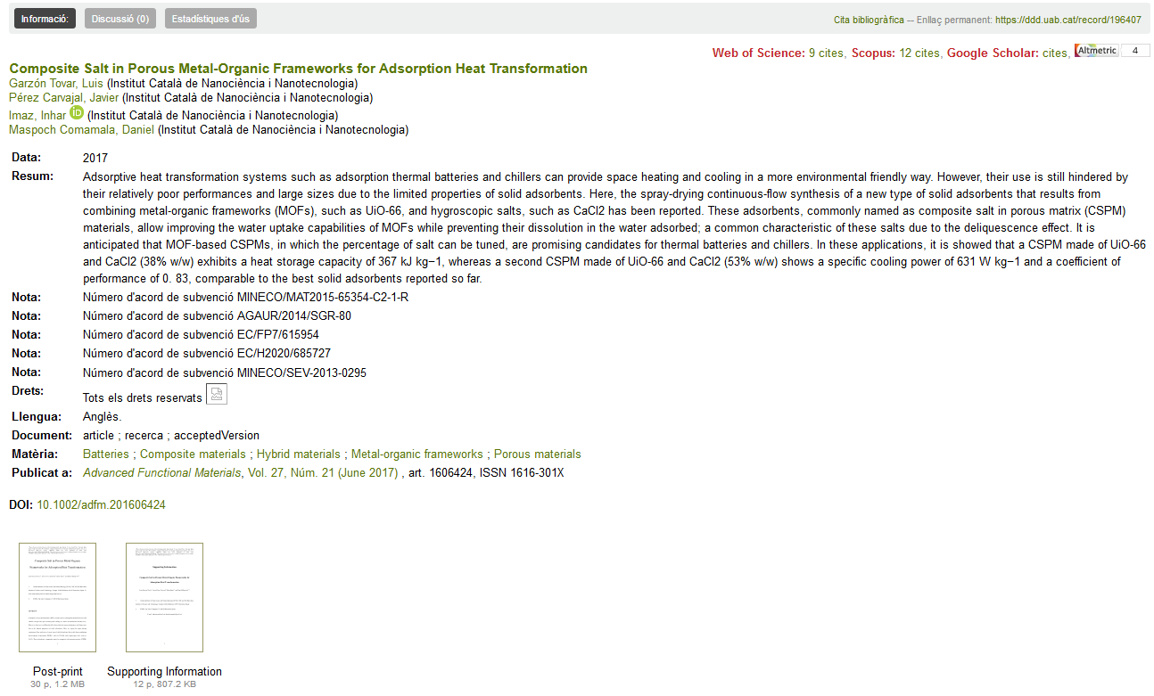

Slide 35

Google Scholar Citations
It started in 2004.
A profile can help you to increase visibility.
It gathers versions and compiles citations. It collects all DDD documents as well.
It is very simple: Gmail account.
https://scholar.google.com/citations

Slide 36
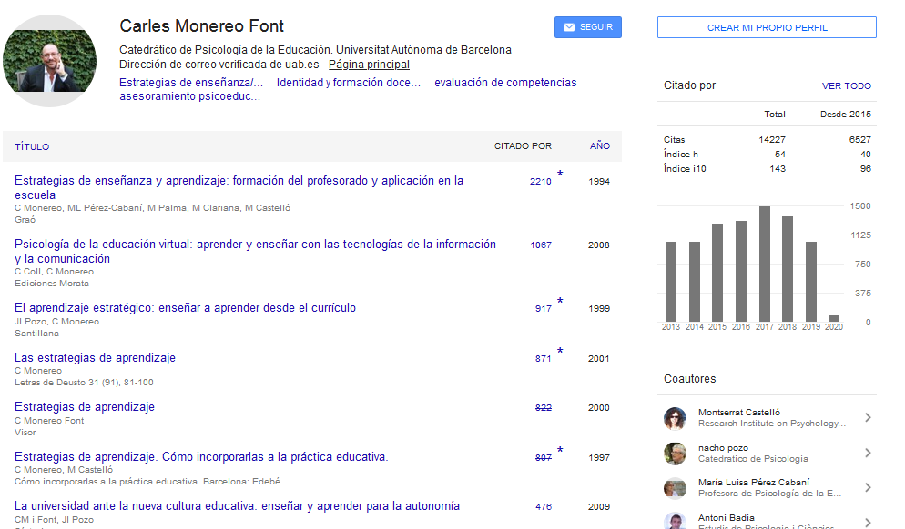

Slide 37
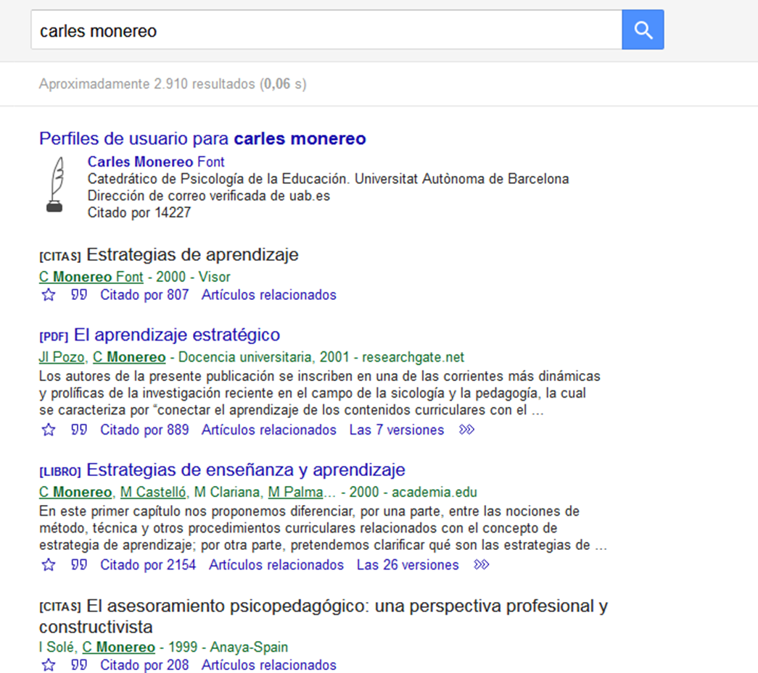
Digital identity
Presence on the Internet

Slide 38
We will talk about…
Text
Open Access
Open Access publishing
Identification systems
Scholarly networks
Recommendations

Slide 39

“Science that is not counted, does not count.”
Ignacio López-Goñi. Lecturer in Microbiology at the Universidad de Navarra. He got the “Asebio 2017 de Comunicación y Divulgación de biotecnología en las redes sociales” award
http://www.noticiasdegipuzkoa.com/2017/12/26/sociedad/la-ciencia-que-no-se-cuenta-no-cuenta

Slide 40
Scholarly networks
Create collaboration spaces
Share and discuss research
Improve research visibility, dissemination and impact
Access and download academic and scientific papers
Meet new colleagues
Speed up the academic communication process
Profit-making repositories
Preservation not granted
Author’s rights not always respected
Little implementation because of a preference for general social networks: Facebook, YouTube or Twitter

Slide 41






Scholarly networks
www.urv.cat/media/upload/arxius/crai/recerca/xarxessocials.pdf

Slide 42
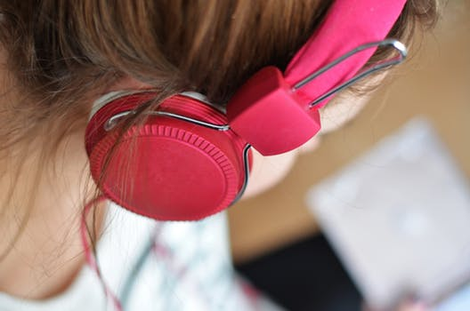
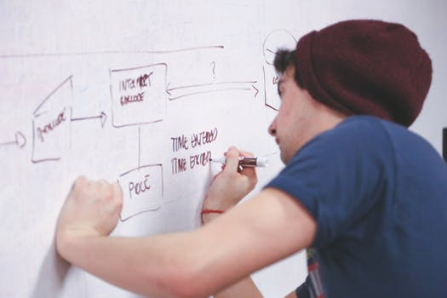
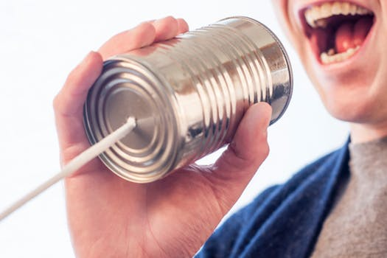
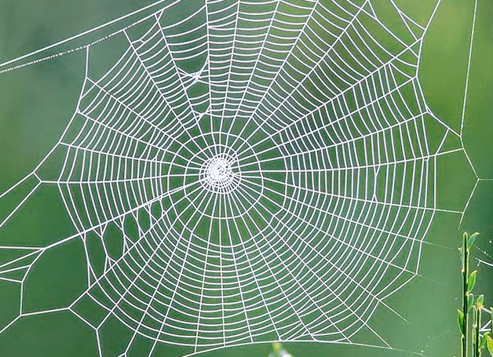



















EC
4
The formula…
Listen
Create
Communicate
Connect
Share

Slide 43
We will talk about…
Text
Open Access
Open Access publishing
Identification systems
Scholarly networks
Recommendations

Slide 44
Recommendations
Good practices…
Create
Cite properly
Publish
Open Access
Keep ALL versions
Disseminate
Identify file (authorship, version and mention of rights)
Permanent URL
Standardised name and membership
Social networks
Choose journal
ORCID
Google Scholar
Submit to the DDD (contact your library)
https://thinkchecksubmit.org/
Notes:
Quan preparem un document:
Nom o acrònim de l’organisme financiador i número de projecte
Correcta normalització del nom i filiació. Recomanacions UAB
L’identificació internacional ORCID (necessari per al Portal de Recerca de Catalunya) http://orcid.org/
Important: Guardar la versions pre-print i post-print
Abans de publicar:
Incloure una llicència CC si no hem transferit els drets (material docent, estudis, ponències…)
Si es tracta d’un pre-print o post-print d’un article de revista, llibre o capítol de llibre, incloure-hi al principi la següent informació: Postprint de: [Citació bibliogràfica de l’article, capítol o llibre] lliurat a [editorial]
Evitar males pràctiques:
Publicar el document a les xarxes socials acadèmiques (Mendeley, Academia.edu…) o la web personal si hi ha hagut una cessió dels drets d’explotació a tercers. Cal el seu permís.
Publicar documents dels quals en sou coautors sense posar-ho en coneixement dels altres.

Slide 45
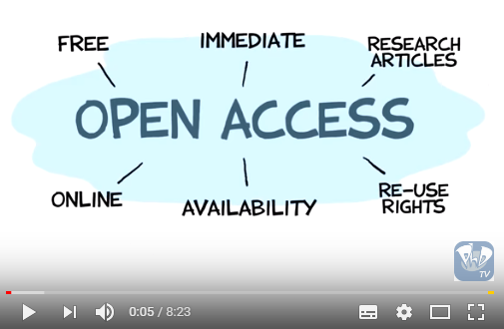
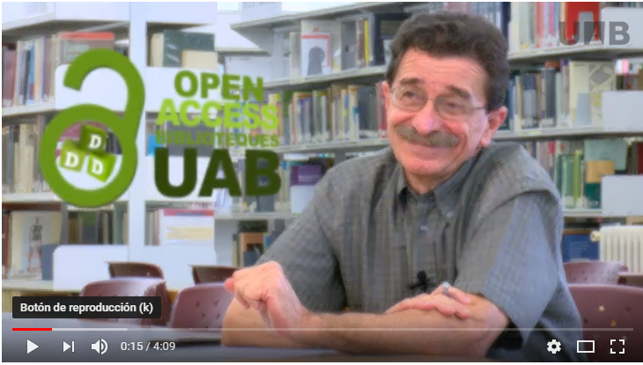
We suggest…
https://youtu.be/BBXfWghYQnc
https://youtu.be/L5rVH1KGBCY
https://www.uab.cat/web/research/open-access-uab/promotion-and-training-1345692601357.html

Slide 46




Open Access UAB
www.uab.cat/open-access
Intellectual Property and Open Access blog www.uab.cat/propietat-intellectual
Digital repositories
https://www.uab.cat/web/our-collections/digital-repositories-1345738248245.html
www.facebook.com/bibliotequesUAB/
@bibliotequesUAB
www.youtube.com/channel/UCe6S0lv1IdvtDx8gg7t4dhg
www.instagram.com/biblioteques_uab/

Slide 47

For further questions, please contact your library.
www.uab.cat/biblioteques
This presentation is available at: https://ddd.uab.cat/record/196578
Photo: Morgan Sessions

Slide 48


Thank you!
#bibliotequesUAB

