Slide 1


Unit 4. The profession
Element 1. Personal skills
Tools for time and
work management
Tatjana Knapp
Zavod RISA

Slide 2

Overview
The day is short and work lasts a long time.
(Hebrew Proverb)
Mastering the skills of time and work management is much easier with the right kind of tools.

Slide 3

Work management
Managing individual and team workflows and workload.
Within an organization or a project.

Slide 4
Project management
A project is a series of tasks that lead to specific outcomes. Project management is the application of processes, methods, skills, knowledge and experience to achieve specific project objectives. It has restricted time and budget.

Slide 5
Task management
Task management is important when a project is divided into smaller pieces.
Task management makes the project more managable.

Slide 6
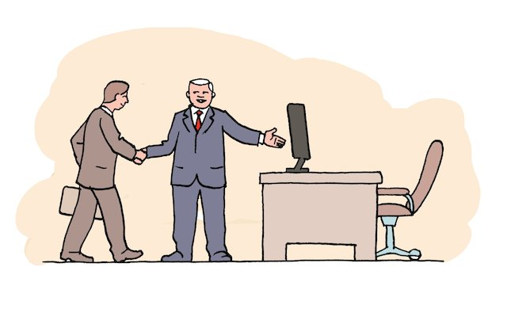
Project managers
Project management and task management.
The project manager needs a full inside into the phases, tasks and progress.
Needs good project management tools
(software).

Slide 7

Facilitators, authors, validators
Task management.
Communication (facilitators and validators).
Need a good task management tool (software) and a good communication tool.

Slide 8
Project management tools
Essential features: planning and scheduling, team collaboration, time tracking, reporting, budgeting, billing and quotes, etc.
Includes gantt-chart, documentation/templates, etc.

Slide 9
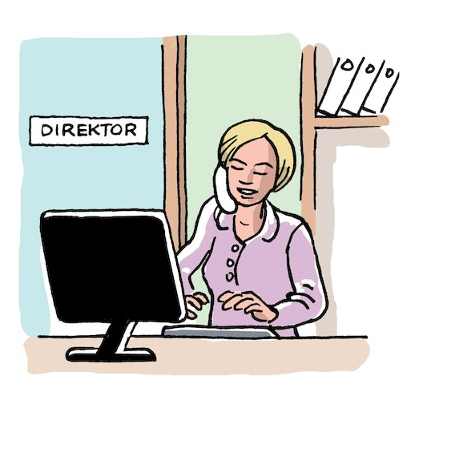
Planning and scheduling
When plan is assigned order and specific dates->
scheduling.
Important terminology (project management): workflow, critical path, priorities, dependencies, deadline reminders, adjusting, etc.

Slide 10
Team collaboration
Communication tools (online and offline): chat and messaging tools, email, phone, face-to-face apps, conference apps, etc.
Working together (online): document collaboration and file sharing tools (One Drive, Google Drive, Dropbox…).

Slide 11
Time tracking
Time tracking applications!
Important features: real-time tracking, (manual) editing, reporting, exporting data, etc.
Examples: Toggl track or Everhour (free per up to 5 users)

Slide 12
Reporting
Essential features: clean and easy user interface, pulling data from different sources, integration with other tools.
Various types: dashboard software, data visualization software, scorecard tools, ad-hoc report writers.

Slide 13
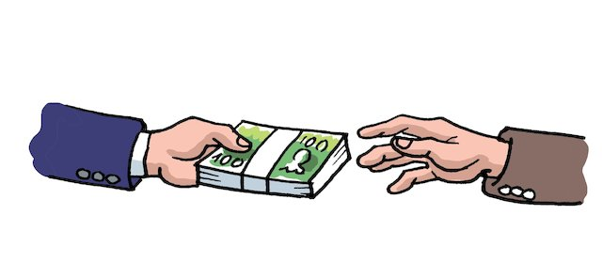
Budgeting and billing
(invoicing)
Essential feature: trustworthy (high security).
Pen and paper, spreadsheets, budgeting applications.

Slide 14
Task management
Task management is/can be a part of project management.
Essential features: calendar, priotirizing, time estimation, collaboration, etc.
Includes to-do lists, real-time updates, (email) alerts, etc.

Slide 15
Software (examples)
Our advice: Use tools with multiple features.
Trello (a free model, different pricing models)
Wrike (a free task list, different pricing models)
Microsoft Project (different pricing models)
Listed above are examples, not recommendations.

Slide 16

Tatjana Knapp
tatjana@risa.si

Slide 17
Acknowledgement
The project EASIT has received funding from the European Commission under the Erasmus+ Strategic Partnerships for Higher Education programme, grant agreement 2018-1-ES01-KA203-05275.

Slide 18
Disclaimer
The European Commission support for the production of this publication does not constitute an endorsement of the contents, which reflect the views only of the authors, and the Commission cannot be held responsible for any use which may be made of the information contained therein.

Slide 19







Partners

Slide 20

EASIT
pagines.uab.cat/easit

