Slide 1

Simplifying language and style of audiovisual journalistic texts
Unit 3C. Easy to understand (E2U)
and audiovisual journalism (AVJ).
Element 2. Linguistic aspects
Rocío Bernabé Caro
Internationale Hochschule SDI München

Slide 2

E2U journalistic texts

Slide 3
The context
"[…]broadcasts are a part of a daily communication culture." (Meckel and Kamps (1998:11)
News items often use visual and aural elements.

Slide 4
The function
News items "aid citizens in becoming informed". (Hobert, 2005)
"For many people, access to easy-to-read versions of news
and other informational materials represent their only way of exercising their democratic right to stay informed.” (IFLA 2010:18)

Slide 5
What to simplify
Verbal and non-verbal information:
that is conveyed aurally.
that is visually.

Slide 6
Simplification principles
Information for All published in 2009 by Inclusion Europe,
Recommendations by Plain Language Association International
The 19 writing recommendations by the project Begriplig Text (begripligtext.se).

Slide 7
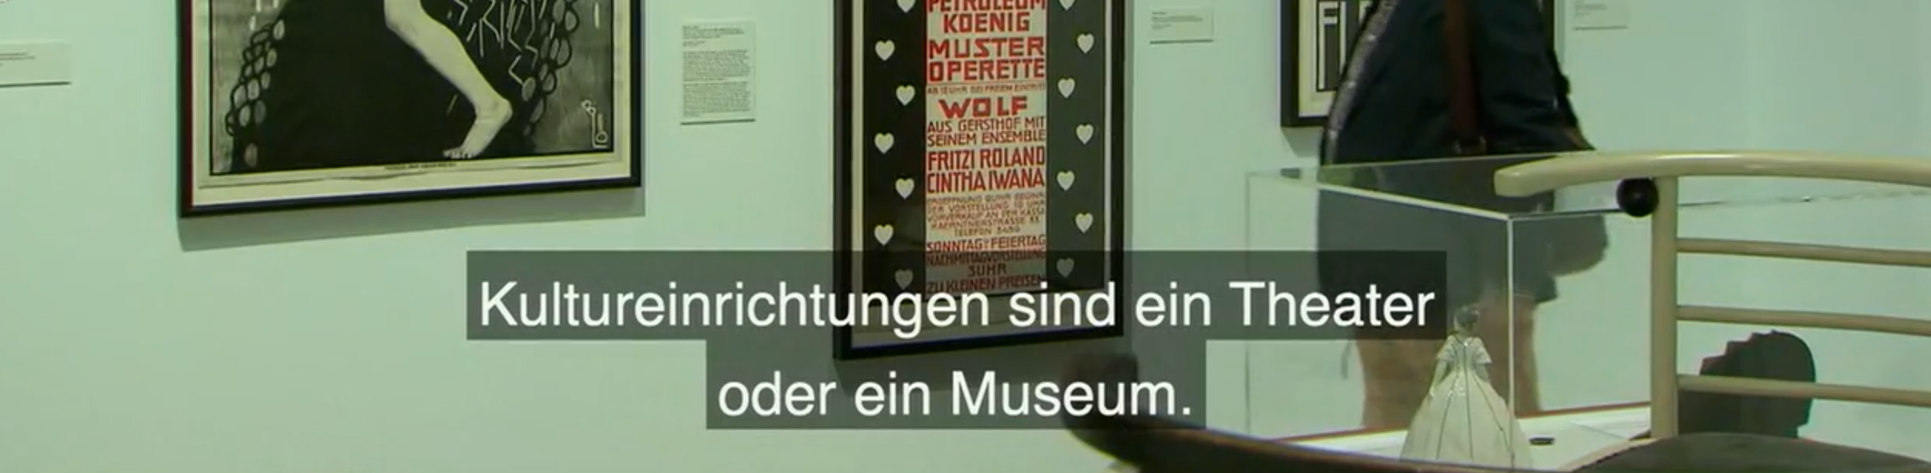
Provide examples

Slide 8
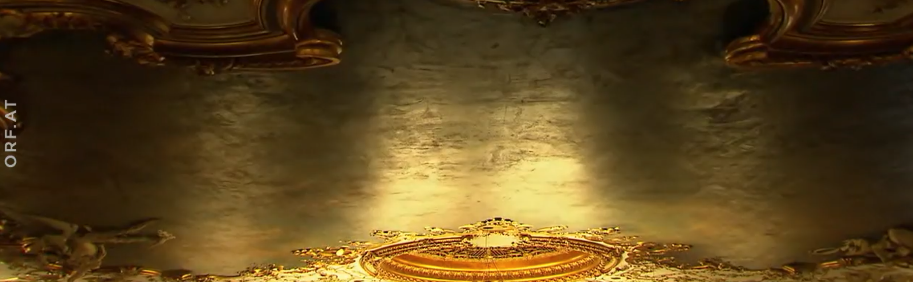
Use synonyms
A cultural institution in Vienna is the Volkstheater.
Volkstheater is an old theatre.

Slide 9
Describe the meaning
The Volkstheater has been renovated
in the last few months.
When an old house is renovated,
everything is made new.

Slide 10
Other recommendations
Avoid abstract words.
Use simple sentences that express 1 idea.
Canonical order of sentences.
Use repetitions.

Slide 11
Repeating patterns
During curfew hours, you can
only leave your house for specific reasons.
You can leave your house
to help someone.
You can leave your house
to take a walk.

Slide 12
Voicing
Good pronunciation and articulation
No strong accents
Speak about things that people can see on the screen
Read the text in a way that emotions can be perceived

Slide 13
Speech rates and sounds
Speak slowly
Leave pauses at sensible points
Avoid interferences and background noises
Good volume
Use special sounds, if necessary

Slide 14
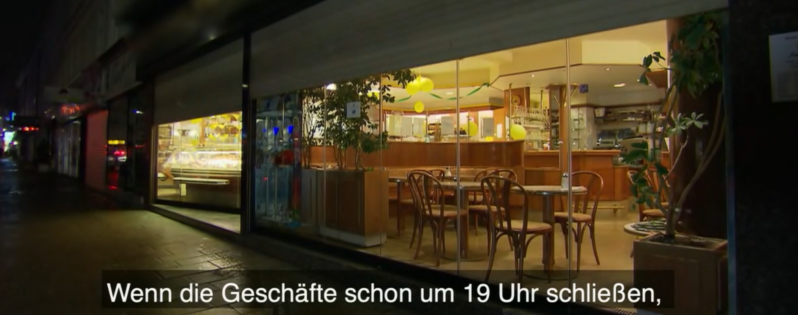
Show and tell

Slide 15
Function of visual items
support learning and aid retention
enhance a point
add an explanation
emphasizes an idea
enhance credibility

Slide 16

Non-verbal visual elements

Slide 17
Summary
E2U journalistic texts can enable persons with intellectual or reading and learning difficulties to exercise their right to be informed.
There are already principles and examples that can help.
Inclusive approaches.

Slide 18

Prepared by: Rocío Bernabé Caro
(Internationale Hochschule SDI München, Germany)

Slide 19

Rocío Bernabé
rocio.bernabe@sdi-muenchen.de

Slide 20

Acknowledgement
The project EASIT has received funding from the European Commission under the Erasmus+ Strategic Partnerships for Higher Education programme, grant agreement 2018-1-ES01-KA203-05275.

Slide 21
Disclaimer
The European Commission support for the production of this publication does not constitute an endorsement of the contents, which reflect the views only of the authors, and the Commission cannot be held responsible for any use which may be made of the information contained therein.

Slide 22







Partners

Slide 23

EASIT
pagines.uab.cat/easit

