Slide 1


General and easy-to-understand audiovisual journalism
Unit 3c. Easy-to-understand languages (E2U)
and audiovisual journalism (AVJ)
Element 1. Processes
Ester Hedberg
Swedish National Association for Dyslexia

Slide 2
Overview
Selecting the relevant news
Time
Truth
Making the content interesting

Slide 3
Accessible journalism
Through accessibility services as AD and AST in standard and simplified format
Written news as audio
Making the content easier

Slide 4

Democracy
“The quality of our democratic life depends, in short, on the public having the facts and being able to make sense of them”
Kovach and Rosenstiel
(The elements of journalism, 2014, p. 21)
Photo: Roman Kraft, Unsplash

Slide 5

Purpose
“The primary purpose of journalism
is to provide citizens with
the information they need
to be free and self-governing” (2014, p. 28)
Photo: Gerd Altmann, Pixabay

Slide 6
Selection
“The items that make up the news agenda are not randomly assembled, nor are they the outcome of a natural and unchanging order. Rather, journalism is a matter of selection.”
Smith and Higgins (The Language of Journalism, 2020, p. 1)

Slide 7
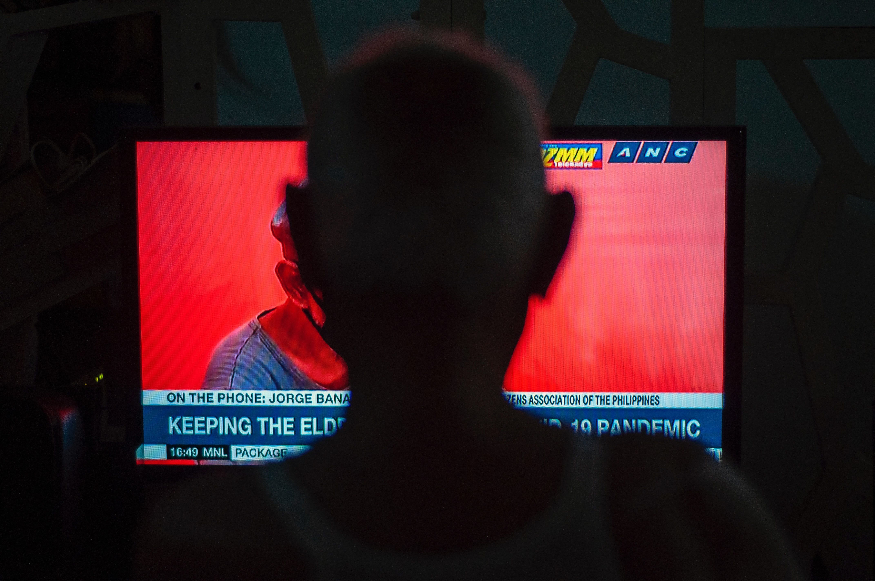
Relevance
What is newsworthy?
The general or the specific?
Know your audience!
Photo: Amanna Avena, Unsplash

Slide 8
Needs of the audience
Different users might mean different needs.

Slide 9
Time
Slower pace
Gaps between news items
Better explanations

Slide 10
Do not avoid
Report in en easy-to-understand manner
without avoiding what is important

Slide 11

Truth
“Journalism’s first obligation is to the truth.”
(Kovach and Rosenstiel, 2014, p. 56).
Photo: Mika Baumeister, Unsplash

Slide 12
Trustworthy
Don’t let your audience down

Slide 13
Interesting
“Journalism must make the significant interesting and relevant.”
(Kovach and Rosentiel, 2014. p.198)

Slide 14
Boring is hard
Make the news captivating for your audience.

Slide 15
How?
“...through superior reporting, thinking, narrative, design and presentation of data in a way that helps the reader make sense of what's going on in the world.” (Kovach and Rosentiel, 2014. p.199)

Slide 16

Ask yourself
What is this story really about?
Who does this story, or these facts, affect?
Who has the information?
What's the best way to tell this story?
(Kovach and Rosentiel, 2014. p.110)
Photo: Afif Kusuma, Unsplash

Slide 17
Understandable
“Whatever it is, your first concern should be whether your method for conveying the story will lead the reader to greater understanding of the issues at hand.”
(Kovach and Rosentiel, 2014, p. 213)

Slide 18
Meet your audience
“Nothing about us without us”

Slide 19

Diversity
Work together with journalists
that have personal
experience of disabilities
Photo: Leon, Unsplash

Slide 20
Summary
select the right news
give time
be trustworthy
report the relevant in an engaging way
meet your audience
encourage diversity at your news desk

Slide 21
Thank you!

Slide 22

Ester Hedberg
ester.hedberg@dyslexi.org

Slide 23
Acknowledgement
The project EASIT has received funding from the European Commission under the Erasmus+ Strategic Partnerships for Higher Education programme, grant agreement 2018-1-ES01-KA203-05275.

Slide 24
Disclaimer
The European Commission support for the production of this publication does not constitute an endorsement of the contents, which reflect the views only of the authors, and the Commission cannot be held responsible for any use which may be made of the information contained therein.

Slide 25







Partners

Slide 26

EASIT
pagines.uab.cat/easit

