Slide 1
Voicing
Unit 3B. Easy-to-understand (E2U) and audio description (AD)
Element 3. Technical aspects
Lourdes Lorenzo-García
Universidade de Vigo

Slide 2
Overview
Quick overview of the software used to prepare voicing.

Slide 3
Voicing and AD
Importance of voicing for AD.
Blind people with some cognitive disability.

Slide 4
Voicing software: types
Professional: Pro Tools, Logic Pro, Cockos Reaper, Adobe Audition, WavePad, FL Studio, Source Forge Audio, Noblurway Mosaic.
Free: Audacity, Ardour, Free Sound Recorder, AVS Audio Recorder (PC) or Garage Band, Quick Time or Ocean Audio (Mac).

Slide 5
Free software
AudescMobile:
iOS and Android-system tablets.
Access to audio-described films and TV-series.
TrAD-Software:
Write and record the audio-descriptor’s voice.

Slide 6
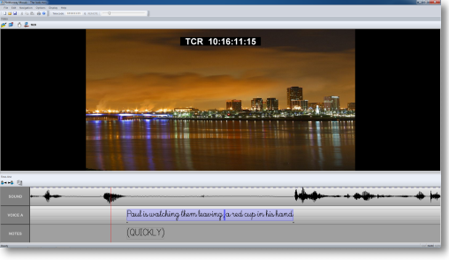
Noblurway Mosaic (I)

Slide 7
Noblurway Mosaic (II)
Audio description lines.
Notes.

Slide 8
Noblurway Mosaic (III)
Audio description lines can be stretched.
Timecodes are automatically assigned when entering the text.

Slide 9
Noblurway Mosaic (IV)
Audio description lines can be exported in a document with timecodes and notes of writing.

Slide 10
Download formats
Text-based formats:
WebVTT, TXT, DOC, Merged TXT, Merged DOC, Stamped Doc, Merged Doc (Stamped).
Media-based formats:
AD alone: MP3, OGG or WAV.
AD + source media + captions: MP4, MP3, OGG or WAV.

Slide 11
3Play Plugin (I)
The plugin references the video and plays the secondary audio description track along with it.

Slide 12
3Play Plugin (II)
Free tool.
Compatible with most video players and publishing platforms.
It enables to add captions and audio description.
www.3playmedia.com/services/features/plugins/3play-plugin/

Slide 13
Editing (I)
The audio must be carefully edited.
Undesirable noises.
Quality of the sound.

Slide 14
Editing (II)
File types and audio quality must be taken into account and selected according to type of media.

Slide 15
More information
“The creation, adaptation and validation of E2U AD and AST.”
“AD and AST Users voice on AD AST Camilla.”
“AD and AST Users voice on AD AST Anna.”
Audio description guidelines (www.adlabproject.eu).

Slide 16
Lourdes Lorenzo-García
llorenzo@uvigo.es

Slide 17
Acknowledgement
The project EASIT has received funding from the European Commission under the Erasmus+ Strategic Partnerships for Higher Education programme, grant agreement 2018-1-ES01-KA203-05275.

Slide 18
Disclaimer
The European Commission support for the production of this publication does not constitute an endorsement of the contents, which reflect the views only of the authors, and the Commission cannot be held responsible for any use which may be made of the information contained therein.

Slide 19
Partners

Slide 20
EASIT
pagines.uab.cat/easit

