Slide 1

Creating intertextual relations: an example
Unit 3B. Easy to understand (E2U)
and audio description (AD).
Element 2. Linguistic aspects.
Piero Cavallo and Rocío Bernabé Caro
Internationale Hochschule SDI München

Slide 2
Overview
What is intertextuality?
Solve lexical barriers.

Slide 3
Intertextuality
Every text has intertextual relations with other texts.
These relations can be implicit or explicit.
They can be citations or reference to the text type.
They can be complex to process.
Audio-visual contents can be considered as texts.

Slide 4
Provide additional information
Written or audio introduction.
Extended audio description.
Extended audio subtitles.

Slide 5
About extended audio subtitles
Audio subtitles
Extended audio description
Extended audio subtitles
Audio introduction

Slide 6
The sample (1 of 2)
1-minute-long news item
from the Slovenian broadcast RTV Slovenija.
It presupposes knowledge about hospitals,
COVID-19, and pregnancy.
E2U audio subtitles and burnt-in subtitles.

Slide 7
The sample (2 of 2)
Two versions:
Standard speech rate.
Slower speech rate.

Slide 8
What information to convey?
E2U audio subtitles.
Summary (general and specific content).
Difficult terminology.

Slide 9
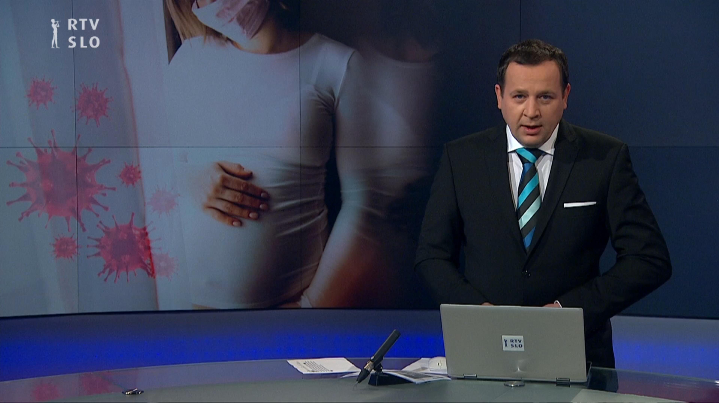
Let’s watch the sample! (Standard)

Slide 10
Let’s watch the sample! (Slower)

Slide 11
Summary
Intertextuality in written texts
and audio-visual contents.
How to use extended audio subtitles to:
  Help people who cannot read written subtitles.
  Clarify intertextuality in audio-visual contents.

Slide 12

Prepared by: Piero Cavallo and Rocío Bernabé Caro
(Internationale Hochschule SDI München, Germany)

Slide 13

Rocío Bernabé
rocio.bernabe@sdi-muenchen.de

Slide 14

Acknowledgement
The project EASIT has received funding from the European Commission under the Erasmus+ Strategic Partnerships for Higher Education programme, grant agreement 2018-1-ES01-KA203-05275.

Slide 15
Disclaimer
The European Commission support for the production of this publication does not constitute an endorsement of the contents, which reflect the views only of the authors, and the Commission cannot be held responsible for any use which may be made of the information contained therein.

Slide 16







Partners

Slide 17

EASIT
pagines.uab.cat/easit

