Slide 1


Identifying and organizing information for E2U ADs
Unit 3B. Easy to understand (E2U)
and audio description (AD)
Element 2. Linguistic aspects
Elisa Perego
Università degli Studi di Trieste

Slide 2
Overview
Identify salient information in source text.
Deliver it in comprehensible AD.

Slide 3
Audiovisual texts
Audiovisual texts = multimodal texts.
Make meaning through several components.

Slide 4



Slide 5


Audiovisual texts
Visual verbal component.
Verbal non-verbal component.

Slide 6

Audio description
“Translate images into words”

Slide 7
Audio description
Selection.

Slide 8
Audio description
Selection.
We cannot describe everything!
> OVERLOAD

Slide 9

Audio description
Spare time and silence:
to process;
to enjoy.

Slide 10

Identifying information
Source text analysis.

Slide 11
Film characters: An example
Focal vs. supporting.
Main features:
appearance;
facial expression
Etc.

Slide 12

Strategies
1. Name
“Virginia Woolf”

Slide 13
Strategies
2. Name and gloss
“The English writer Virginia Woolf”

Slide 14
Strategies
3. Describe
“A middle-aged woman with a slightly hooked nose and hair pulled back in a bun”

Slide 15
Strategies
4. Describe and name
“A middle-aged woman with a slightly hooked nose and hair pulled back in a bun, Virginia Woolf”

Slide 16




Slide 17
Strategies
Time constraints.
When.
Wished level of comprehensibility.

Slide 18
Strategies
Short and clear.
Repetitions.
Consistency.

Slide 19

E2U AD strategies
Avoid pronouns!

Slide 20

E2U AD strategies
Select one salient element:
hooked nose.

Slide 21
E2U AD strategies
Stick to short gloss:
“The English writer”.

Slide 22

E2U AD strategies
Provide info when character in not on screen.

Slide 23
E2U AD strategies
Use audio introductions.

Slide 24

E2U AD strategies
Use «audio conclusions»!
to recap,
to repeat.
Help remember.
Restore coherence.

Slide 25
E2U AD strategies
Linarity.
Text organization.
Repeated text patterns.

Slide 26
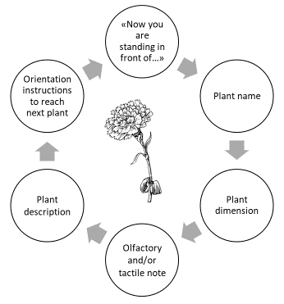
Example
Plant AD.
Fixed structure.
Recurring language chunks.
Same info.

Slide 27
Example
Name.

Slide 28
Example
Dimension.

Slide 29
Example
Olfactory and
or tactile cues.

Slide 30
Example
Description.

Slide 31
Example
Orientation.

Slide 32
Recap
Apply E2U principles.
Audio introduction.
Audio conclusion.

Slide 33
Recap
Structured text.
Phases.
Recurring language.

Slide 34


Slide 35
Picture of Virginia Woolf
Picture: Reworked version of image Virginia_Woolf_(4).jpg by LSDSL
Source: https://commons.wikimedia.org
Licence: CC BY-SA 2.0

Slide 36
Other pictures
Source: https://publicdomainvectors.org/
Licence: CC0 1.0

Slide 37

Prepared by: Elisa Perego (UNITS)
Produced by: Martina Atzeri (UNITS)

Slide 38

Elisa Perego
eperego@units.it

Slide 39
Acknowledgement
The project EASIT has received funding from the European Commission under the Erasmus+ Strategic Partnerships for Higher Education programme, grant agreement 2018-1-ES01-KA203-05275.

Slide 40
Disclaimer
The European Commission support for the production of this publication does not constitute an endorsement of the contents, which reflect the views only of the authors, and the Commission cannot be held responsible for any use which may be made of the information contained therein.

Slide 41






Partners

Slide 42

EASIT
pagines.uab.cat/easit

