Slide 1
Subtitling parameters: visual aspects
Unit 3A. Easy to understand (E2U) and subtitling
Element 2. Linguistic aspects
Rocío Bernabé
Internationale Hochschule SDI München

Slide 2
Visual aspects
Placement
Contrast
Lines
Font

Slide 3
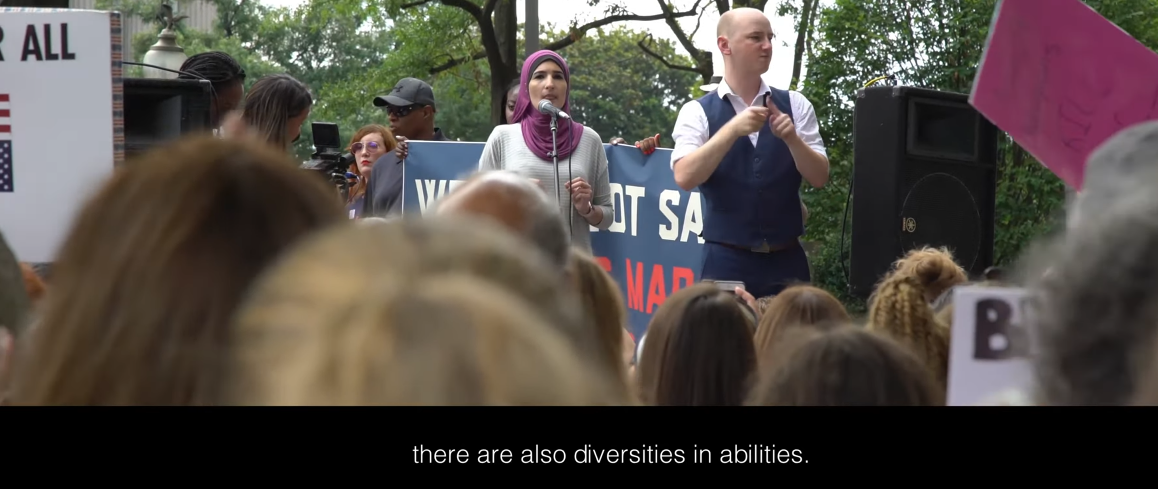
Placement
Lower bottom
Same position, where possible

Slide 4
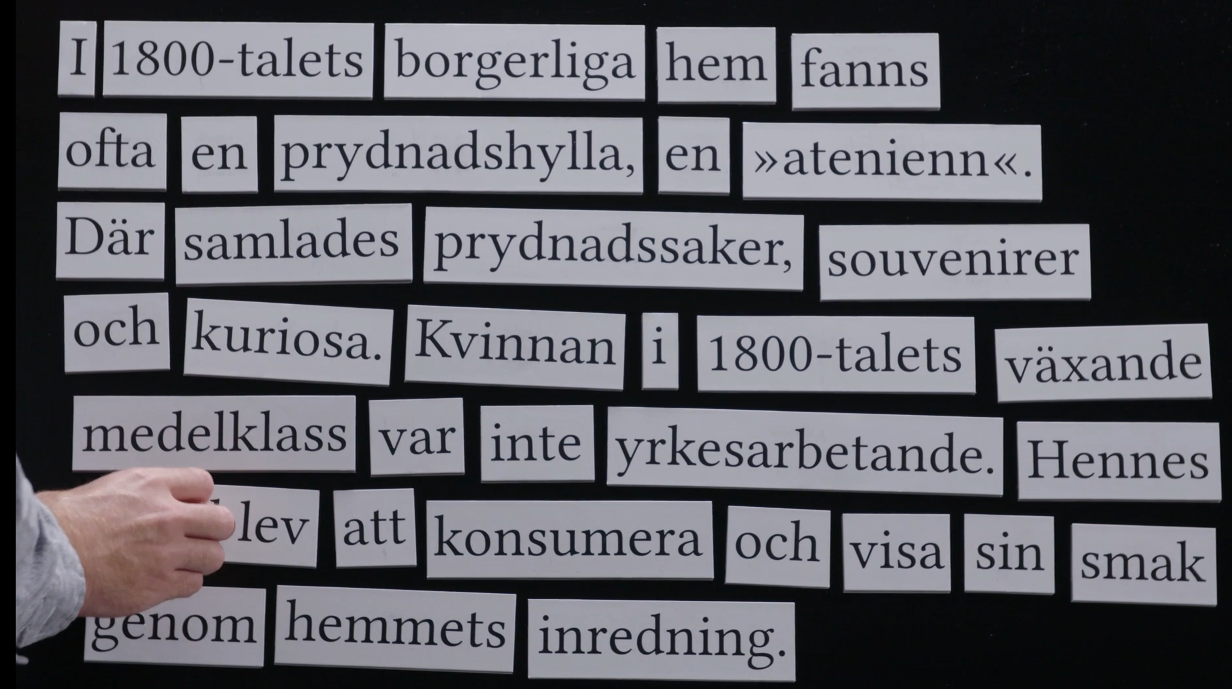
Contrast
This paragraph is displayed at the exhibition.
This paragraph is displayed at the exhibition.

Slide 5
Contrast ratio
4.5:1
4.5:1

Slide 6
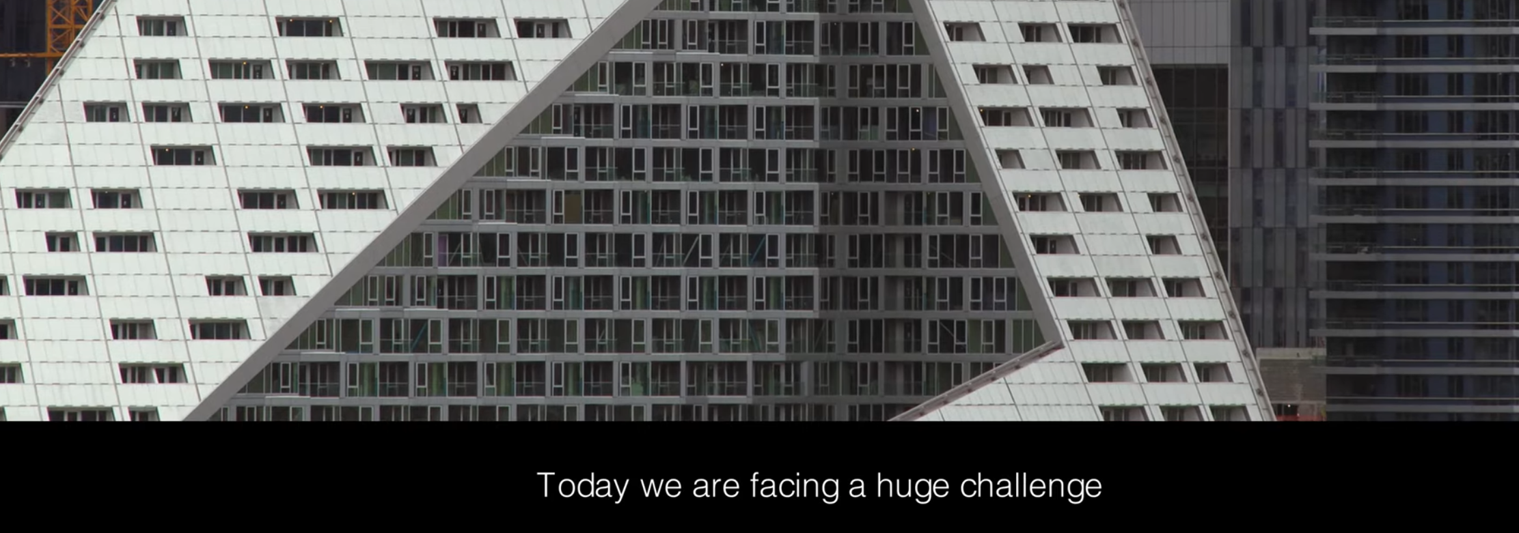
Subtitling box

Slide 7
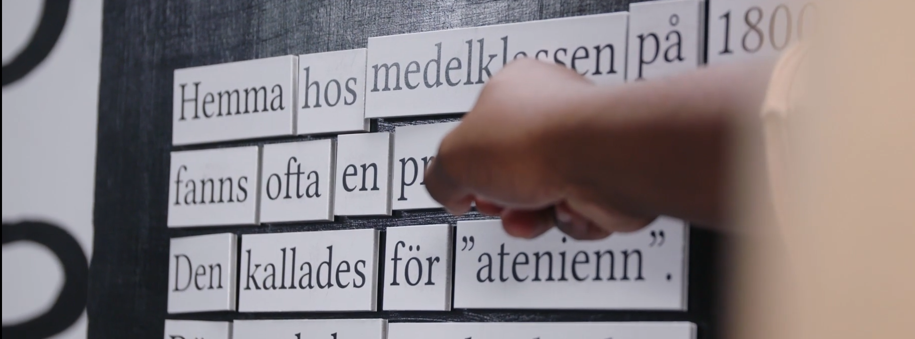
Large and opaque
Bourgeoise to middle-class.

Slide 8
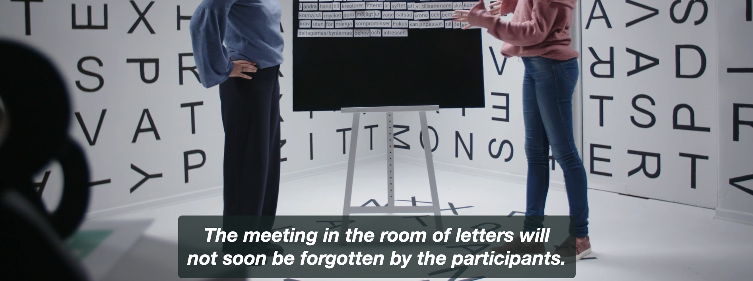
Smaller and transparent

Slide 9
No box
This paragraph is displayed at the exhibition.

Slide 10
Lines
Avoid animated lines.
Use static text.
Limit the number to two subtitling lines.
Start each sentence in a new line.
Use a line per speaker.

Slide 11
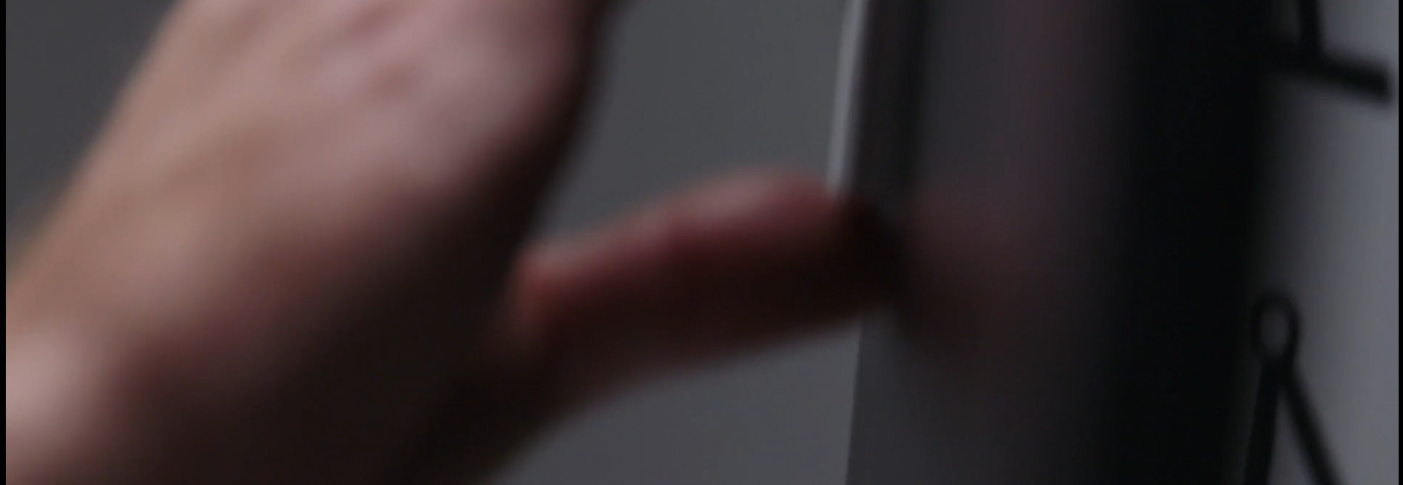
Characters per line
I work as a marketing communicator at the Nordic Museum.

Slide 12
Fonts
Use a larger font-sizes, (e.g., pixel, per cent, ems).
Use fonts with the greatest legibility (e.g., Calibri).

Slide 13
Text alignment
Align subtitling text to the left.

Slide 14
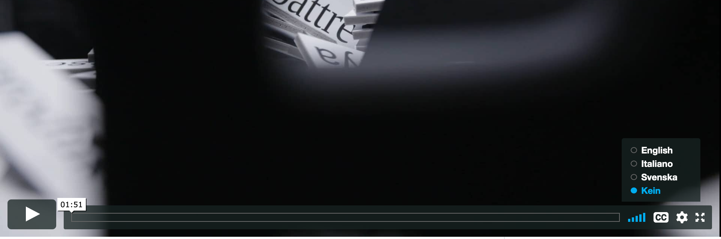
Customisation
Allow users to turn on/off the subtitles at any time.
Provide clear instructions for operating the service.
Provide a written file with the text, if possible.

Slide 15
Summary
Coherent visual presentation
SDH subtitling
Open issues:
number of characters per line
number of subtitle lines

Slide 16


Prepared by: Rocío Bernabé (SDI München) In collaboration with: Universidade de Vigo, Spain

Slide 17


Rocío Bernabé
Rocio.bernabe@sdi-muenchen.de

Slide 18
Acknowledgement
The project EASIT has received funding from the European Commission under the Erasmus+ Strategic Partnerships for Higher Education programme, grant agreement 2018-1-ES01-KA203-05275.

Slide 19
Disclaimer
The European Commission support for the production of this publication does not constitute an endorsement of the contents, which reflect the views only of the authors, and the Commission cannot be held responsible for any use which may be made of the information contained therein.

Slide 20







Partners

Slide 21

EASIT
pagines.uab.cat/easit

