Slide 1


Validation of E2U subtitles
Unit 3A. Easy to understand (E2U)
and subtitling
Element 1. Processes
Rocío Bernabé
Internationale Hochschsule SDI München

Slide 2
Overview
Definition
Roles
Workflow

Slide 3
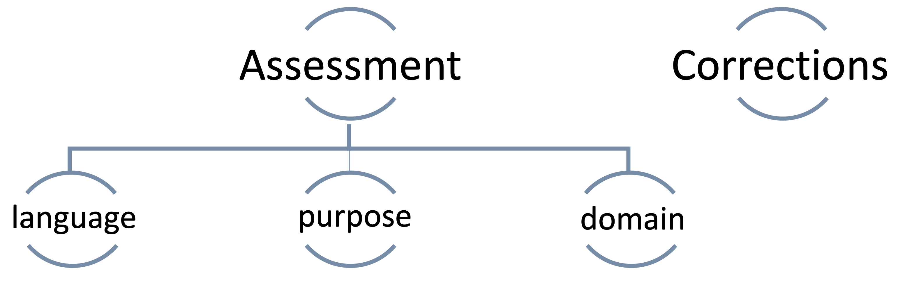
Validation tasks

Slide 4
Roles in validation
Validators:
  Are experts in E2U texts
  Are users of E2U language
Facilitators

Slide 5
Validation groups
Similar to focus groups
Persons with varied reading skills and comprehension degrees
Size: 4 to 6 persons
Sessions of 1 to 2 hours

Slide 6
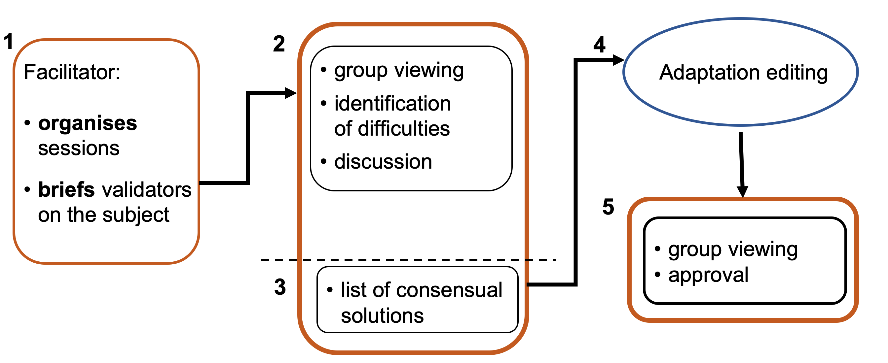
Validation process

Slide 7
Characteristics
Collaborative
Human-centred
Iterative
Time-consuming

Slide 8

Validation logos

Slide 9
Discussion
How to validate large amounts of content
Interlingual translations

Slide 10
Prepared by: Rocío Bernabé and Piero Cavallo
(SDI München)

Slide 11

Rocío Bernabé
rocio.bernabe@sdi-muenchen.de

Slide 12
Acknowledgement
The project EASIT has received funding from the European Commission under the Erasmus+ Strategic Partnerships for Higher Education programme, grant agreement 2018-1-ES01-KA203-05275.

Slide 13
Disclaimer
The European Commission support for the production of this publication does not constitute an endorsement of the contents, which reflect the views only of the authors, and the Commission cannot be held responsible for any use which may be made of the information contained therein.

Slide 14







Partners

Slide 15

EASIT
pagines.uab.cat/easit

