Slide 1

What are E2U subtitles?
Unit 3A. Easy to understand (E2U)
and subtitling
Element 1. Processes
Rocío Bernabé
Internationale Hochschule SDI München

Slide 2
Overview
Characteristics
Constraints
Resources for creation

Slide 3
E2U subtitles
[…] are an access service that aims to support viewers in the meaning-making process by using cognitive text simplification.

Slide 4
Simplification method
Easy-to-Read subtitles
Plain language subtitles
Easy-pictogram subtitles

Slide 5
Subtitling language
Interlingual
Intralingual

Slide 6
Constraints
audiovisual constraints:
  spatial
  temporal
simplification constraints:
  compliance with text simplification guidelines
  lack of empirically-based guidelines

Slide 7
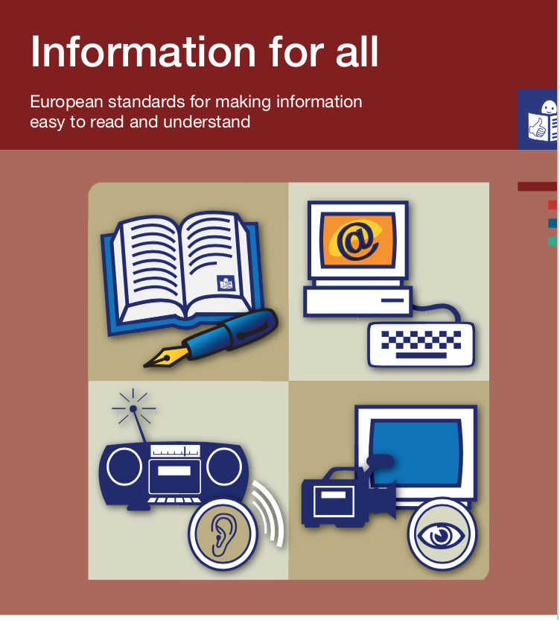

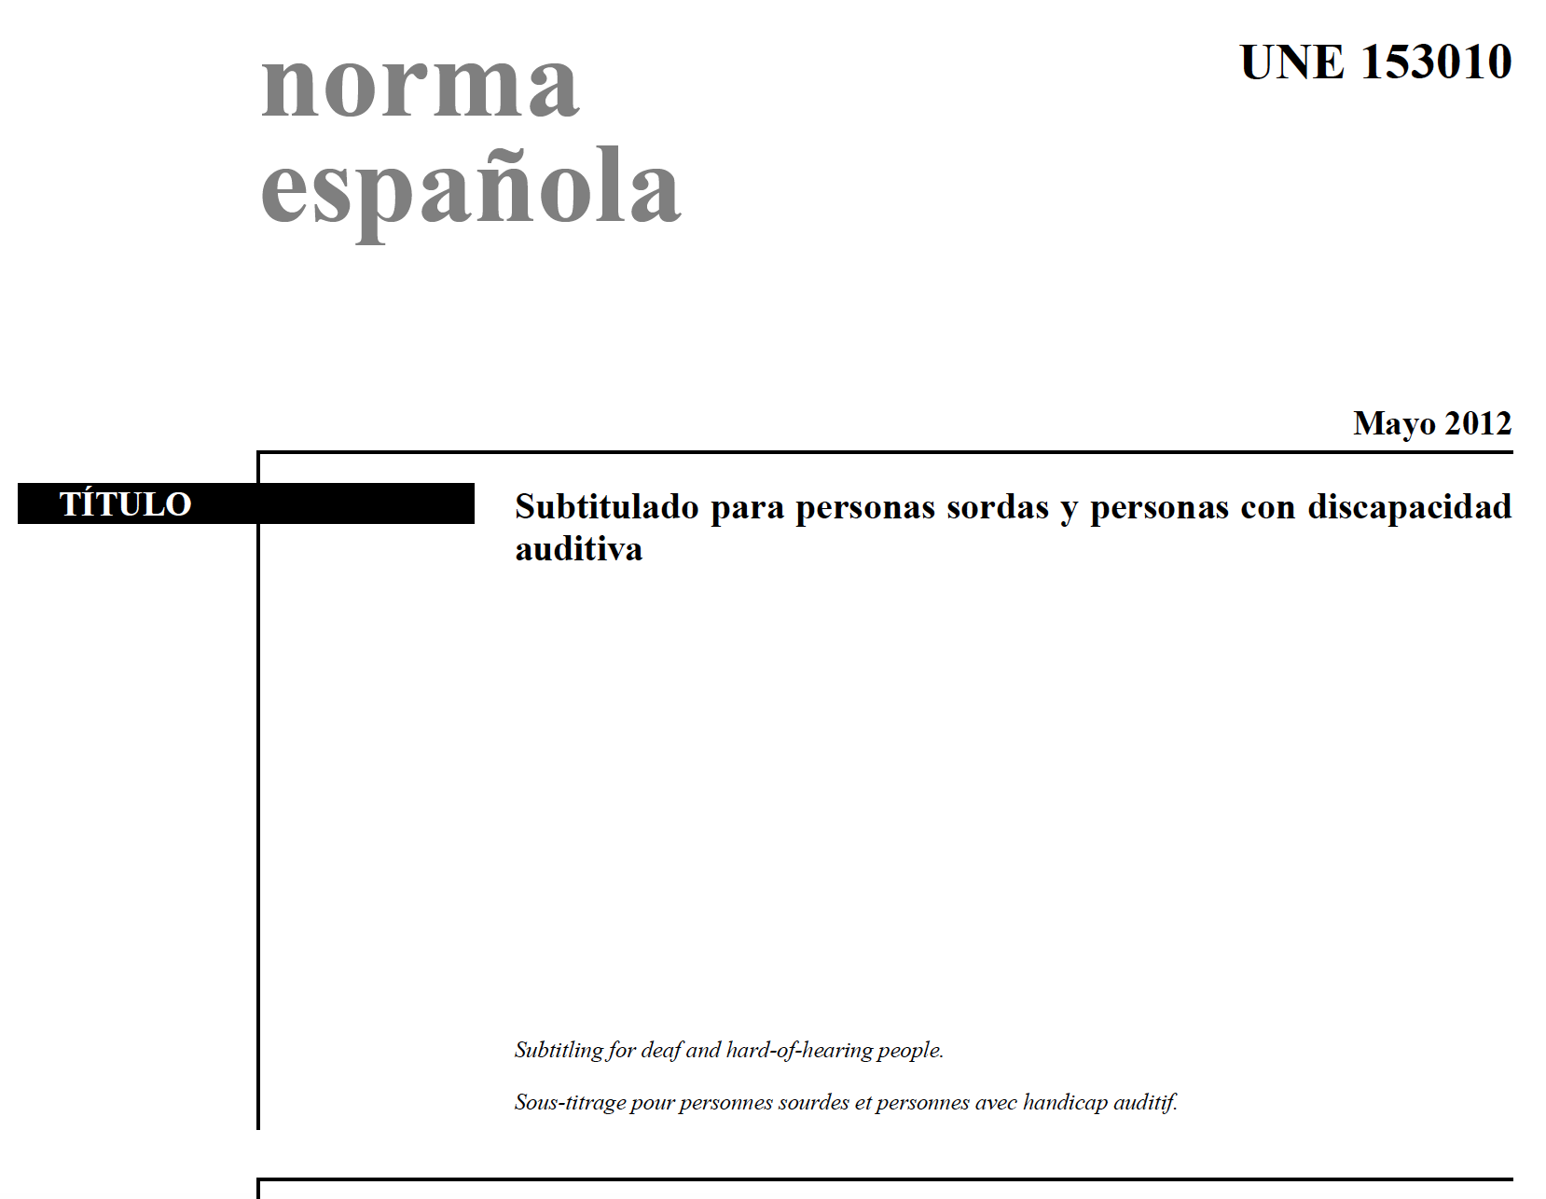

Guidelines
© Unknown author, CC BY

Slide 8
E2U audiences
often do not have a sensory impairment.
may not be familiar with some SDH subtitling conventions.
are familiar with E2R conventions.

Slide 9
Summary
Different simplification methods
Interlingual and intralingual.
SDH subtitling guidelines can help.

Slide 10

Prepared by: Rocío Bernabé (SDI München)
In collaboration with: Universidade de Vigo, Spain

Slide 11

Rocío Bernabé
rocio.bernabe@sdi-muenchen.de

Slide 12

Acknowledgement
The project EASIT has received funding from the European Commission under the Erasmus+ Strategic Partnerships for Higher Education programme, grant agreement 2018-1-ES01-KA203-05275.

Slide 13
Disclaimer
The European Commission support for the production of this publication does not constitute an endorsement of the contents, which reflect the views only of the authors, and the Commission cannot be held responsible for any use which may be made of the information contained therein.

Slide 14







Partners

Slide 15

EASIT
pagines.uab.cat/easit

