Slide 1


Visual presentation of E2U: images
Unit 2. Easy-to-understand language (E2U)
Element 5. Visual presentation of E2U
Sergio Hernández Garrido
Stiftung Universität Hildesheim

Slide 2
Overview
Use of images in E2U.

Slide 3
Comprehensibility enhancement through images
Images in E2U should have a purpose in the text.
Images should refer to the text’s content.

Slide 4
Purposes of images in E2U
Images should serve the following purposes:
Exemplifying.
Adding information.
Securing comprehensibility.
Summarizing information.

Slide 5
Images in E2U
The relation between images and text must be clear.
Comprehensibility is the most important principle of E2U.
Images that have only a decoration purpose should be avoided.

Slide 6
Images make abstract information visible
Images can help to make abstract information more visible.
Image itself should not be abstract.
Charts and diagrams are especially helpful for this purpose.

Slide 7
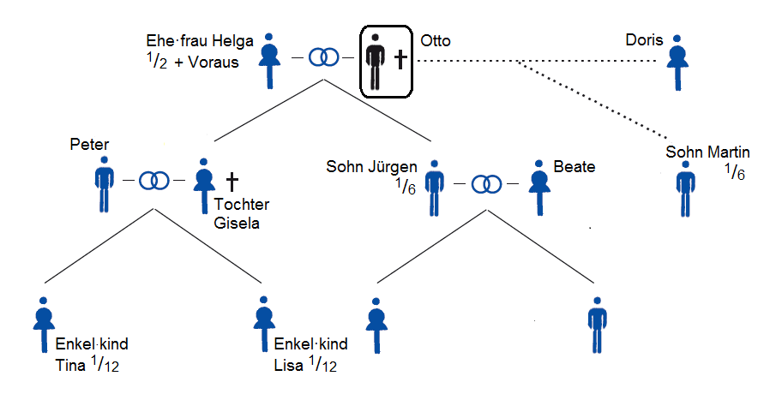
Images make abstract information visible – Example
Niedersächsisches Justizministerium 2015.

Slide 8
Acceptability enhancement through images
Images may increase acceptability, but they are also ambivalent.
Different parts of the target groups might react differently to the same type of imagery.

Slide 9
Research on the use of images in E2U
Further empirical research is needed.
Projects are currently underway.

Slide 10

Christiane Maaß and Sergio Hernández
easit@uni-hildesheim.de

Slide 11
Acknowledgement
The project EASIT has received funding from the European Commission under the Erasmus+ Strategic Partnerships for Higher Education programme, grant agreement 2018-1-ES01-KA203-05275.

Slide 12
Disclaimer
The European Commission support for the production of this publication does not constitute an endorsement of the contents, which reflect the views only of the authors, and the Commission cannot be held responsible for any use which may be made of the information contained therein.

Slide 13







Partners

Slide 14

EASIT
pagines.uab.cat/easit

