Slide 1
Discourse aspects of E2U
Unit 2. Easy-to-understand language (E2U)
Element 4. The language of E2U
Sergio Hernández Garrido
Stiftung Universität Hildesheim

Slide 2
Overview
Discourse level of E2U texts.
Intertextuality.
Presupposed knowledge.
Text types.

Slide 3
Intertextuality
Texts have intertextual relations with other texts.
Different forms of intertextuality:
Implicit or explicit reference to another text (citations).
Implicit or explicit reference to the whole text type (what to expect from a text?)

Slide 4
Text referring to other texts
Other texts have information that the readers have to know to understand the initial text.
Texts that presuppose knowledge from other texts are complex for readers to process.
Target groups of E2U usually do not have the reading experience to understand intertextual relations.

Slide 5
Intertextuality requires text experience
If intertextuality is presupposed, it is a hazard to comprehensibility.
Intertextuality in E2U: Indicate where the information is to be found and give summaries on the information.
Important information should be added directly to the E2U text.

Slide 6
Are the referred texts also in E2U?
Is the referred information in other texts also in E2U format?
Other texts may be written in standard or expert language. These texts are not accessible for the target groups.
→ Relevant information from other texts should be added directly into the E2U texts.

Slide 7
Intertextuality in online formats
Online texts are hypertexts.
Hypertexts bring intertextuality to another level.
Hypertexts open new ways to add information.
Hypertexts are not limited to what is seen on the screen.
Hypertexts represent a whole web of texts.
The content consists of many single texts that are linked.

Slide 8
Hypertexts and E2U (1)
New opportunities for the creation of E2U content.
The amount of information that has to be added to a single text can be shortened.
Additional information can be given in texts that are linked to the initial text.

Slide 9
Hypertexts and E2U (2)
Target groups have to know how links work.
Links should be explicitly introduced in the initial text.
Target groups have to be instructed that they can click on the link.
Information in the linked text should be comprehensible and perceptible for the target groups.

Slide 10
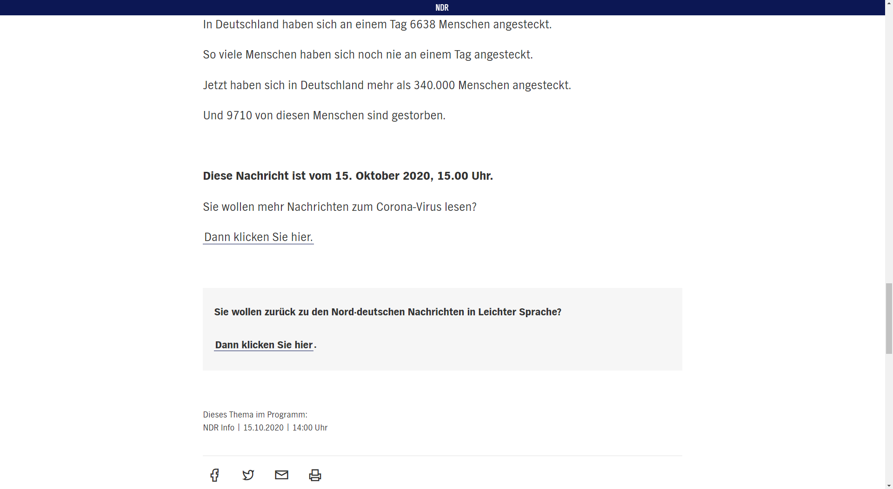
Hypertexts and E2U (3)
NDR.de (North German Broadcasting Association) 2020.

Slide 11
Considering previous knowledge
Which kind of previous knowledge can be expected from the target groups?
It is important to introduce additional information necessary for the target groups to understand the content.
Additions may regard content.
Additions may regard terminology.

Slide 12
Text type knowledge
Experienced readers can recognize at first glance which text type a text belongs to.
Readers have expectations on the content and functions of a text based on its text type.
This knowledge helps experienced readers to find the macroproposition of text and facilitates reading.

Slide 13
Text type knowledge and E2U
E2U target groups have a more restricted text type knowledge.
E2U readers need more information on the text type.
The text’s main points and its functionality have to be brought to the surface.
Example: Informative texts → Use of questions as subheadings.

Slide 14
Text type conventions
Target groups of E2U have some previous knowledge on many text types.
Maintaining some text type conventions of the original text.
E2U features make it sometimes difficult to keep text type conventions.

Slide 15
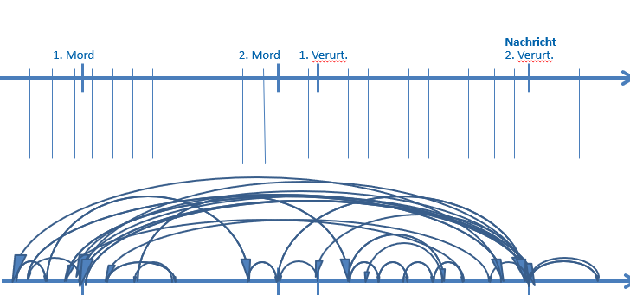
Text type conventions – Example (1)
Telling a story in chronological order enhances comprehensibility.
Usually, news text do not tell the story chronologically.
Forschungsstelle Leichte Sprache (Research Centre for Easy Language).

Slide 16
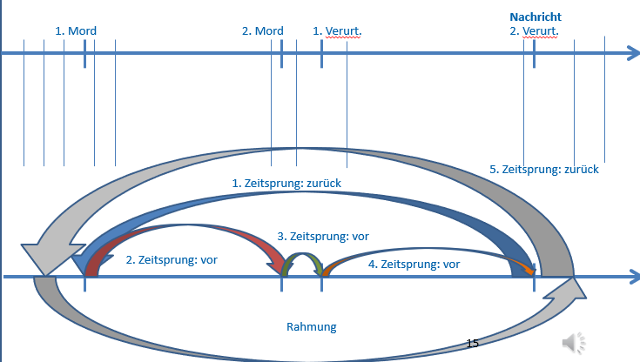
Text type conventions – Example (2)
A story in chronological order would be easier to understand.
This clashes with the text type conventions of a news text.
Forschungsstelle Leichte Sprache (Research Centre for Easy Language).

Slide 17
Text type conventions - Summary
It may not be possible to keep text type conventions completely.
Text type conventions should not be erased completely.
Bridging function of E2U: E2U texts building a bridge to the standards texts.

Slide 18
Christiane Maaß and Sergio Hernández
easit@uni-hildesheim.de

Slide 19
Acknowledgement
The project EASIT has received funding from the European Commission under the Erasmus+ Strategic Partnerships for Higher Education programme, grant agreement 2018-1-ES01-KA203-05275.

Slide 20
Disclaimer
The European Commission support for the production of this publication does not constitute an endorsement of the contents, which reflect the views only of the authors, and the Commission cannot be held responsible for any use which may be made of the information contained therein.

Slide 21
Partners

Slide 22
EASIT
pagines.uab.cat/easit

