Slide 1


Unit 2. Easy-to-understand language
Element 3. Processes
Validating
Tatjana Knapp
Zavod RISA

Slide 2
Overview
Validating: Is the content really Easy-to-understand?
A crucial process!
The process should actively include the end-users of Easy-to-understand information.

Slide 3


Marking the content
European logo:
A national logo (example):

Slide 4

1. Comprehensibility
The guidelines

Slide 5
2. Comprehension
Validators: People with different barriers to obtaining information who validate the information.
Facilitators: Coordinators of the validating process.
Not yet officially recognized professions (EU profession database, 2020).

Slide 6
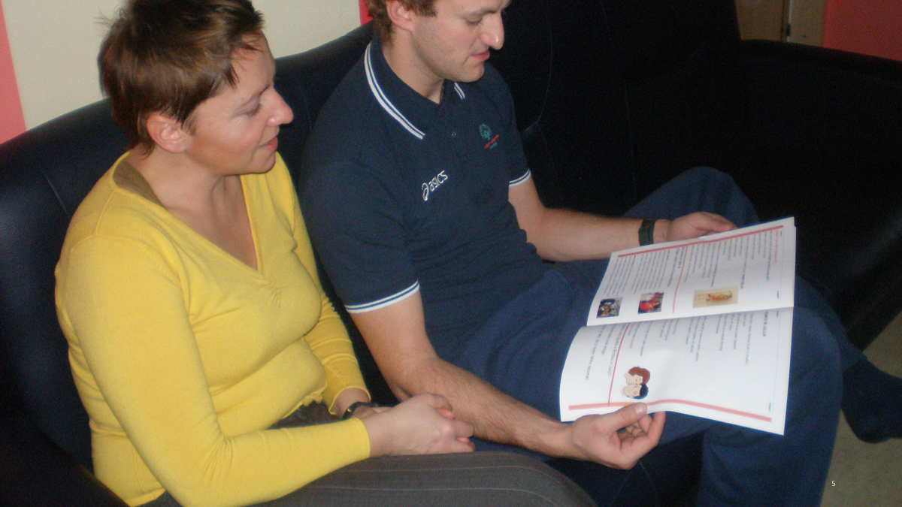
A facilitator and a validator

Slide 7
The profession recognition
European Project TRAIN2VALIDATE, 2020-2023.
Creation of new specific professional profiles in the process of production of easy-to-read materials (validators and facilitators.)
Website: www.plenainclusionmadrid.org/train2validate

Slide 8
The publishing process
Recommendation:
Inclusion of the end-users before, during and after the creation of the content.
Selecting the content
Producing the content
Promoting the content
validation

Slide 9
The baselines
Unharmonized methodologies in Europe (2020).
Basis: Inclusive methodology.
Core: Comprehension (language comprehension, picture comprehension, etc.).

Slide 10
Language comprehension
Involves analysis at different levels (word, sentence, message) and the integration of message meaning with the prior discourse and world knowledge.(Singer, 2013)
Similar can be applied to picture comprehension.

Slide 11
Validating comprehension
2 types: producing/adapting the content together (co-authoring) or working with drafts.
2 activities: facilitation and comprehension assessment.

Slide 12
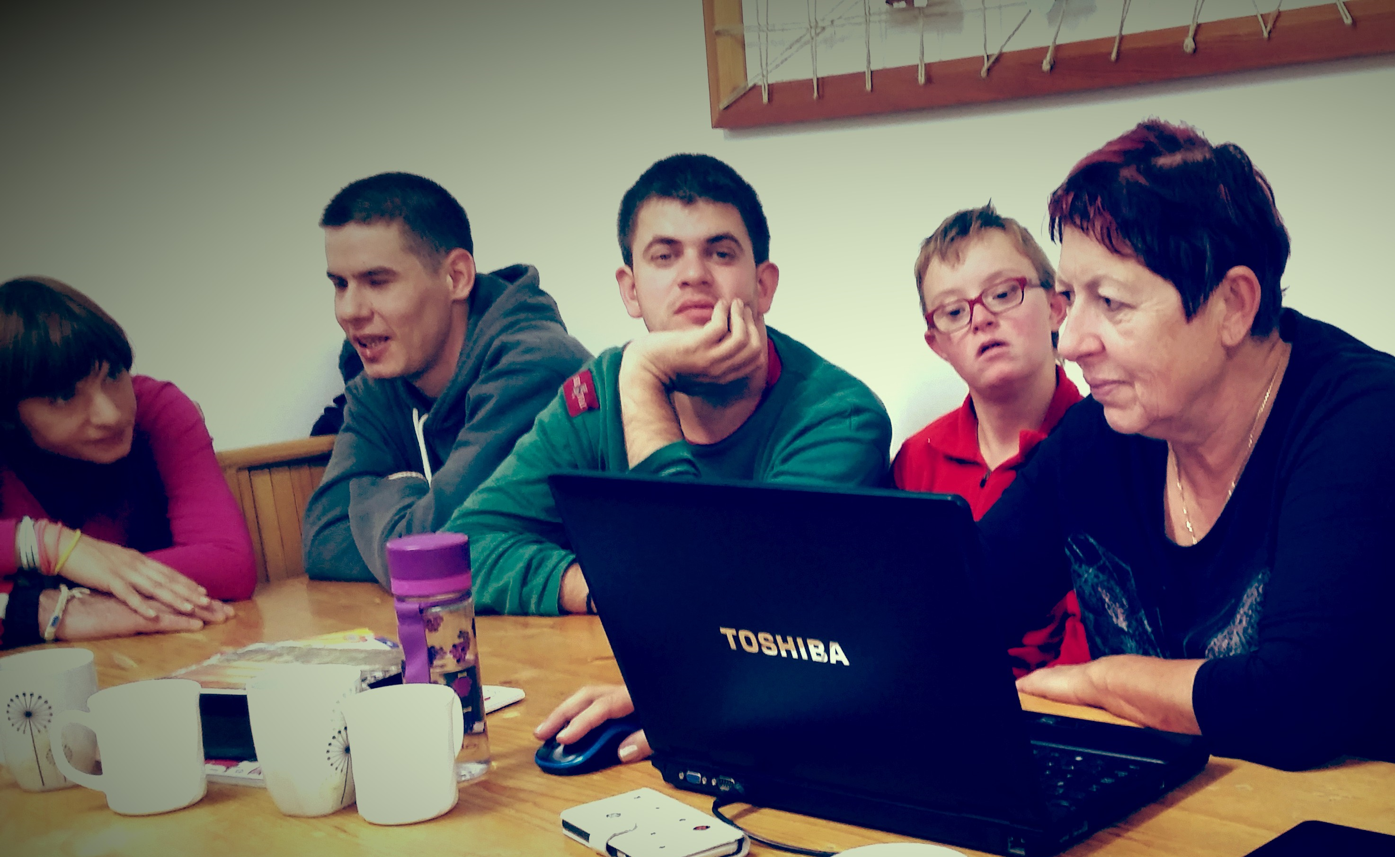
A group of end-users co-creating

Slide 13
Facilitation
Facilitator: Creating a group of validators (sometimes working with 1 validator).
Organizing and coordinating the validation sessions.
Communicating the content between authors (text, picture), editors and validators.

Slide 14
Comprehension assessment
The validators and the facilitator.
Analysing the information.
Giving feedback.

Slide 15
Communication!
The most important personal skill.
See Unit 4, Element 2: Communicating with validators and end-users

Slide 16
Examples (videos)
U2. E4. Sample
U3. E1. Sample: Validation
U4. E1. Validators: A true profession
U4. E2. Validation meeting: Interpersonal skills
U4. E2. Communicating with validators and end-users

Slide 17

Tatjana Knapp
tatjana@risa.si

Slide 18
Acknowledgement
The project EASIT has received funding from the European Commission under the Erasmus+ Strategic Partnerships for Higher Education programme, grant agreement 2018-1-ES01-KA203-05275.

Slide 19
Disclaimer
The European Commission support for the production of this publication does not constitute an endorsement of the contents, which reflect the views only of the authors, and the Commission cannot be held responsible for any use which may be made of the information contained therein.

Slide 20







Partners

Slide 21

EASIT
pagines.uab.cat/easit

