Slide 1
Creating contents in E2U
Unit 2. Easy-to-understand language (E2U)
Element 3. Processes
Christiane Maaß
Stiftung Universität Hildesheim

Slide 2
Overview
Process of creating content in E2U.
Examples of texts directly created in E2U.

Slide 3
Creating and adapting/translating
Creating content in E2U from scratch.
Adapting or translating into E2U.

Slide 4
Difference between creating and adapting/translating
Creating: There is not a source material.
Adapting/translating: There is a source material.

Slide 5
Guidelines of E2U
Focus lies on adapting/translating into E2U.
The linguistic and layout features of E2U are the same in both practices.
End product: Perceptible and comprehensible content for the target groups.

Slide 6
Important competences for creating content in E2U
Knowledge about the target groups.
Knowledge about the target situation.
Training in E2U.
Soft skills.

Slide 7
Knowledge about the target groups
Authors must have knowledge about the target groups and their communicative needs.
Basis for decisions on:
Easy or Plain Language.
Media realisation.
Content editing, etc.

Slide 8
Knowledge about the target situation
Authors must have knowledge about the target situation in which the content will be used.
Content must be retrievable in the target situation.

Slide 9
Training in E2U
Authors must know the rules of E2U.
Authors need training in implementing E2U rules.

Slide 10
Soft skills
Authors must know the communicative needs of the target groups and adapt the content accordingly.
Authors must behave professionally during the whole creating process.

Slide 11
Integrating E2U from the beginning (1)
Wider spectrum of opportunities.
More flexibility when it comes to planning the texts.
Linguistic and layout features can be taken care of during the production process.

Slide 12
Integrating E2U from the beginning (2)
EL and PL in audiovisual translation (Maaß/Hernández Garrido 2020):
Material can be directly scripted in EL or PL.
A component in EL or PL can be added to a content later on.

Slide 13
Integrating E2U from the beginning (3)
Integration of accessibility services during the production phase leads to a highly perceptible and accessible product.
→ “Accessible filmmaking” (Romero-Fresco 2019).

Slide 14
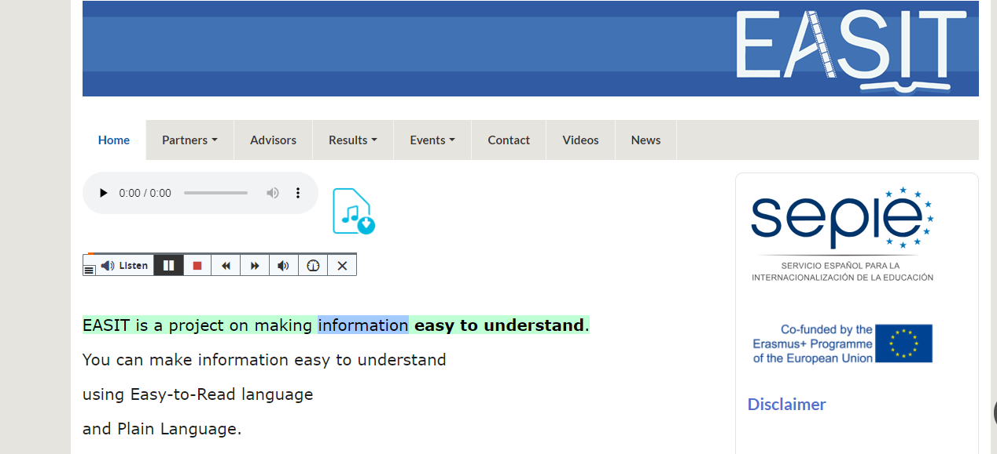
Example of creating content in E2U
EASIT homepage:
EASIT homepage site in English: https://pagines.uab.cat/easit/en.

Slide 15
Christiane Maaß and Sergio Hernández
easit@uni-hildesheim.de

Slide 16
Acknowledgement
The project EASIT has received funding from the European Commission under the Erasmus+ Strategic Partnerships for Higher Education programme, grant agreement 2018-1-ES01-KA203-05275.

Slide 17
Disclaimer
The European Commission support for the production of this publication does not constitute an endorsement of the contents, which reflect the views only of the authors, and the Commission cannot be held responsible for any use which may be made of the information contained therein.

Slide 18
Partners

Slide 19
EASIT
pagines.uab.cat/easit

