Slide 1
E2U language in Italy: Specificities, recommendations and guidelines
Unit 2. Easy to understand language (E2U)
Element 2. Legislation, standards, and guidelines
Elisa Perego
Università degli Studi di Trieste

Slide 2
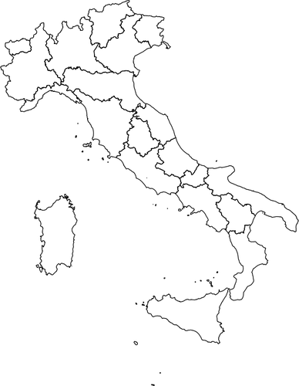
Overview
Linguistic specificities.
Examples.
Standards.
Guidelines.

Slide 3
Anffas ONLUS
“National Association of Families of Persons with Intellectual and/or Relational Disabilities” (anffas.net).
Participates in most activities linked to language simplification.

Slide 4
Inclusion Europe
Anffas.
European standards for making information easy to read and understand (2009). Italian translation: Informazioni per tutti. Linee guida europee per rendere l'informazione facile da leggere e da capire per tutti.

Slide 5
Inclusion Europe guidelines
Major step.
BUT: No language-specific recommendations.

Slide 6
Some principles
Cortelazzo and Pellegrino (2002)
(Cf. http://www.maldura.unipd.it/buro/gel/gel.html)
Sciumbata (2017)

Slide 7
Specificities (1)
Limit the use of:
subjunctive mode,
past and present participles,
impersonal forms,
Latin words or expressions.

Slide 8
Specificities (2)
Avoid the combination of the “d” consonant (d eufonica) with the conjunctions “e” (and) and “o” (or) preceding a vowel: E ora vs. Ed ora.

Slide 9
Specificities (3)
common and concrete words: ricordare, segnali
Vs.
formal and low-frequency or abstract items: rammentare, segnaletica

Slide 10
Specificities (4)
Assicurare (to ensure)
Pagare (to pay)
Vs.
Provvedere alla copertura assicurativa
Provvedere al pagamento

Slide 11
Specificities (5)
sfratto (eviction)
Vs.
provvedimento esecutivo di rilascio

Slide 12
Specificities (6)
Replace double negation (e.g. not unhappy) with single clear word (such as happy):
more straightforward,
easier.

Slide 13
Specificities (7)
Be direct!
No mild or indirect words rather than harsh, blunt, unpleasant words:
E.g. morire (to die) rather than venire a mancare / passare a miglior vita (to pass away).

Slide 14
Plain Language vs Easy Language
Such recommendations can be applied also to Plain Italian.
Easy Language and Plain Language are often mixed or used interchangeably, at least as far as Italian is concerned.

Slide 15
Pictures
Source: https://publicdomainvectors.org/
License: CC0 1.0

Slide 16
Credits
Prepared by: Elisa Perego (UNITS) Produced by: Martina Atzeri (UNITS)

Slide 17
Elisa Perego
eperego@units.it

Slide 18
Acknowledgement
The project EASIT has received funding from the European Commission under the Erasmus+ Strategic Partnerships for Higher Education programme, grant agreement 2018-1-ES01-KA203-05275.

Slide 19
Disclaimer
The European Commission support for the production of this publication does not constitute an endorsement of the contents, which reflect the views only of the authors, and the Commission cannot be held responsible for any use which may be made of the information contained therein.

Slide 20
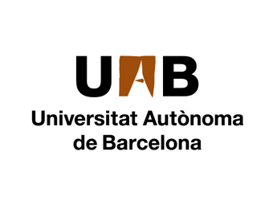
Partners

Slide 21
EASIT
pagines.uab.cat/easit

