Slide 1
Modalities and different forms of media realisation
Unit 2. Easy-to-understand language (E2U)
Element 1. Understanding E2U
Prof. Dr. Christiane Maaß
Stiftung Universität Hildesheim

Slide 2
Overview
Modalities.
Different forms of media realisations of E2U.
Focus on Easy Language, including Easy-to-Read, and Plain Language.

Slide 3
Definition of “modality”
Modality refers to the sensory channels that are addressed through a specific content:
Seeing.
Hearing.
Touch, etc.

Slide 4
Definition of “multimodality”
Multimodal texts are texts that address at least two sensory channels:
Audio-visual content:
Hearing.
Seeing.

Slide 5
E2U in written communication (1)
Easy and Plain Language traditionally focus on written communication.
English: Easy-to-Read.
Swedish: Lättläst (“easy reading”).
Spanish: lectura fácil (“easy reading”).

Slide 6
E2U in written communication (2)
Rulesets of E2U focus on written texts.
Current legislation focuses on written communication.

Slide 7
E2U in written communication (3)
Content in Easy and Plain Language has mainly been made in printed form and in written digital formats.
Texts written in E2U are an additional service to the standard.

Slide 8
Barriers of E2U in written communication (1)
Written texts in E2U are not enough for accessibility and inclusion:
Target groups of E2U tend not to have written texts as a preference.

Slide 9
Barriers of E2U in written communication (2)
Written texts in E2U are not enough for accessibility and inclusion:
Target groups of E2U tend not to have the Internet as a source for information.

Slide 10
Barriers of E2U in written communication (3)
Written texts in E2U are not enough for accessibility and inclusion:
Texts in E2U are often not very retrievable for the target groups.

Slide 11
Barriers of E2U in written communication (4)
Written texts in E2U are not enough for accessibility and inclusion:
Focussing on just written formats excludes the implementation of E2U in other media realisations.

Slide 12
E2U in other media realisations
Research and application of E2U has started looking into multimodal media realisations:
Audio-visual formats.

Slide 13
E2U in audio-visual formats (1)
Example: Fairy tale project of the Research Centre for Easy German and the North German Broadcasting Association.
Fairy tales translated into Easy German and sign language.

Slide 14
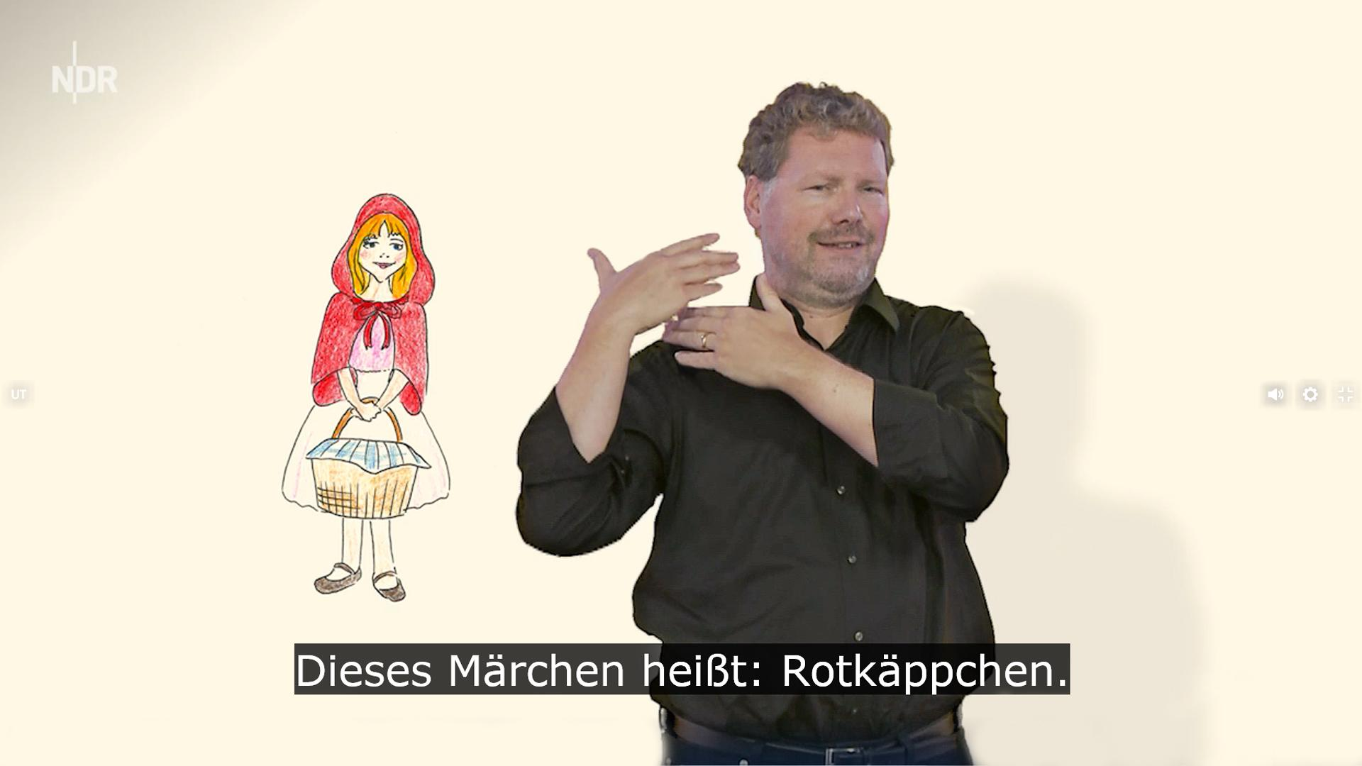
E2U in audio-visual formats (2)
Rotkäppchen. NDR Märchen in Leichter Sprache. © NDR.de

Slide 15
Interpretation into E2U
E2U is being used in interpreting scenarios:
In interpreting scenarios, Plain Language is rather used than Easy Language.

Slide 16
E2U in other media realisations
EASIT proposes the application of E2U in subtitling, audio description, and audio-visual news.
Research publications look into the possibilities of implementing E2U in other formats of audio-visual translation and accessible communication.

Slide 17
Christiane Maaß and Sergio Hernández
easit@uni-hildesheim.de

Slide 18
Acknowledgement
The project EASIT has received funding from the European Commission under the Erasmus+ Strategic Partnerships for Higher Education programme, grant agreement 2018-1-ES01-KA203-05275.

Slide 19
Disclaimer
The European Commission support for the production of this publication does not constitute an endorsement of the contents, which reflect the views only of the authors, and the Commission cannot be held responsible for any use which may be made of the information contained therein.

Slide 20
Partners

Slide 21
EASIT
pagines.uab.cat/easit

