Slide 1


Media accessibility services
Unit 1. Media accessibility
Element 4. What is media accessibility?
Anna Matamala
Universitat Autònoma de Barcelona

Slide 2
Overview
What are media accessibility services?
Focus on both traditional audiovisual content (two-dimensional, i.e. 2D) and on new audiovisual formats, such as virtual reality.

Slide 3
Audiovisual content
Audiovisual
Audio
Verbal
Non-verbal
Visual
Verbal
Non-verbal
An access service
is needed
when there is no access
to one of these components

Slide 4

Subtitles
Subtitles for the deaf
and hard-of-hearing (SDH): appropriate term?
Service
No access to the audio
Left: Image by DR Design
Right: Image by Jack Foley

Slide 5
Sign language
Service
No access to the audio
Image by DR Design
Subtitles for the deaf and hard-of-hearing (SDH), captionin

Slide 6
Audio description
No access to the images
Service
Image by DR Design

Slide 7
Touch tour & audio introduction
No access
to the images
in the performing arts
Touch tour
Service
+
Audio introduction
Image by DR Design

Slide 8
Translation
Translation through:
Dubbing
Voice-over
Subtitling
No access
to the language
Service

Slide 9
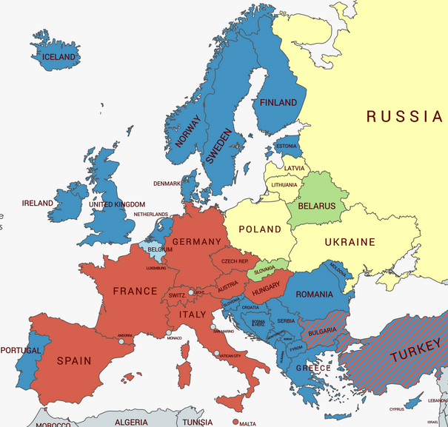
Audiovisual tradition in Europe
Dubbing
Voice-over
Subtitling
Mixed
Flemish: subtitles;
French: dubbing
Dubbing from other
countries
Image by MapChart

Slide 10

Audio subtitles
No access
to the language and the subtitles
Service
Image by DR Design

Slide 11
Audiovisual Translation & Media Accessibility
Audiovisual Translation | Media Accessibility
Dubbing Subtitling Sign language interpreting Voice-over | Subtitling for the deaf and hard-of-hearing (SDH) Audio description Sign language interpreting Audio subtitling

Slide 12
Accessibility & Translation
Translation:
audiovisual transfer modes
Accessibility: access services
Personalisation by the user

Slide 13

Anna Matamala
anna.matamala@uab.cat

Slide 14
Acknowledgement
The project EASIT has received funding from the European Commission under the Erasmus+ Strategic Partnerships for Higher Education programme, grant agreement 2018-1-ES01-KA203-05275.

Slide 15
Disclaimer
The European Commission support for the production of this publication does not constitute an endorsement of the contents, which reflect the views only of the authors, and the Commission cannot be held responsible for any use which may be made of the information contained therein.

Slide 16







Partners

Slide 17

EASIT
pagines.uab.cat/easit

