Slide 1


Understanding the audiovisual text
Unit 1. Media accessibility
Element 4. What is media accessibility?
Anna Matamala
Universitat Autònoma de Barcelona

Slide 2
Overview
Audiovisual texts and multimodality.

Slide 3


Text
Audio
Written
Multimodal
Audiovisual

Slide 4
Audiovisual text

Slide 5



Audiovisual text
Audio
Verbal
X
Visual
Non-verbal

Slide 6

Non-verbal sound elements
Diegetic or extradiegetic

Slide 7
Verbal sound elements
Main language or other languages

Slide 8
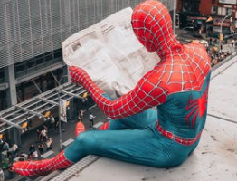
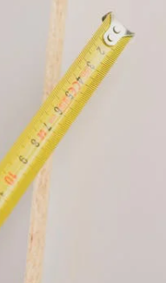
Non-verbal visual elements

Slide 9
Verbal visual elements
Text on screen not related to the plot
Text related to the plot
Diegetic or extradiegetic

Slide 10
Distribution of elements
Visual
Linguistic
Non-linguistic
Audio

Slide 11
Questions
Who?
When?
Why?
For whom?
What?
Where and how?
Stage?

Slide 12
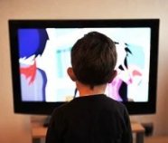
Multimodal text
A text combining more than one mode.
Examples:

Slide 13
Pictures
Source: pixabay.com, pexels.com.
License: Pixabay License, Pexels License.

Slide 14

Anna Matamala
anna.matamala@uab.cat

Slide 15
Acknowledgement
The project EASIT has received funding from the European Commission under the Erasmus+ Strategic Partnerships for Higher Education programme, grant agreement 2018-1-ES01-KA203-05275.

Slide 16
Disclaimer
The European Commission support for the production of this publication does not constitute an endorsement of the contents, which reflect the views only of the authors, and the Commission cannot be held responsible for any use which may be made of the information contained therein.

Slide 17






Partners

Slide 18

EASIT
pagines.uab.cat/easit

