Slide 1


Accessibility
Unit 1. Media accessibility
Element 2. What is accessibility?
Anna Matamala
Universitat Autònoma de Barcelona

Slide 2
Overview
The notion of accessibility and beyond.

Slide 3

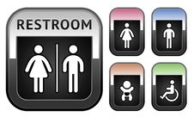
Reduced mobility

Slide 4




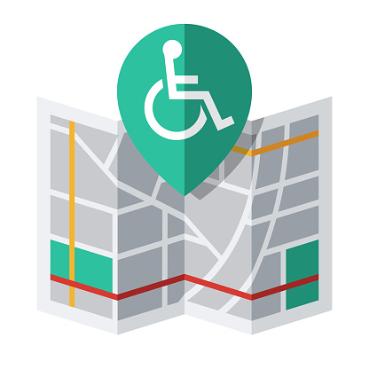




Access to all aspects of life

Slide 5
Types of accessibility
Audiovisual text
Written text
Physical
Cognitive
Sensorial
Web
Performing arts
Museum
Linguistic
Social

Slide 6
Different definitions
EN 17161:2019 standard
ISO/IEC TR 29156:2015
ISO 11620:2014

Slide 7
Universalist approach
Accessibility no longer considered to concern
exclusively or mainly specific groups
of persons with disabilities,
but all human beings.

Slide 8
Accessibility & usability
Usability:
“Extent to which a product can be used by specified users to achieve specified goals with effectiveness, efficiency and satisfaction in a specified context of use” (ISO 9241-11 standard)

Slide 9
Questions
From disability to capabilities
From accessibility to personalisation and customisation

Slide 10
Pictures
Source: pixabay.com, publicdomainvectors.org, stockfreeimages.com
License: Pixabay License, CC0

Slide 11

Anna Matamala
anna.matamala@uab.cat

Slide 12
Acknowledgement
The project EASIT has received funding from the European Commission under the Erasmus+ Strategic Partnerships for Higher Education programme, grant agreement 2018-1-ES01-KA203-05275.

Slide 13
Disclaimer
The European Commission support for the production of this publication does not constitute an endorsement of the contents, which reflect the views only of the authors, and the Commission cannot be held responsible for any use which may be made of the information contained therein.

Slide 14






Partners

Slide 15

EASIT
pagines.uab.cat/easit

