Slide 1
Human diversity
Unit 1. Media accessibility
Element 1. Human diversity
Anna Matamala
Universitat Autònoma de Barcelona

Slide 2
Overview
Concepts related to human diversity.

Slide 3
Human diversity
Factors:
Ethnicity
Culture
Marital status
Physical and mental capabilities
Gender
Political beliefs
First language
Religious beliefs
Sexual orientation
Age
Socio-economic status
National origin
Not fixed categories.

Slide 4
Diversity
Otaye-Ebede, Lilian & Akobo, Loyila. (2020) “Social and psychological perspectives on diversity”. In J. Syed & M. Ozbilgin (Eds.), Managing diversity and inclusion: An international perspective (2nd ed.). SAGE.

Slide 5
Definition of diversity
“a variety of visible and non-visible differences […]
inherent amongst individuals and groups”,
but “more emphasis given to social groups that have been historically subjected to discrimination”.

Slide 6
Stereotypes
Biased generalisations about a social group.

Slide 7
Prejudice
Negative emotion towards a social group.

Slide 8
Unconscious bias
Favouring those who share similar values over others who don’t without being aware of it.

Slide 9
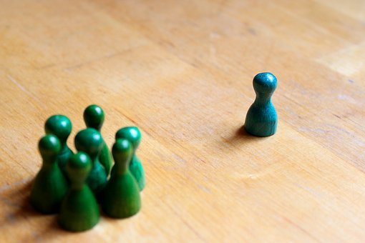
Discrimination
Treating people less favourably because they are linked to a particular group.

Slide 10
Universal Declaration of Humans Rights
Everyone is entitled to all the rights and freedoms.
No distinction shall be made.

Slide 11
UN Convention on the Rights of Persons with Disabilities
All discrimination on the basis of disability shall be prohibited.
Persons with disabilities are guaranteed equal and effective legal protection against discrimination.

Slide 12
Pictures
Source: pixabay.com, publicdomainvectors.org
License: Pixabay License, CC0

Slide 13
Anna Matamala
anna.matamala@uab.cat

Slide 14
Acknowledgement
The project EASIT has received funding from the European Commission under the Erasmus+ Strategic Partnerships for Higher Education programme, grant agreement 2018-1-ES01-KA203-05275.

Slide 15
Disclaimer
The European Commission support for the production of this publication does not constitute an endorsement of the contents, which reflect the views only of the authors, and the Commission cannot be held responsible for any use which may be made of the information contained therein.

Slide 16
Partners

Slide 17
EASIT
pagines.uab.cat/easit

