Slide 1



Factiva
Information resources in Economics, Business and Statistics
February 2025
Notes:
Imatge: https://ddd.uab.cat/record/195250/ CC-BY-SA

Slide 2
Factiva

Slide 3

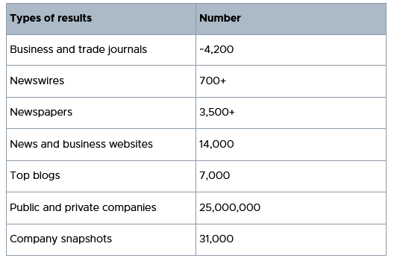
Types of documents
Notes:
Among the resources, I’d like to highlight…
~4,200 business and trade journals covering over 30 industries.
3,500+ newspapers, most offering same day content, and archival coverage of the world's most influential newspapers, including The Wall Street Journal, South China Morning Post, Les Echos, The Guardian, and Frankfurter Rundschau.
31,000 in-depth company snapshots

Slide 4
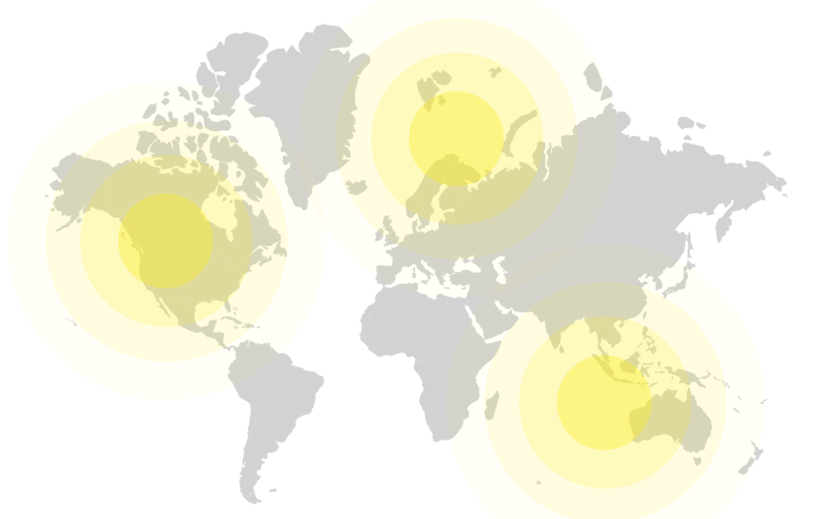
Content Scope
30,000 sources
200 countries
32 languages
Notes:
Db of multilingual content that cover…

Slide 5
Uses of Factiva
You can use Factiva to…
  Track industry developments and global market activity
  Monitor current news
  Monitor media and track brand coverage
  Research a global company
Notes:
Let’s 3 of the multiples uses of Factiva

Slide 6
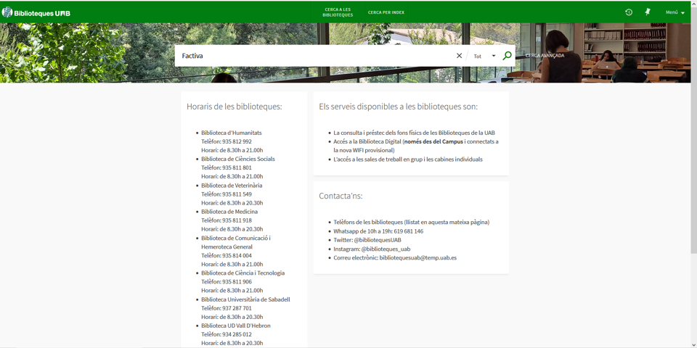
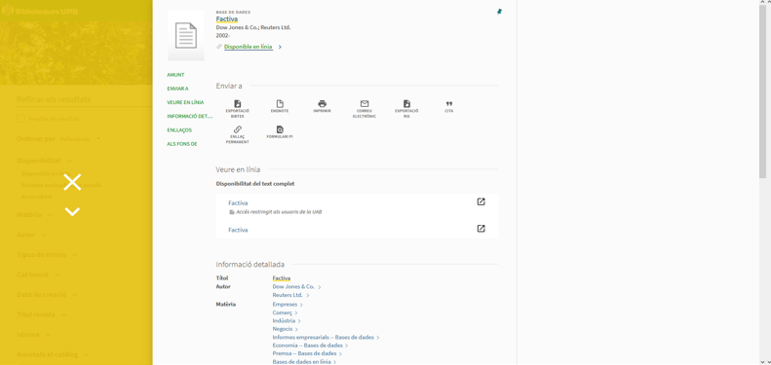

How to access Factiva
Notes:
To access Factiva, go to the Search Tool, write Factiva, and click the expression “Available on line”, and the “first arrow”

Slide 7

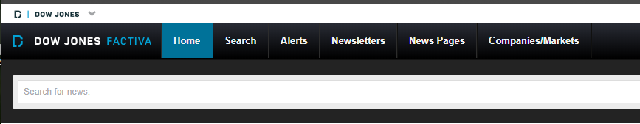

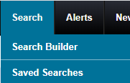

Home Page
Notes:
From the Home Menu, we find the basic search, that is google-alike
It is better to use the Search Builder, from the Search Drop Menu, the second way of searching by keyword

Slide 8
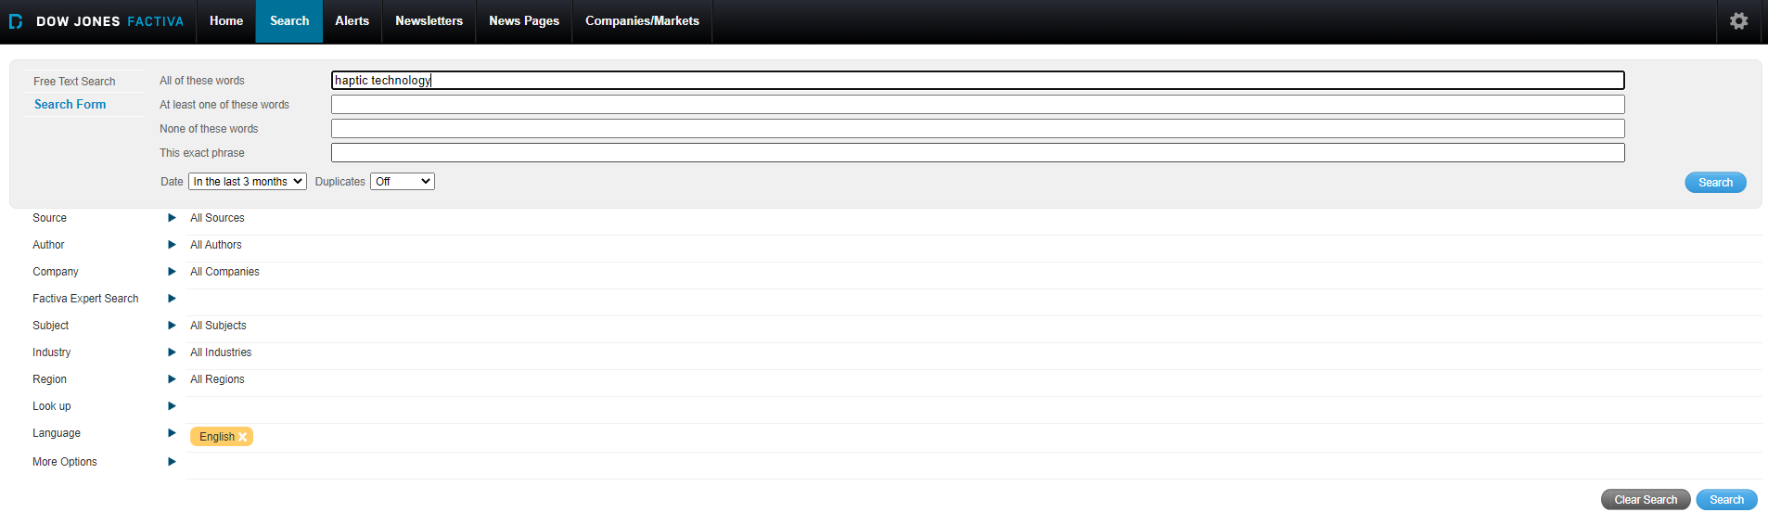

Search Builder
Notes:
Click the option Search form, and it will appear a drop menu
This is the best way to search information by keyword on any subject (except companies and industries) in the sources mentioned above
By default, the search is launched in all sources in the last 3 months and only news in English, but you can change all this criteria according to your needs

Slide 9
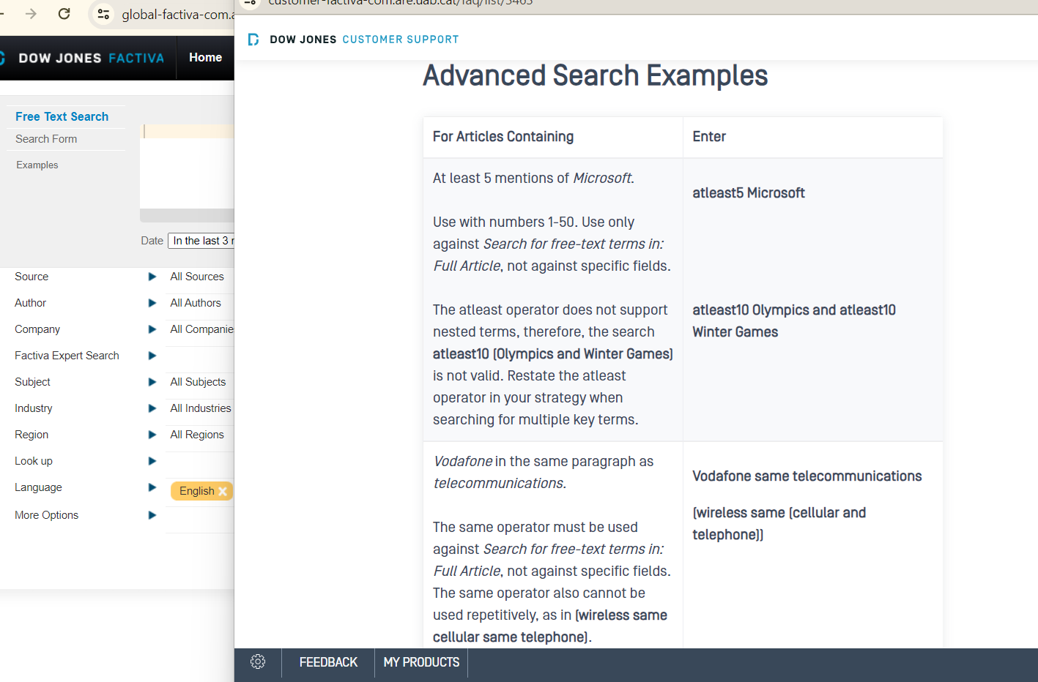
Search Builder
Notes:
Click the option Search form, and it will appear a drop menu
This is the best way to search information by keyword on any subject (except companies and industries) in the sources mentioned above
By default, the search is launched in all sources in the last 3 months and only news in English, but you can change all this criteria according to your needs

Slide 10
Advanced Operators of Factiva
and, or, nor, "", *
atleastN atleast5 volkswagen (1-50) (num of ocurrences)
same volkswagen same scandal (in the same paragraph)
adjN cup adj5 qatar 1-10 (close to, in the same order)
nearN nuclear near8 energy (in any order)1-500
/F50 Chatgpt/F50 in the first 50 words 1-500
Globali?ation ? = one character
Wc > 5000 more than 5000 words

Slide 11
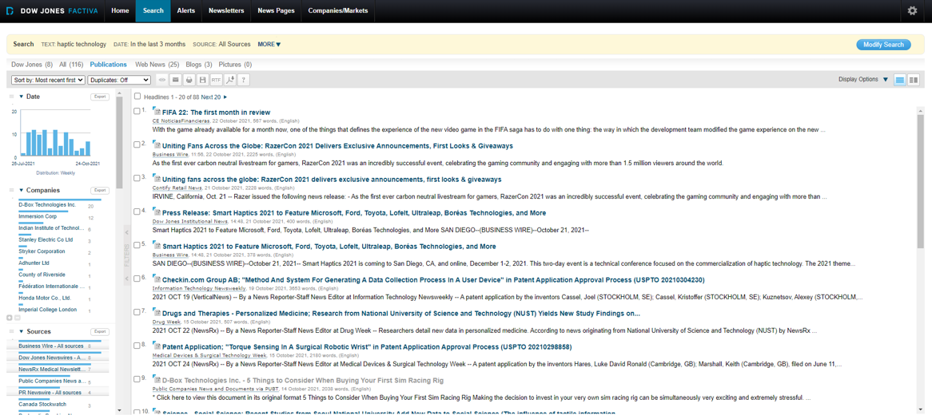
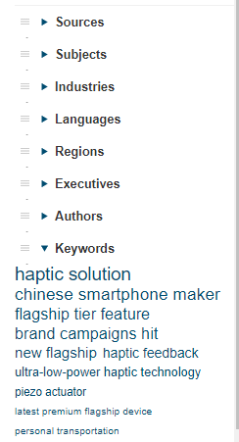

Page of Results
Notes:
Page of results:
Square: Number of results
Yellow box: search terms, limited to all publications, default to last three months,
Green box: output with the results selected (print, mail, download in pdf or rtf format)
2 columns: facets and companies in the left, articles in the right
So, that’s a quick way to find an overview of a top—articles in the middle, facets and companies on the left, etc.

Slide 12
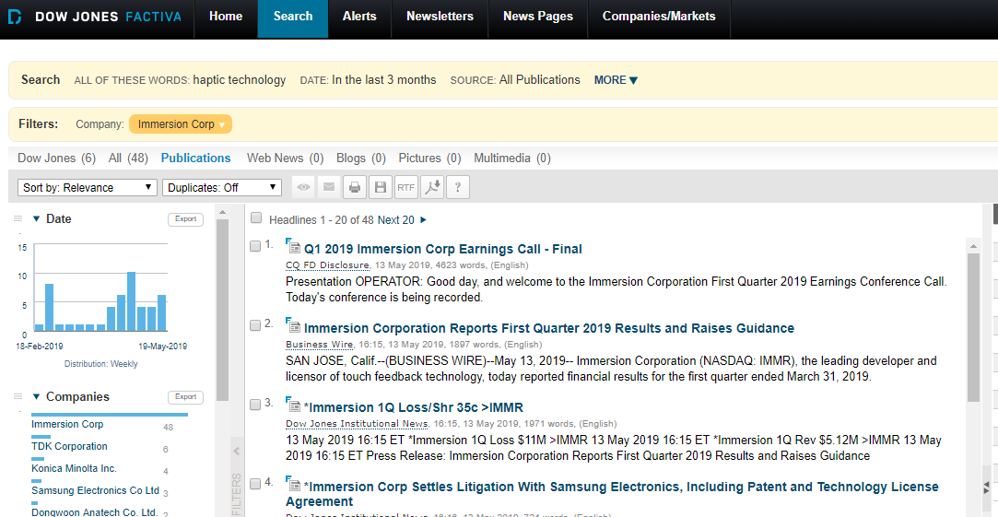

Narrowing your search
Notes:
Clicking on the facets will narrow the search even further

Slide 13

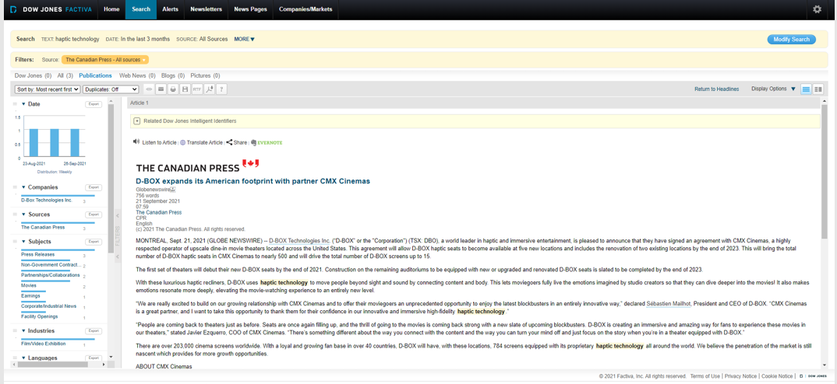
Document page: all in HTML, not in PDF
Notes:
In Factiva, you only can read the articles in HTML, not as it was published in PDF

Slide 14

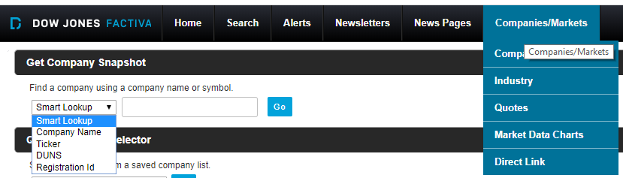
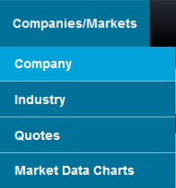

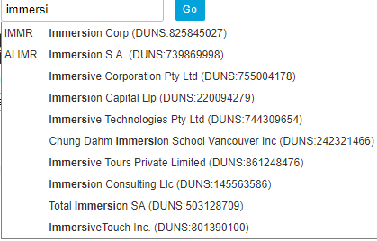
Company Search
Notes:
If you want to search on big companies there are quite a few options
In the company/Markets drop menu, if you choose the Company 1rs option, you can get a company snapshot
The dropdown In Smart Lookup helps give ticker and DUNS info along to help decide which company you are looking for

Slide 15

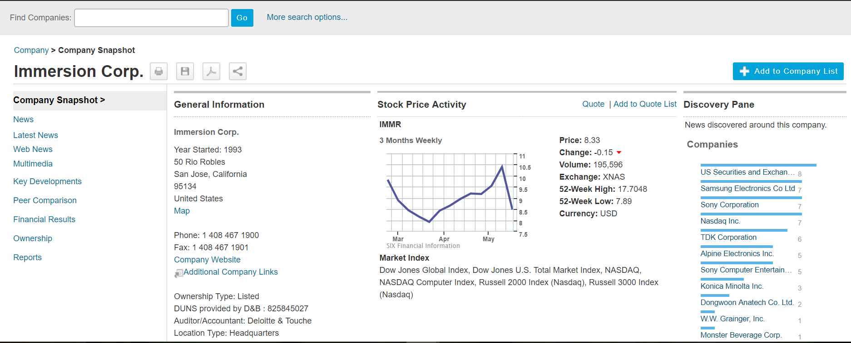



Company Snapshot
Notes:
Once you get the company you are searching, you access to the Company Snapshot (31,000 big companies)
There are 3 columns
Left: Sections News, Peer comparison, Financial results -imp tools for analysis-, and Company Reports
Center: Diff kind of general information
Right: News

Slide 16

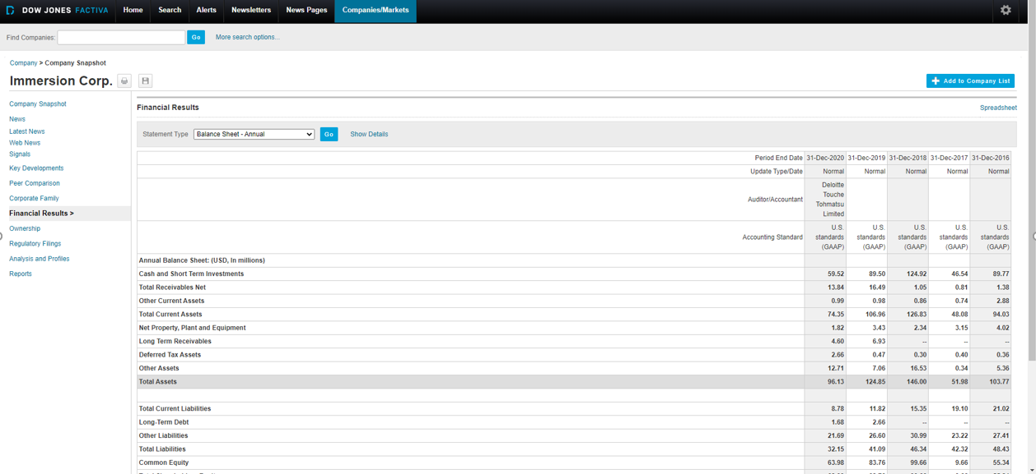
Financial Results of a company
Notes:
Here are the financial results of a company

Slide 17
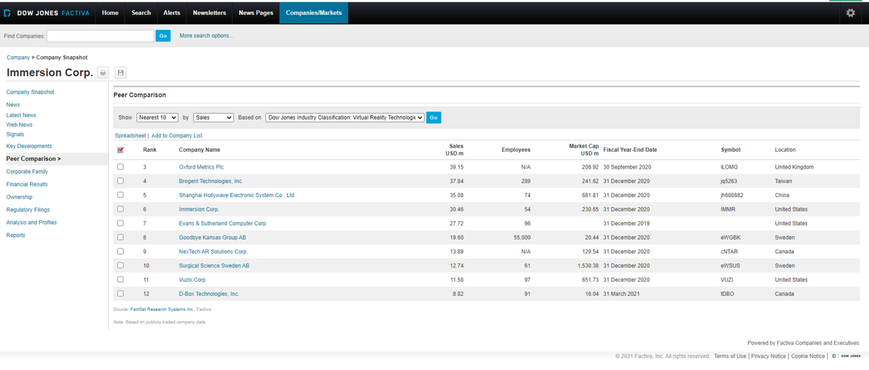

Peer comparison of a company
Notes:
Here are the peer comparison results of a company

Slide 18
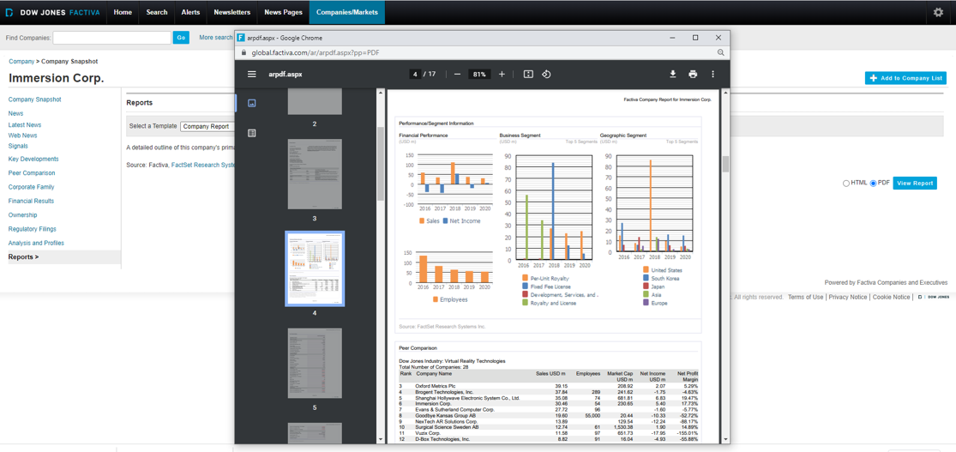

Company Report
Notes:
Here it is an example of a company report in pdf

Slide 19
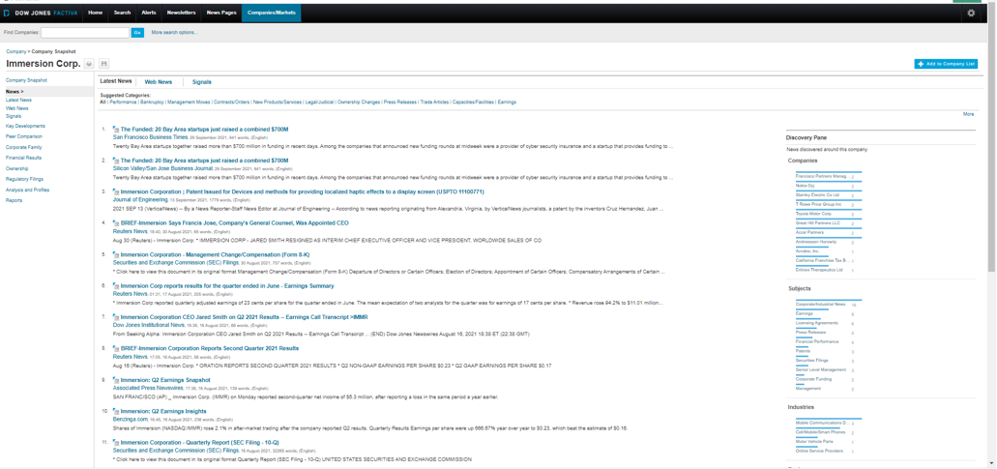



News about a company
Notes:
The best way to search news about a company is from the Company/markets menu and then through the news section

Slide 20
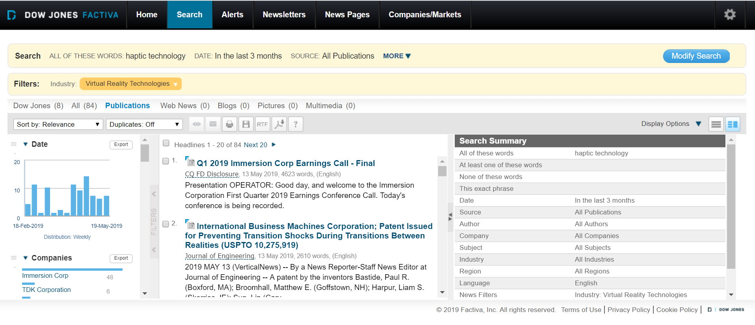
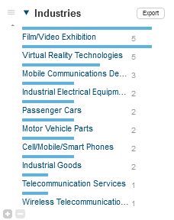


Two ways to get Industry Information
Notes:
From the original search, use the facet industry to get valuable industry information

Slide 21
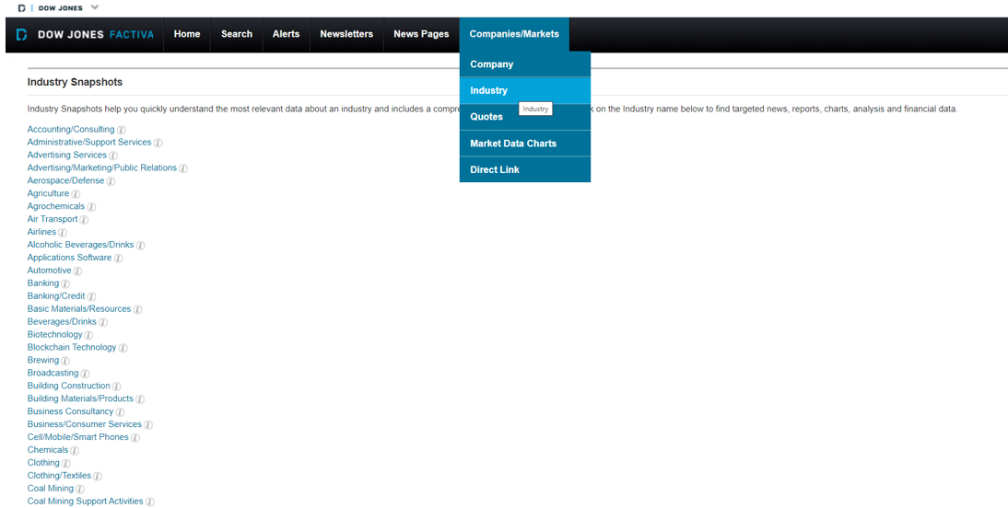

Industry Snapshot
Notes:
The Industry Snapshots can be found in the Companies/Markets section.
If you choose one, you access to the industry snapshot

Slide 22

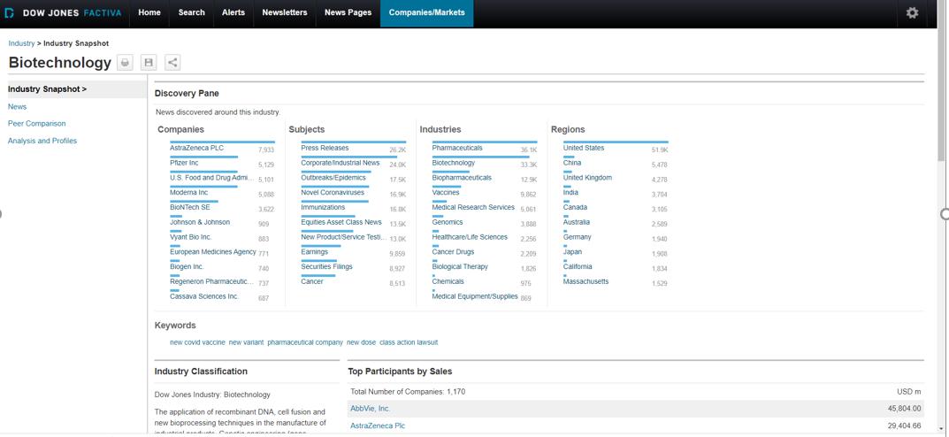

Industry Snapshot
Notes:
In each industry snapshot, you will find info about this industry: news, peer comparison, analysis and profiles (by reports)

Slide 23
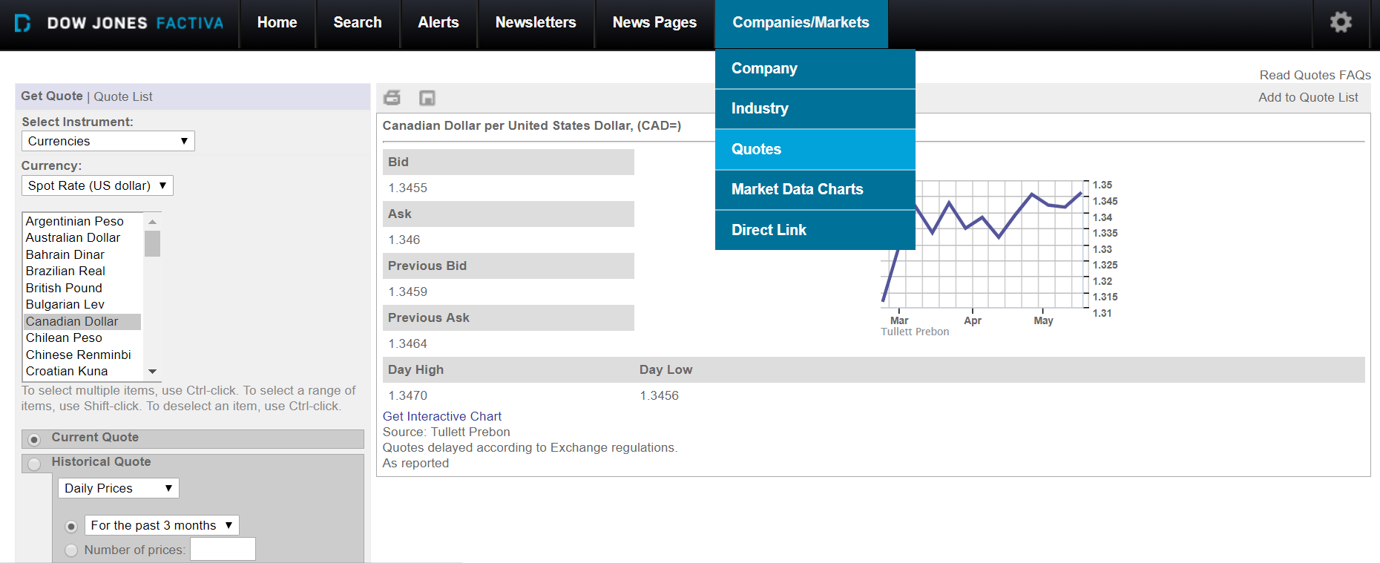
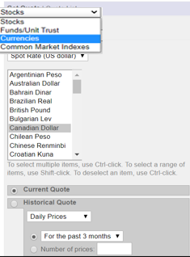


Quotes
Notes:
You can also search Current and historical stocks, funds, currencies and market indexes
This example shows a currency trend with ability to create interactive chart in a current situation

Slide 24
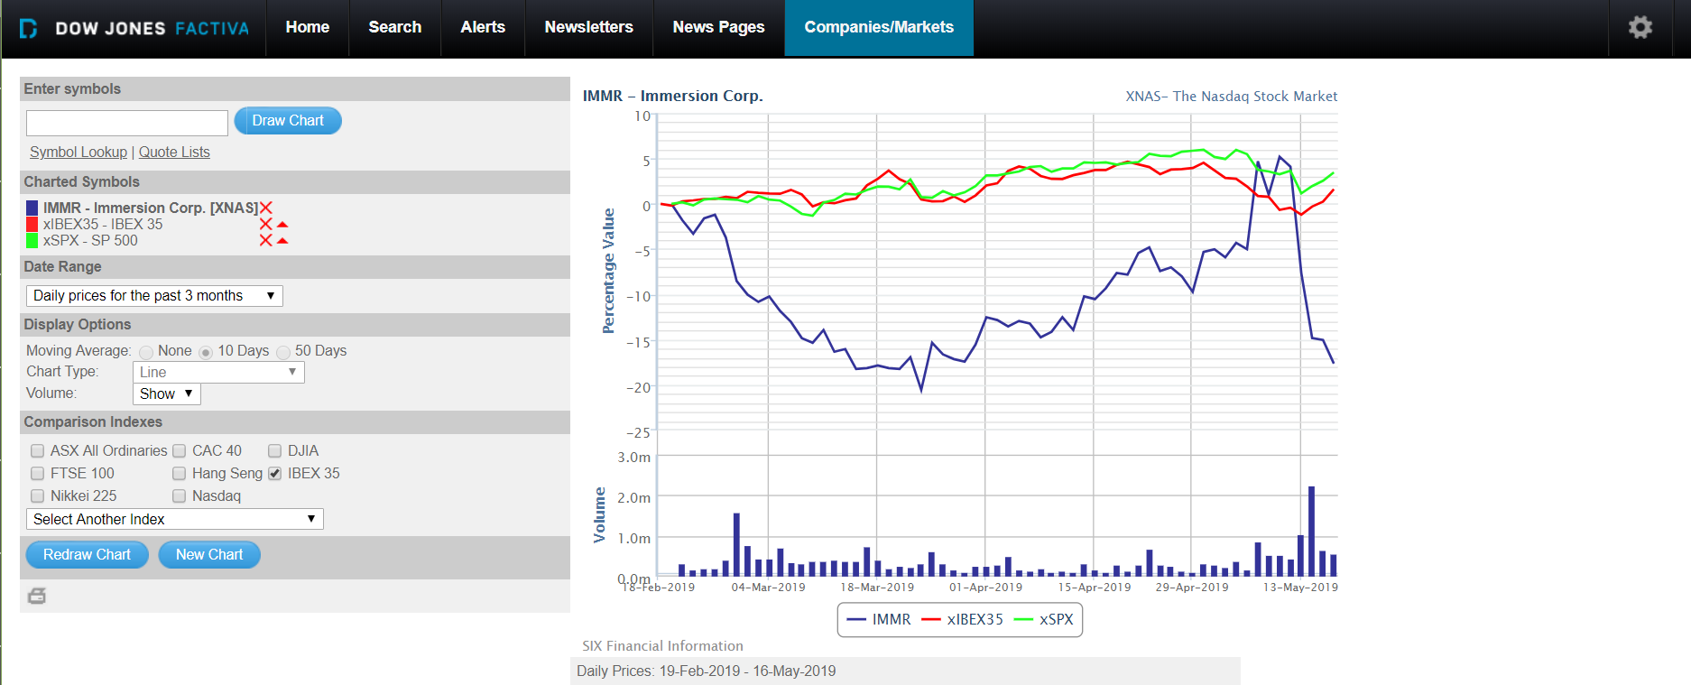

Example of a Stock Quote
Notes:
Interactive Stock quote for historical data on IMMR

Slide 25
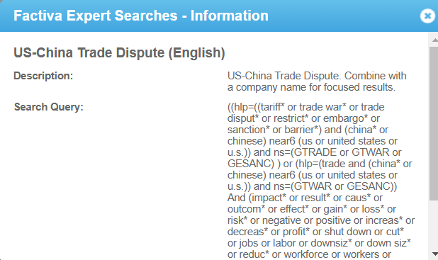
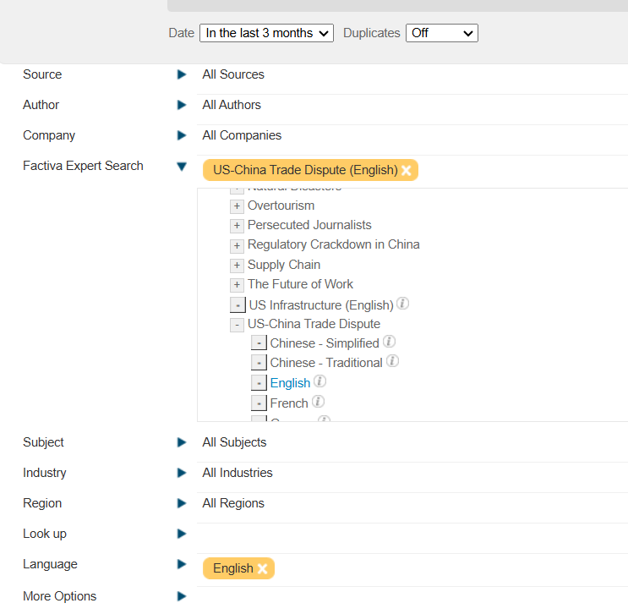

Factiva Expert Search
Notes:
From Search Builder page:
Choose Factiva Expert Search and you will get a hierarchical menu of complex pre-built search strategies for topics
If you clic in the icon “I” you can see the long query that is behind some of these searches

Slide 26
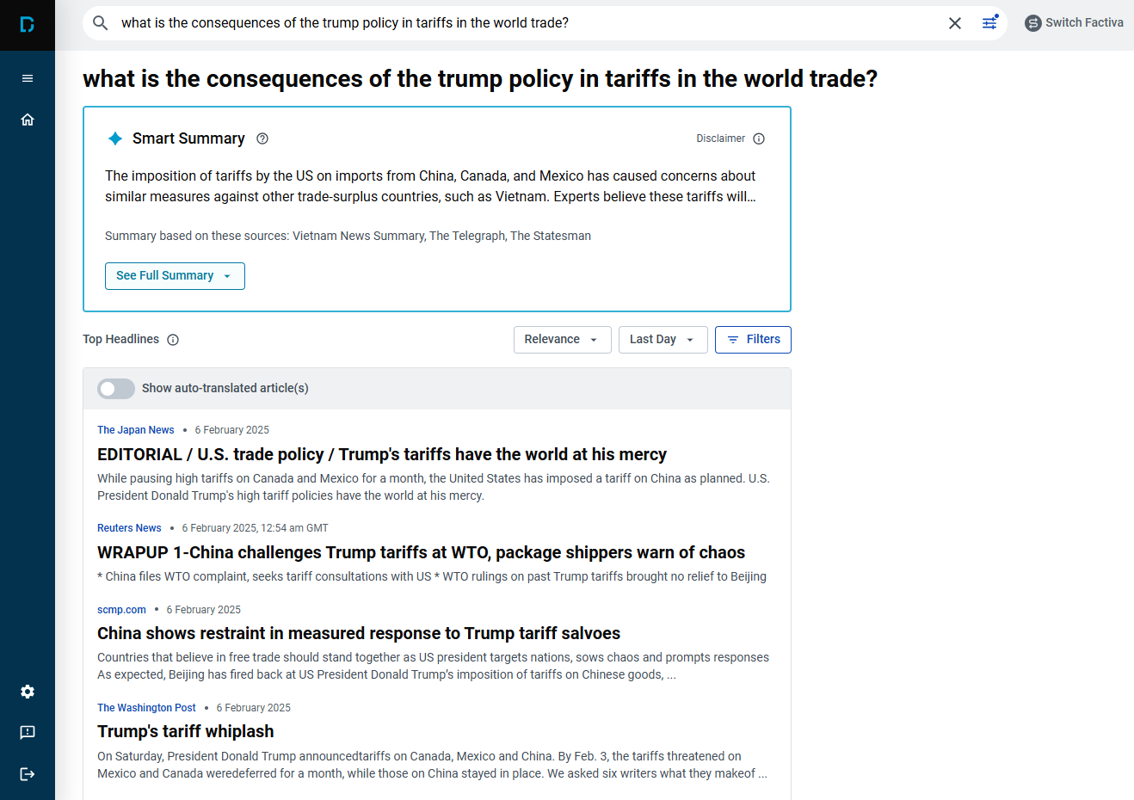

New User Interface: use of natural language
Cc-by-sa. Managed services with AI, by Deepak pal. Flickr
Notes:
Interactive Stock quote for historical data on IMMR

Slide 27


Use the LibGuide
https://proquest.libguides.com/factiva/about

Slide 28

Thanks!

