Slide 1






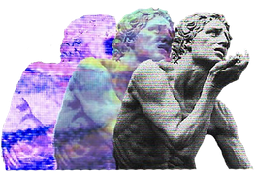
Canvas
EQgender: A cyberfeminist toolkit for online education
Authors: Paloma Sepúlveda-Parrini & Paloma Valdivia-Vizarreta
Institutional barriers and cultural resistance
Cyberfeminist utopias
Speculative design

