Slide 1
AUDIOVISUAL TEXTS
MODULE 1
UNIT 1
ALINE REMAEL
UNIVERSITY OF ANTWERP

Slide 2
Intuitively you all know what an audiovisual text is.

Slide 3
DEFINITION
Audiovisual texts or audiovisual productions:
make use of words, images and sounds to tell their story.

Slide 4
DEFINITION
They are composed of different modes (or sign systems) and therefore multimodal. They also use different communication channels.

Slide 5
MODES
the visual non-verbal mode: images,
the visual-verbal mode: text on screen,
the aural non-verbal mode: sounds and music,
the aural verbal mode: speech.

Slide 6
INTERACTION
Which mode is dominant and how the modes interact in any specific audiovisual text varies and is connected to film genre.

Slide 7
CHANNELS (1)
The different modes are transmitted through two channels:
the visual channel (the images) and the auditory channel (the sound track).

Slide 8
The visual channel conveys the:
visual-non-verbal mode or the images and action,
visual-verbal mode or text on screen.

Slide 9
The visual channel also conveys how this is filmed.

Slide 10
The auditory channel conveys:
speech (dialogues, voice-over etc.),
sounds, sound effects, music.

Slide 11
NOT JUST FILM
Other types of productions besides filmic ones often have audiovisual components too.

Slide 12
NOT JUST FILM
Examples are:
live events such as opera and theatre,
exhibitions, museums, …

Slide 13
WHY DO I NEED TO KNOW THIS?
The audio description (AD) for people with sight loss is added to these already complex productions.
The core AD audience has access only to the auditory channel.

Slide 14
A STILL FROM A FILM CLASSIC
A few stills from the opening scene from the film classic
The Snows of Kilimanjaro (King 1952).
Source: publicdomainmovie.net

Slide 15
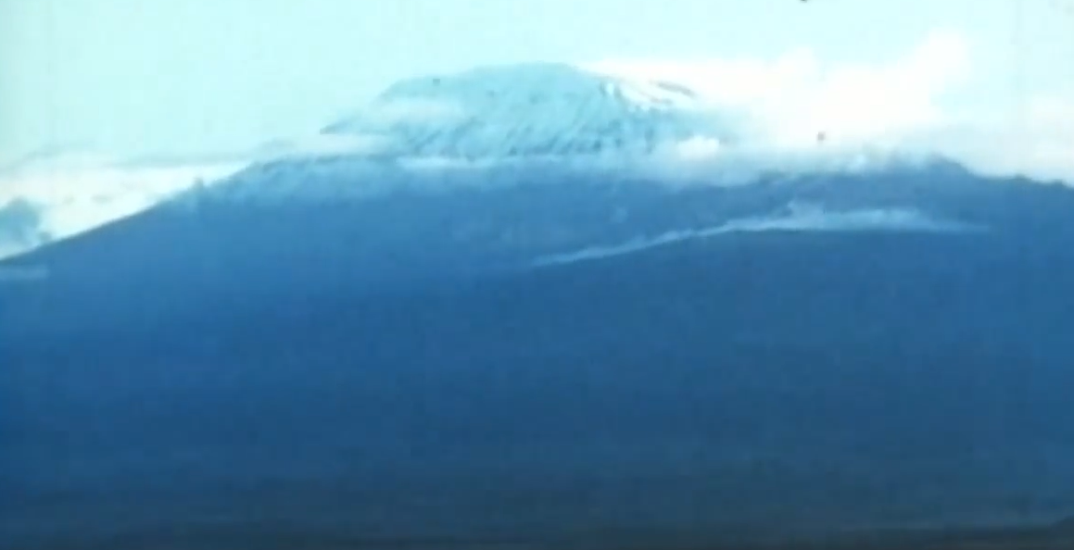
The opening shot of a snow-capped mountain with voice-over.

Slide 16
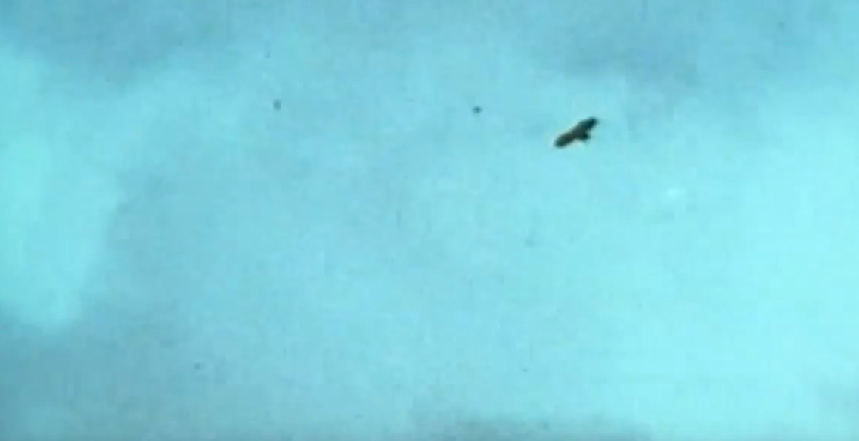
A subsequent shot shows large birds flying overhead to the accompaniment of menacing violin music.

Slide 17
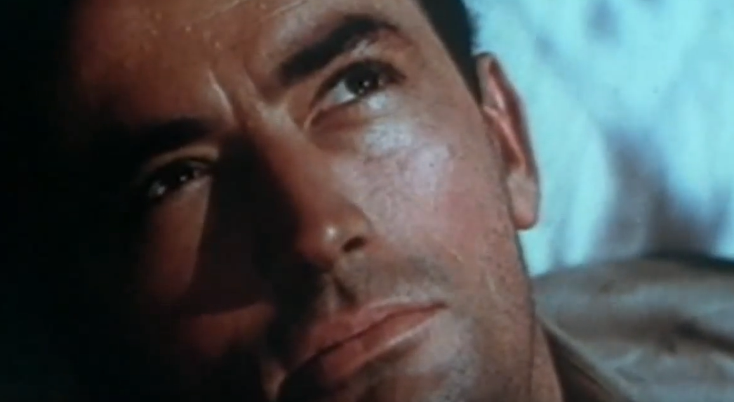
Shots of the birds alternate with close-up shots of a man who is watching them. The menacing music continues.

Slide 18
The voice-over identifies the mountain.
The music suggests the birds pose a threat and links this threat to the man watching them.

Slide 19
CONCLUSION 1
The visual and aural modes convey meaning in themselves and through their interaction.

Slide 20
CONCLUSION 2
Audiences who have access only to some of the modes, miss part of the story if there is no AD.

Slide 21
I hope you have learnt quite a bit about audiovisual texts.

Slide 22
READING
A classic you may like to read:
“Film Art. An Introduction” by Bordwell and Thompson (1979).

Slide 23
AUDIOVISUAL TEXTS
MODULE 1
UNIT 1
ALINE REMAEL
UNIVERSITY OF ANTWERP

Slide 24
The preparation of this presentation was supported by ADLAB PRO
(Audio Description: A Laboratory
for the Development of a New Professional Profile),
financed by the European Union
under the Erasmus+ Programme,
Key Action 2 – Strategic Partnerships,
Project number:2016-1-IT02-KA203-024311.

Slide 25
The information and views set out in this presentation
are those of the authors and do not necessarily reflect
the official opinion of the European Union.
Neither the European Union institutions and bodies
nor any person acting on their behalf may be held responsible for the use which may be made
of the information contained therein.

