Slide 1
Time and space in AD
Module 2
Unit 5
Agnieszka Chmiel
Adam mickiewicz university in poznan

Slide 2
When and where?

Slide 3
Organisation of information
GENERAL → DETAILS

Slide 4
A forest. (Obława)
In a bar. (Uwikłanie)
A monolithic town. (A girl with the dragon tattoo)

Slide 5
In the publishing house. (Rewers)
At night in the manor house. (Ranczo)
The terracotta and sandy-coloured spires and domes of Oxford. (Brideshead revisited)

Slide 6
A morning in the forest. Silvery frost covers the ground and tree branches. (Listy do M.)

Slide 8
Function of settings
Background to the action (a police station).

Slide 9
Function of settings
Symbol of power (castle).

Slide 10
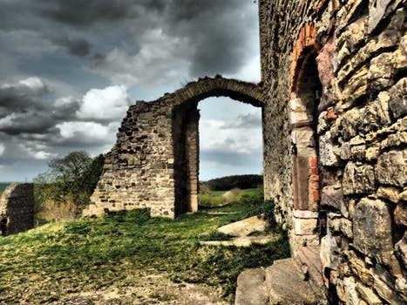
Function of settings
Symbol of downfall (dilapidated castle).

Slide 11
Temporal relations
Linear plot vs. non-chronological order of events.
Flashbacks and flashforwards.

Slide 12
Temporal relations
Principle of continuity.
If broken – indicate change in the AD.

Slide 13
Modern times. Sabina leans on her stick as she walks around the arrivals hall. It’s the fifties again. (Rewers)

Slide 14
flashbacks
She remembers seeing the tree frozen. (Ice Age 2)
The same tree comes back in her winter time memories. (Epoka lodowcowa 2)

Slide 15
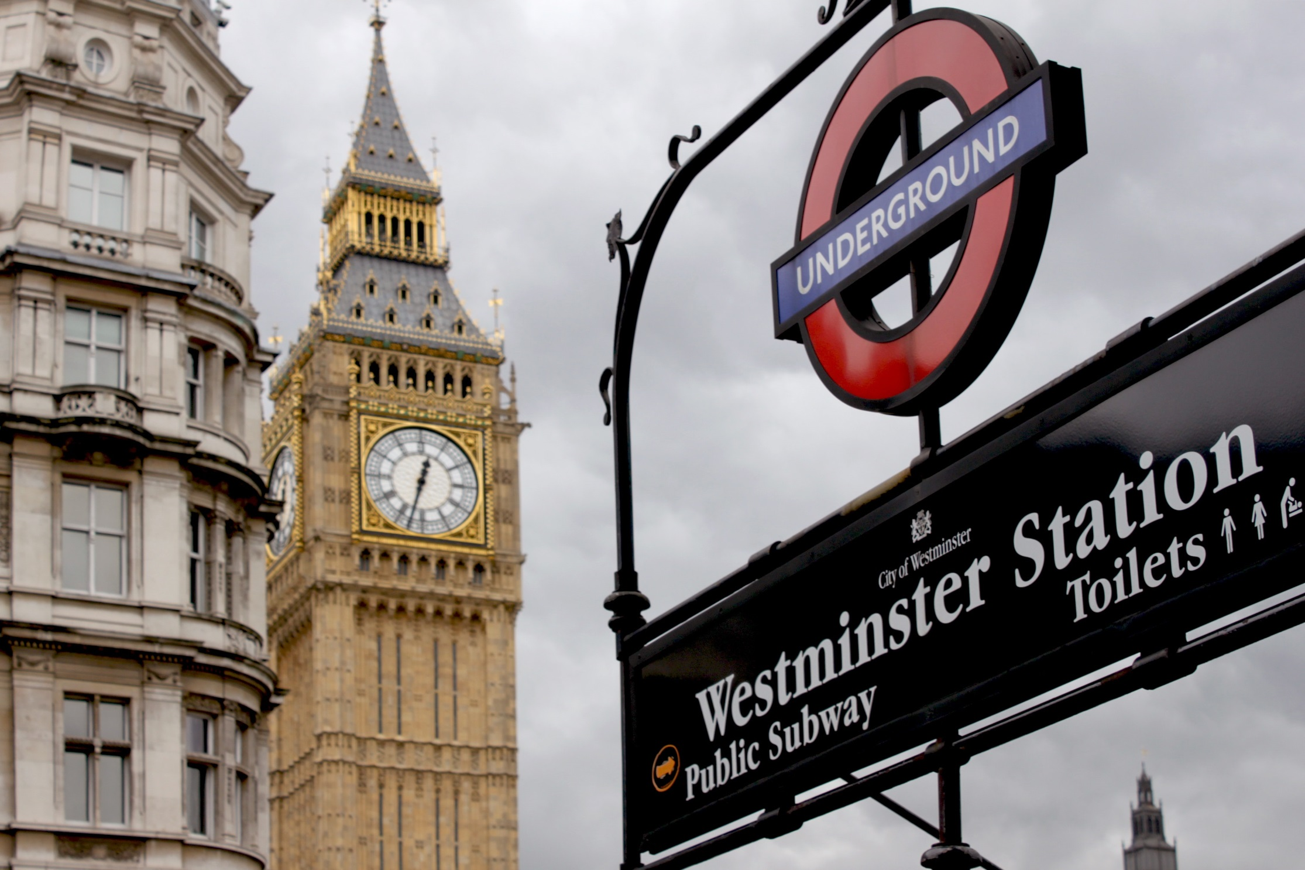
Settings = characters
The Hours:
Virginia Woolf, London, 1920s.

Slide 16
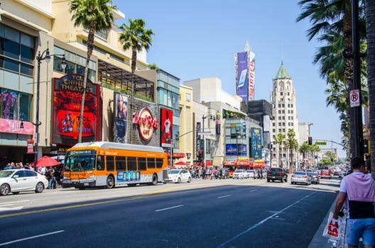
Settings = characters
The Hours:
Laura, Los Angeles, 1951.

Slide 17
Settings = characters
The Hours:
Clarissa, New York, 2001.

Slide 18
Familiar vs. unfamiliar settings

Slide 19
references
Remael, A., Reviers, N., Vercauteren, G. (2015) Pictures painted in Words. ADLAB Audio Description guidelines. Trieste: EUT, www.adlabproject.eu/Docs/adlab%20book/index.html

Slide 20
Time and space in ad
Module 2
Unit 5
Agnieszka chmiel
Adam mickiewicz university in Poznan

Slide 21
The preparation of this presentation was supported by ADLAB PRO
(Audio Description: A Laboratory
for the Development of a New Professional Profile),
financed by the European Union
under the Erasmus+ Programme,
Key Action 2 – Strategic Partnerships,
Project number:2016-1-IT02-KA203-024311.

Slide 22
The information and views set out in this presentation
are those of the authors and do not necessarily reflect
the official opinion of the European Union.
Neither the European Union institutions and bodies
nor any person acting on their behalf may be held responsible for the use which may be made
of the information contained therein.

