Slide 1
Screen ad: culture
Module 2
Unit 6
Iwona mazur
Adam mickiewicz university in poznan

Slide 2
Culture in films
Cultural references (culture-specific items, culturemes).
Intertextual references.

Slide 3
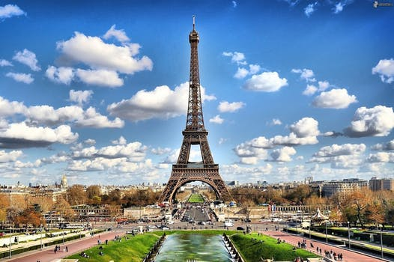
Typology
Geographical.
Ethnographic.
Socio-political.
(Remael and Díaz Cintas 2007)

Slide 4
intertextuality

Slide 5
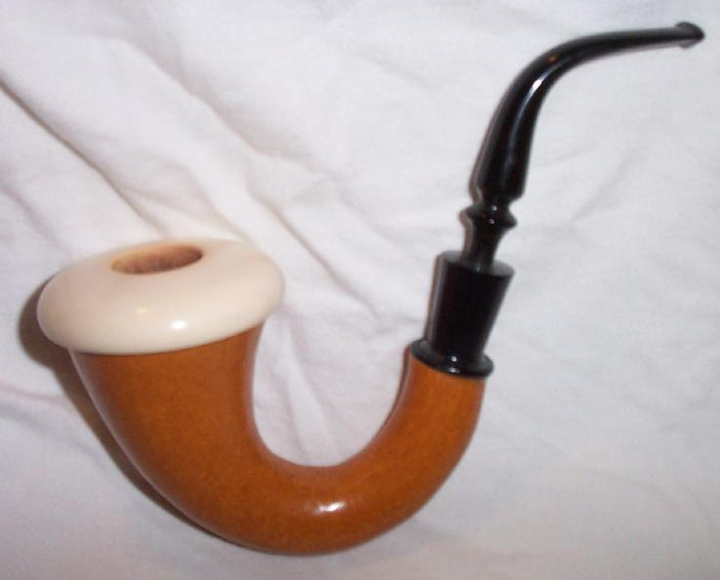
Source: pl.wikipedia.org

Slide 6
“Landa smokes a Sherlock Holmes-style calabash.”

Slide 7
“Landa smokes a big, saxophone-shaped pipe.”

Slide 8
channels

Slide 9
aural → no ad

Slide 10
Visual → ad

Slide 11
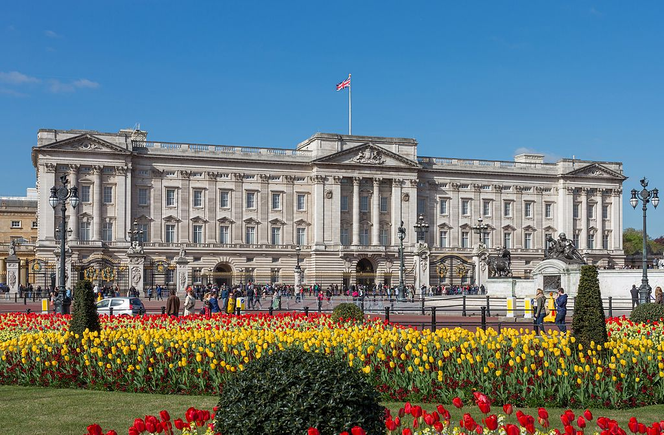
Source: en.wikipedia.org

Slide 12
“Buckingham Palace” (name)

Slide 13
“The official London residence of the Queen, Buckingham Palace” (gloss + name)

Slide 14
“A grand building” (generalisation)

Slide 15
Describe or describe + name.

Slide 16
Influencing parameters
Time.
Importance.
Assumed knowledge of the audience.

Slide 17
Cultural distance

Slide 18
The British → name

Slide 19
Foreigners → explain

Slide 20
transCulturality

Slide 21
Globalization → less cultural distance

Slide 22
references
Remael, A., Reviers, N., & Vercauteren, G. (2015). Pictures painted in words. ADLAB Audio Description guidelines. Trieste: EUT. Retrieved from www.adlabproject.eu/Docs/adlab%20book/index.html

Slide 23
references
Szarkowska, A. & Jankowska, A. (2015). Audio describing foreign films. The Journal of Specialised Translation, 23, 243-269.

Slide 24
Screen ad: culture
Module 2
Unit 6
Iwona mazur
Adam mickiewicz university in poznan

Slide 25
The preparation of this presentation was supported by ADLAB PRO
(Audio Description: A Laboratory
for the Development of a New Professional Profile),
financed by the European Union
under the Erasmus+ Programme,
Key Action 2 – Strategic Partnerships,
Project number:2016-1-IT02-KA203-024311.

Slide 26
The information and views set out in this presentation
are those of the authors and do not necessarily reflect
the official opinion of the European Union.
Neither the European Union institutions and bodies
nor any person acting on their behalf may be held responsible for the use which may be made
of the information contained therein.

