Slide 1
language
Module 2
Unit 7
Agnieszka Chmiel
Adam mickiewicz university in poznan

Slide 2
Words = images

Slide 3
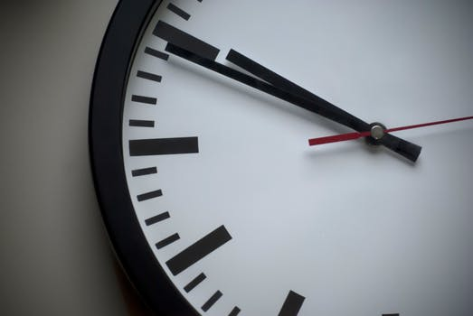
language
Brief.
Descriptive.

Slide 4
“We see…”
”In front of us...”

Slide 5
Specific vocabulary

Slide 6
nouns
dog
dachshund

Slide 7
nouns
sweater
turtleneck

Slide 8
verbs
walks
skips
marches

Slide 10
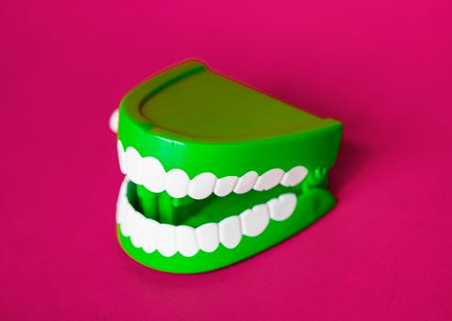
adverbs
smile widely
grin

Slide 11
adverbs
characteristically
appropriately

Slide 12
syntax
simple present tense
short sentences

Slide 13
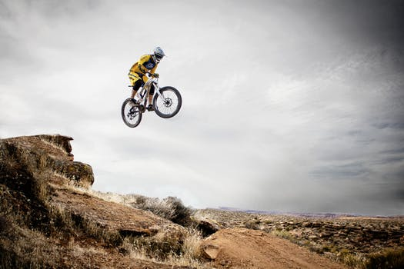
syntax
short sentences
ellipses

Slide 14
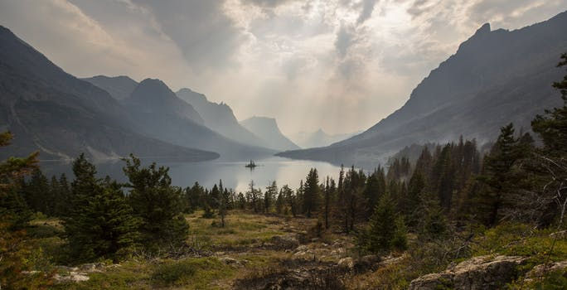
syntax
longer sentences
more complex syntax

Slide 15
Similes and metaphors

Slide 16
The stage stands on end and sinks like the Titanic.
(The Simpsons Movie)

Slide 17
He holds the syringe like a dart and inserts it in the buttock.
(Seksmisja)

Slide 18
The lightning hits the water. A web of blue zigzags, illuminating the raging ocean.
(The Life of Pi – Polish AD)

Slide 19
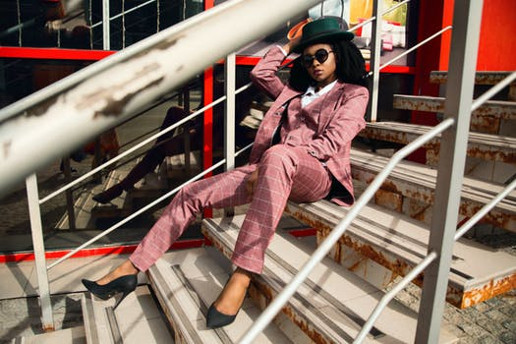
organisation

Slide 21
references
Remael, A. (2005) “Audio description for recorded TV, cinema and DVD. An experimental stylesheet for teaching purposes”.
ITC Guidance on Standards for Audio Description. (2000). http://audiodescription.co.uk/uploads/general/itcguide_sds_audio_desc_word3.pdf

Slide 22
language
Module 2
Unit 7
Agnieszka Chmiel
Adam mickiewicz university in poznan

Slide 23
The preparation of this presentation was supported by ADLAB PRO
(Audio Description: A Laboratory
for the Development of a New Professional Profile),
financed by the European Union
under the Erasmus+ Programme,
Key Action 2 – Strategic Partnerships,
Project number:2016-1-IT02-KA203-024311.

Slide 24
The information and views set out in this presentation
are those of the authors and do not necessarily reflect
the official opinion of the European Union.
Neither the European Union institutions and bodies
nor any person acting on their behalf may be held responsible for the use which may be made
of the information contained therein.

