Slide 1
Ad for Static arts
Module 4
Unit 3
Chris taylor
University of trieste

Slide 2
First considerations
Provide general information on the work;
Give an explanation of the style, movement, period of the exhibit.

Slide 3
More considerations
Help the person with sight loss (PSL) to build up the image (colours, shapes, position of objects).

Slide 4
More considerations
Careful use of vocabulary;
Offer the chance to touch the exhibits.

Slide 5
Linguistic and textual features of ad in general
AD is a genre distinguishable from other types of text.

Slide 6
Linguistic features of ad
(Almost) exclusive use of present tense;
Short, paratactic, declarative sentences;
More than usual use of verbs;
Vivid vocabulary, particularly adjectives.

Slide 7
textual features of ad
Cohesion through repetition and anaphoric reference;
More than usual use of non-finite verbs in theme position;
Isolated noun phrases.

Slide 8
Linguistic and textual features of ad for museums
Thus many of the features pertaining to AD in general apply also to static arts AD. However there are some important differences.

Slide 9
differences
Concision, timing and synchronisation, which are so important, for example, in film AD, are not so necessary in static art description.

Slide 10
Concision
Screen AD generally requires the use of short, simple, paratactic sentences, while static art AD is not subject to such strict limitations.

Slide 11
timing
Timing is of paramount importance in screen AD where the text has to be inserted between stretches of dialogue, but in static art AD this is unnecessary.

Slide 12
synchronisation
Whereas in screen AD, the text has to be synchronised with the moving pictures, static art does not require such precision.

Slide 13
appraisal
While for AD in general the use of appraisal (personal interpretations, subjective description) is either frowned upon or acceptable in small doses, museum AD allows for more liberty in this respect.

Slide 14
Example of appraisal
The phrase ‘a beautiful girl’ in film translation is a subjective opinion and should be avoided.
In describing art, more flexibility is afforded the describer e.g., ‘these magnificent 17th century tapestries’.

Slide 15
An example from miramare castle, trieste
… the walls are covered with rich, cream-coloured silk, hand painted with floral patterns to achieve a perfect oriental style.

Slide 16
Analysis and criticism
You should be able to analyse and criticise existing ADs.
To what extent have the considerations (slides 2-4) been followed? Is there sufficient or too much detail?

Slide 17
Analysis and criticism (2)
Are the features described suitable for the audience (art lovers, ordinary members of the public, the elderly, children)?

Slide 18
Analysis and criticism (3)
Have the linguistic and textual features of the genre been applied?
Is there sufficient, or too much, appraisal?

Slide 19
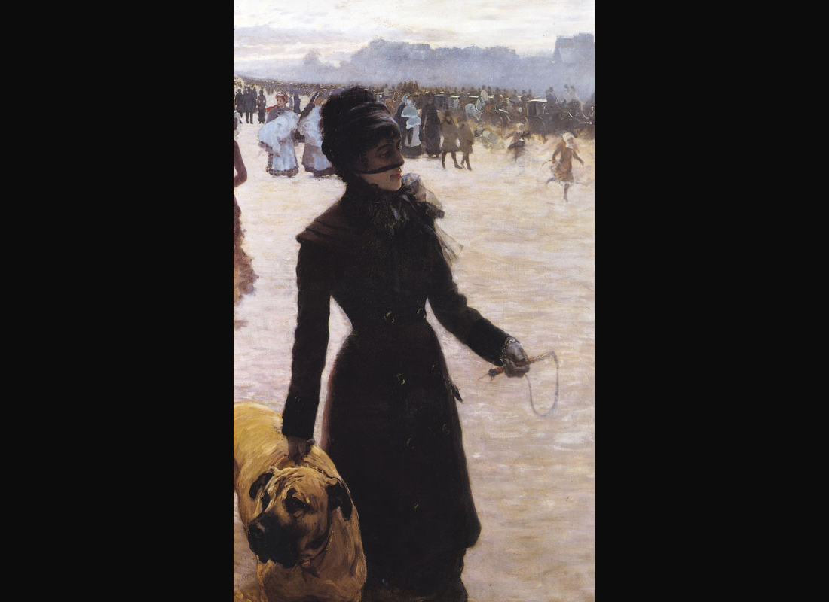

Slide 20
ANALYSIS
Please refer to the additional video ‘AD ANALYSIS’ for advice on analysing the audio description of this picture.

Slide 21
Ad for Static arts
Module 4
Unit 3
Chris taylor
University of trieste

Slide 22
The preparation of this presentation was supported by ADLAB PRO
(Audio Description: A Laboratory
for the Development of a New Professional Profile),
financed by the European Union
under the Erasmus+ Programme,
Key Action 2 – Strategic Partnerships,
Project number:2016-1-IT02-KA203-024311.

Slide 23
The information and views set out in this presentation
are those of the authors and do not necessarily reflect
the official opinion of the European Union.
Neither the European Union institutions and bodies
nor any person acting on their behalf may be held responsible for the use which may be made
of the information contained therein.

