Slide 1
Tactile exploration
Module 4
Unit 7
elisa perego
University of trieste

Slide 2
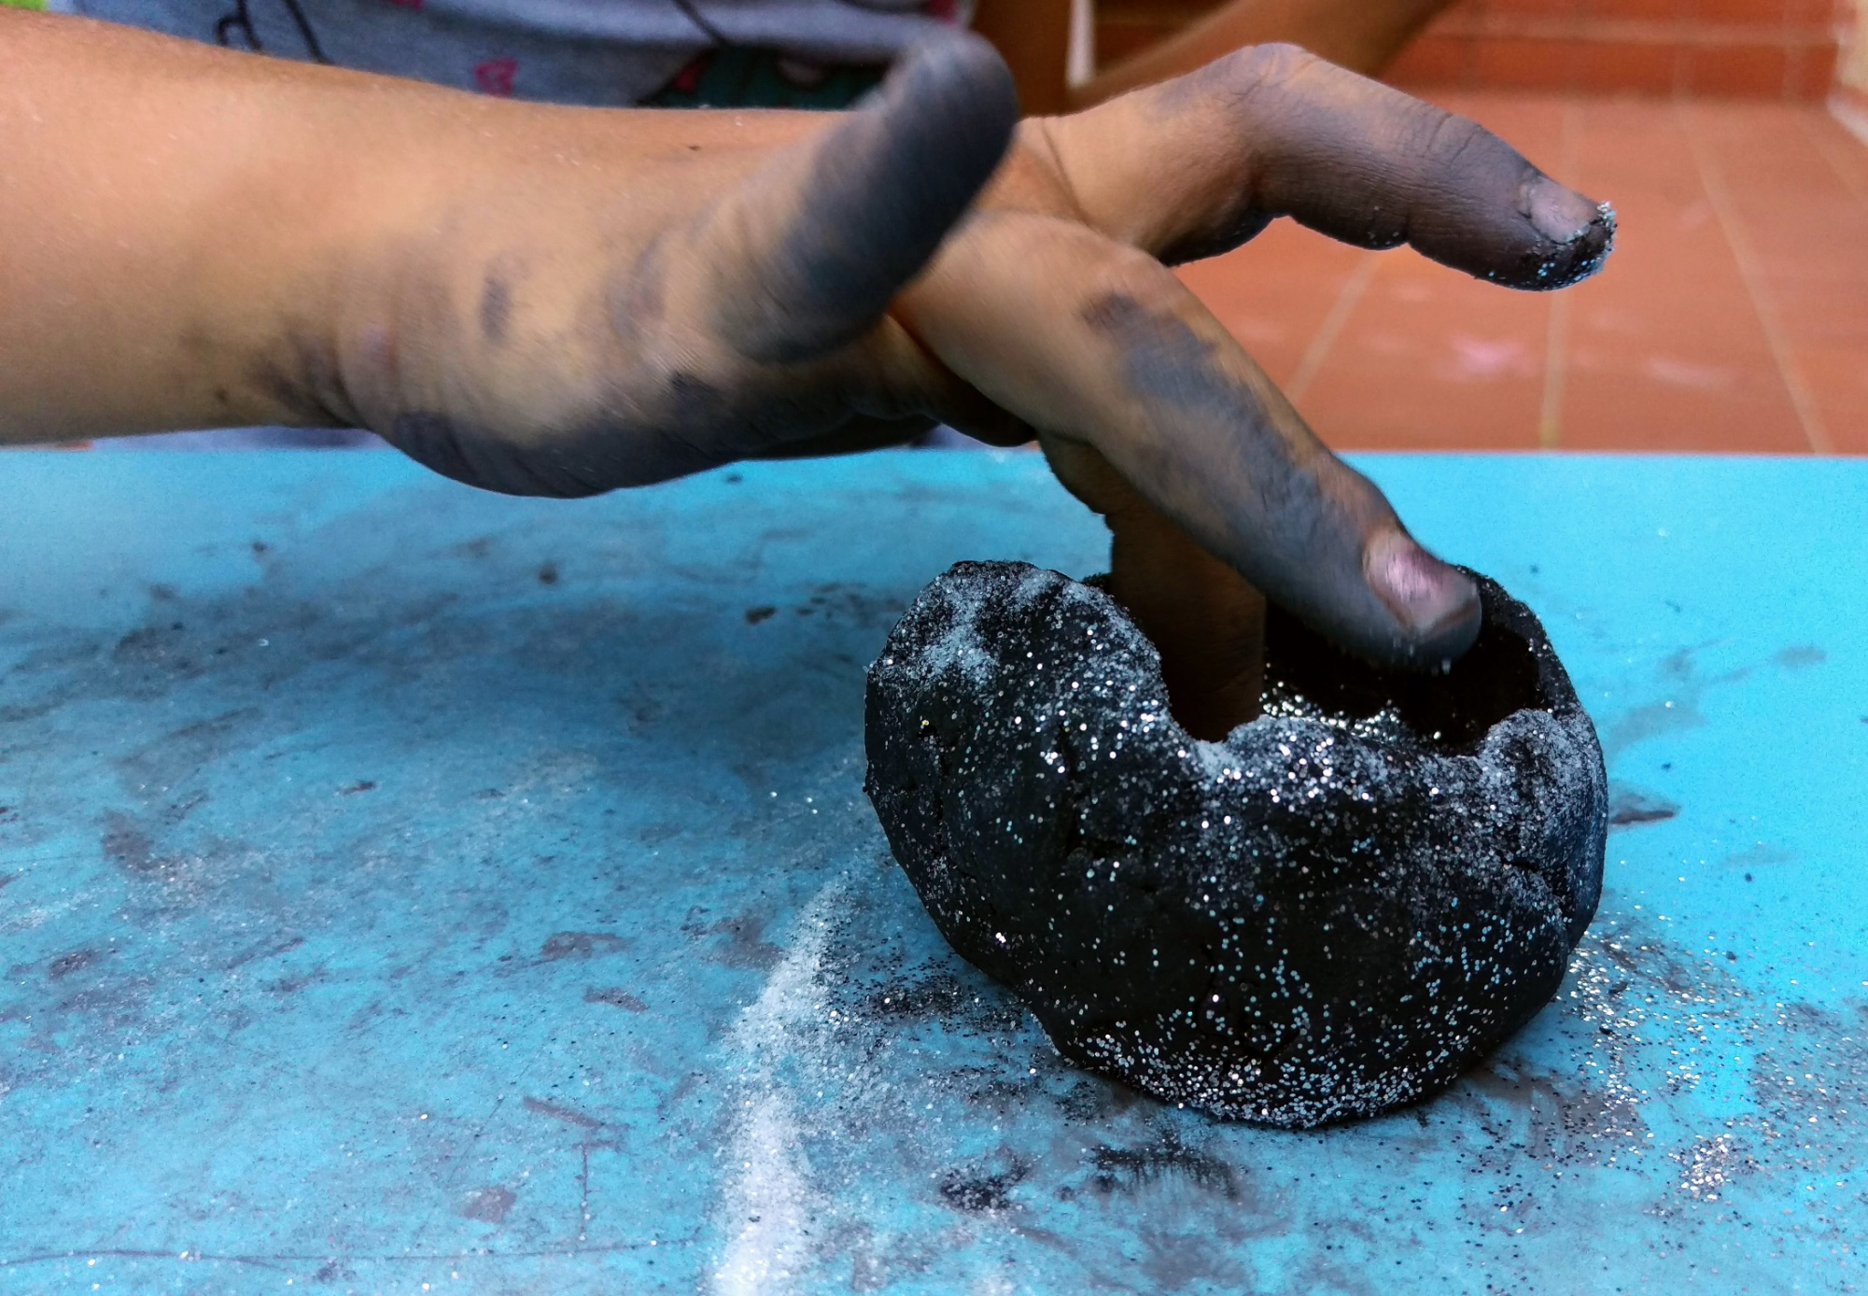
The importance of touch
Crucial sense (for learning and communicating).
Primary means of experiencing the world.

Slide 3
The importance of touch
When sight is absent:
Fills visual gaps.
Important additional source of information.
Means for experiencing the aesthetic beauty of objects.

Slide 4
Touch and art
Words are not enough.
Haptic supports:
Nuances of beauty.
More direct experience.
More involving.
More memorable (for all).

Slide 5
Touch and art
Touch:
successive,
slow,
analytical,
active.
(De Coster and Loots 2004: 331)

Slide 6
Touch and art
Familiarity.
Experience.
Individual differences.

Slide 7
Touch tours
Time- and cost-intensive.
Forward planning.
Team work.

Slide 8
How to choose items
Meaningful within museum/gallery.
Most appealing to the touch (and to the eye).
Adequately «legible».

Slide 9
How to choose items
No absolute rules.
Study the context.
Talk with curators.
Be creative and prepared.

Slide 10
An example
National Tile Museum in Lisbon (Eardley et al. 2016):
Tiles belonging on everyday life.
Complex patterns broken down.

Slide 11
Touching the originals
How perishable/fragile is the material?
How common and easily replaceable is the object?

Slide 12
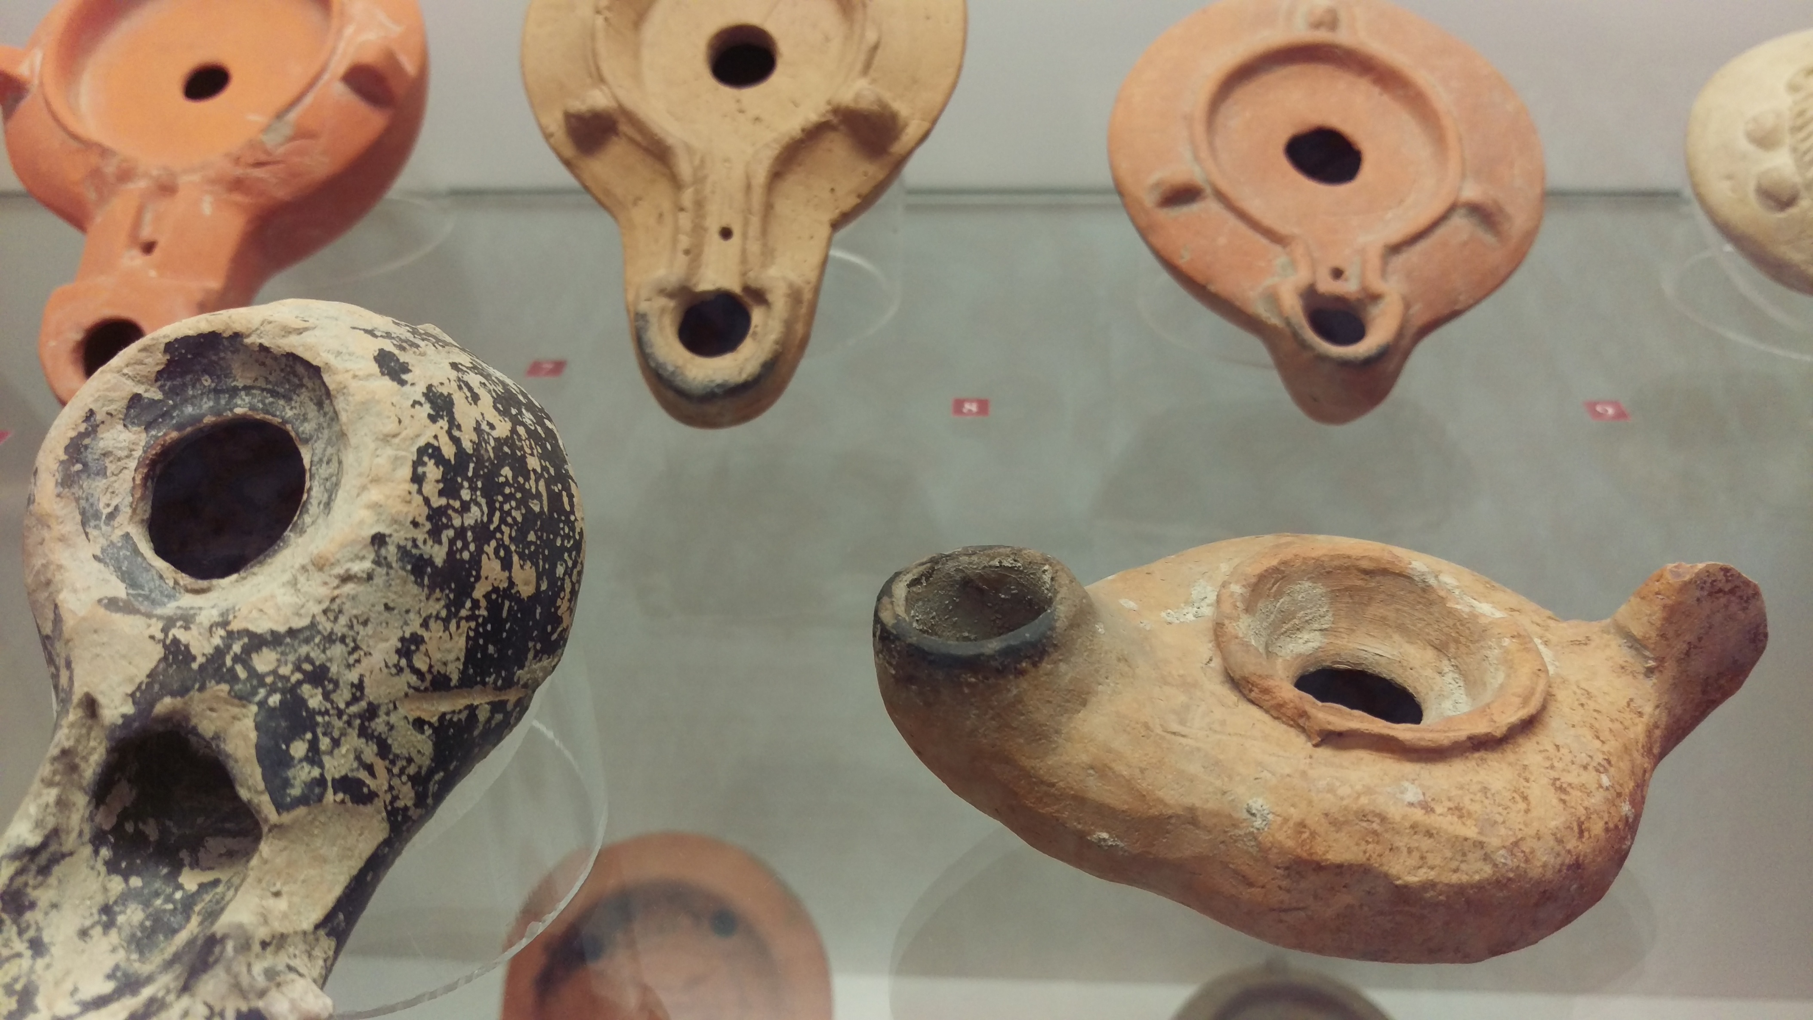

Slide 13
replicas
Paintings, artworks and objects, or relevant parts of them, can be reproduced: cf. tactile museums.

Slide 14
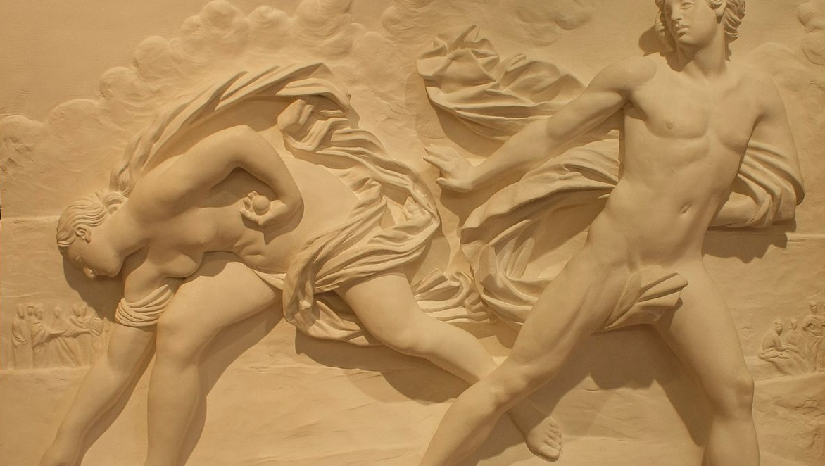

Slide 15
the human guide
Immersive.
More interactive.
Tailor-made.

Slide 16
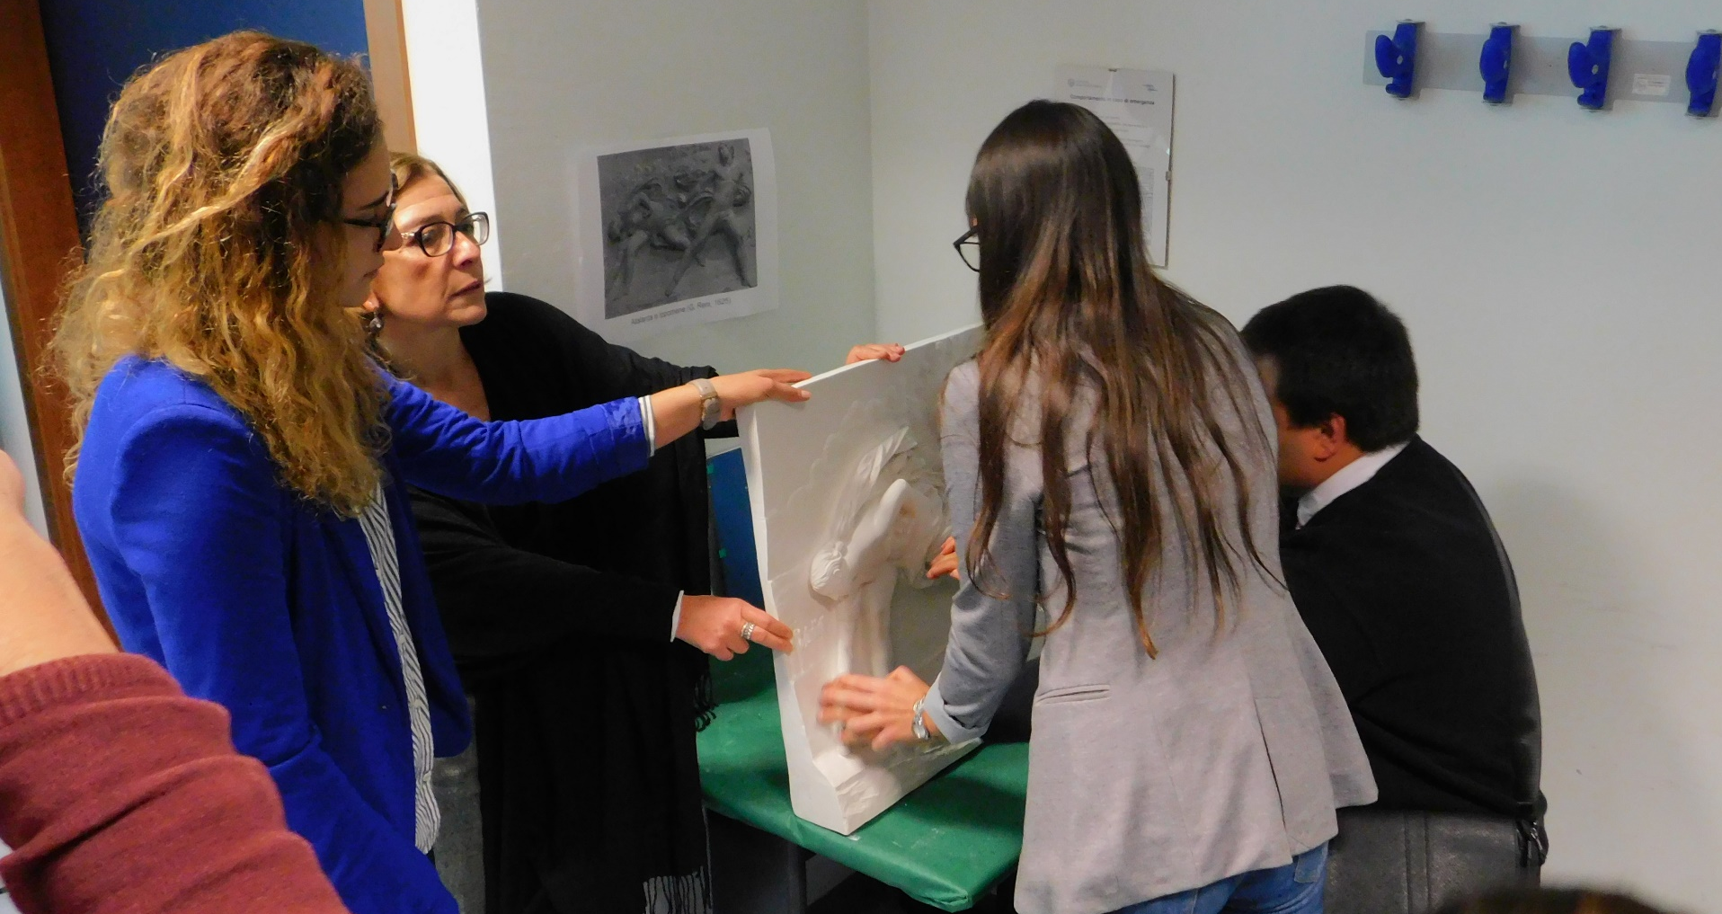

Slide 17
The exploration procedure
Structured, organized process:
perimeter,
centre,
details.

Slide 18
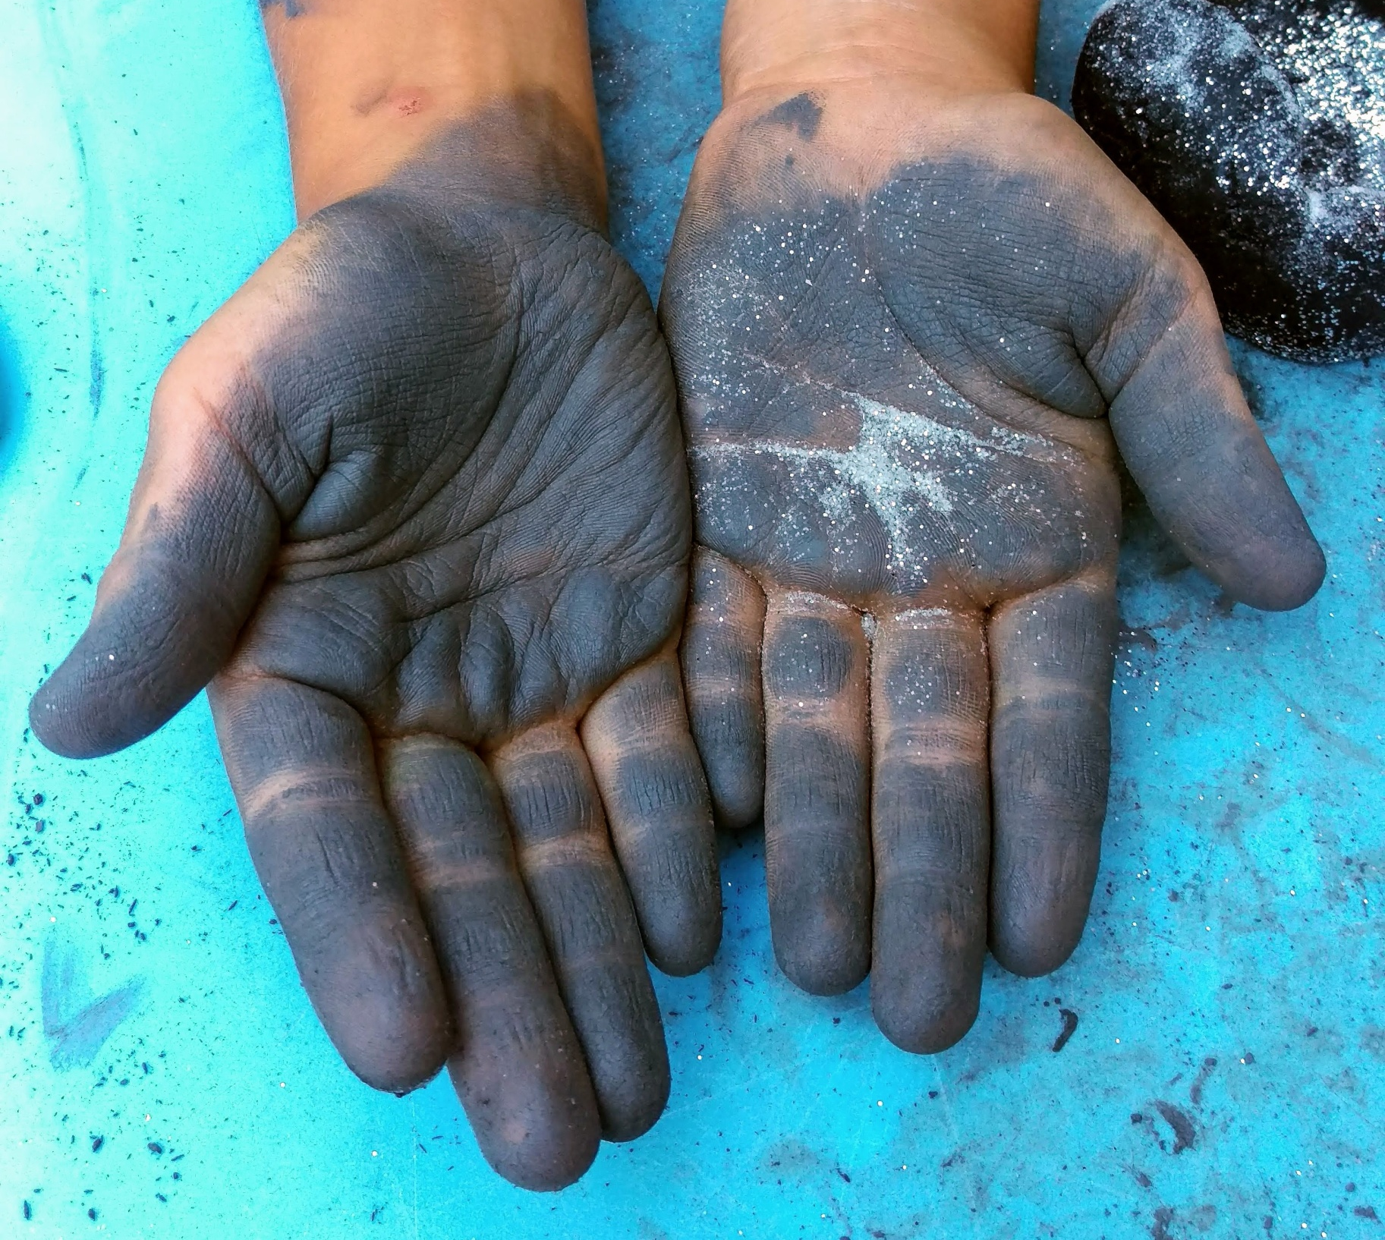
The exploration procedure
Both hands.
Palms.
Finger.
Fingertips.

Slide 19
Tactile exploration
Module 4
Unit 7
elisa perego
University of trieste

Slide 20
The preparation of this presentation was supported by ADLAB PRO
(Audio Description: A Laboratory
for the Development of a New Professional Profile),
financed by the European Union
under the Erasmus+ Programme,
Key Action 2 – Strategic Partnerships,
Project number:2016-1-IT02-KA203-024311.

Slide 21
The information and views set out in this presentation
are those of the authors and do not necessarily reflect
the official opinion of the European Union.
Neither the European Union institutions and bodies
nor any person acting on their behalf may be held responsible for the use which may be made
of the information contained therein.

