Slide 1
DUBBING
Module 5
Unit 3
ANNA MATAMALA
UNIVERSITAT AUTÒNOMA DE BARCELONA

Slide 2
SUBTITLING COUNTRIES
AUDIOVISUAL TRANSLATION
VOICE-OVER COUNTRIES
DUBBING COUNTRIES

Slide 3
SYNCHRONISATION
Lip synchronisation.
Isochrony.
Kinetic synchrony.

Slide 4
language
“Dubbese” as a prefabricated orality.
It sounds natural and spontaneous, but it is not.

Slide 5
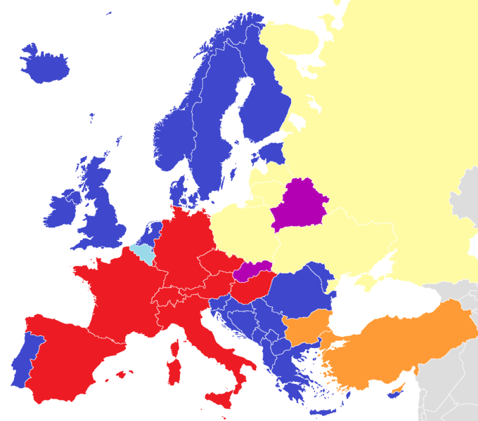
map
Source: commons.wikimedia.org/wiki/File:Dubbing_films_in_Europe.pnG

Slide 6
PROCESS
Translation.
Synchronisation (dialogue writer).
Spotting (text segmenting).
Quality control (revision).

Slide 7
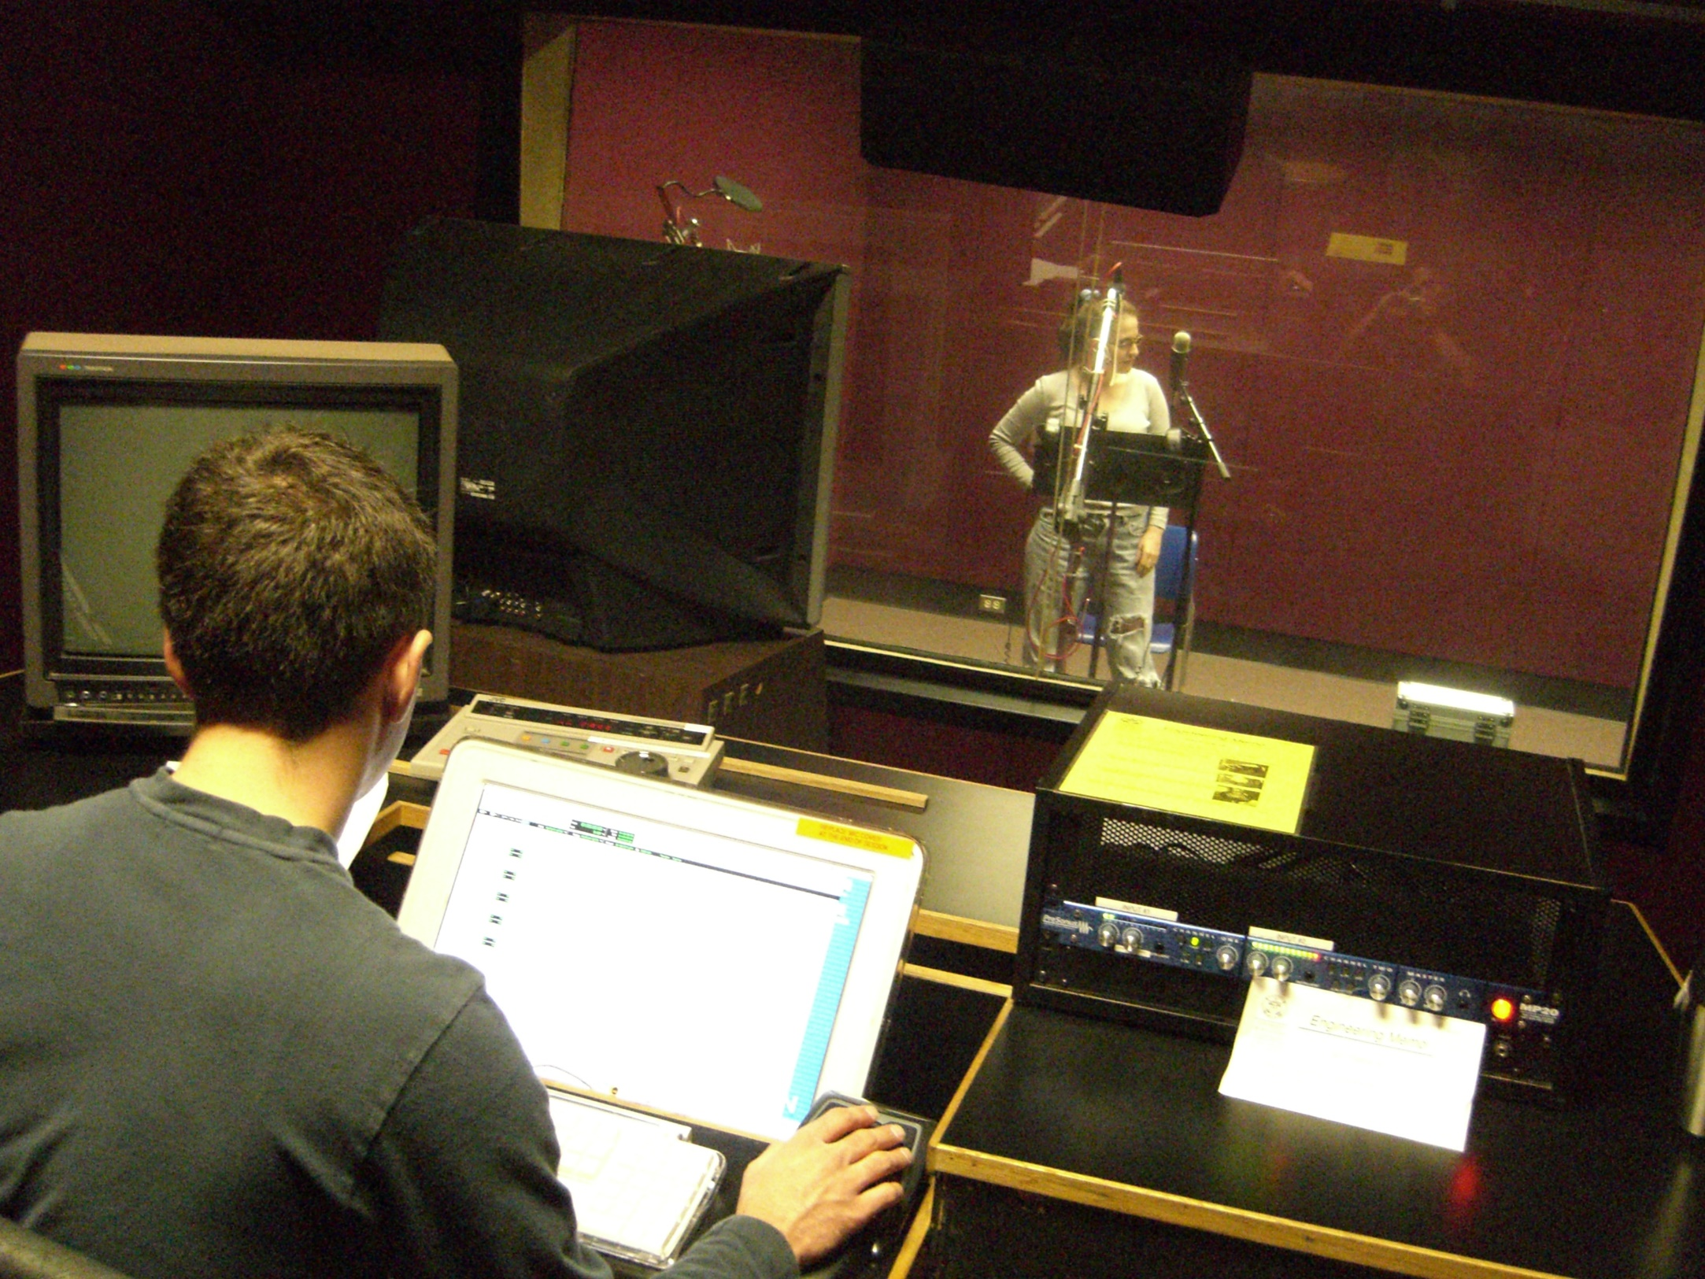
PROCESS
Source: https://commons.wikimedia.org/wiki/File:LipSyncRecording.jpg

Slide 8
SYMBOLS
(P)
(ON)
(OFF)
(AD LIBS)
(DE)
(G)
(R)
(ATT)

Slide 9
dialogues
Changes in the dialogues.
Censorship.
Source: imdb

Slide 10
AD
Watch the content in the version of the audience.

Slide 11
AD
Watch the content in the version of the audience.
Impact on AD of dialogues changed in dubbed version.

Slide 12
REFERENCE
Chaume, Frederic (2012) Audiovisual Translation: Dubbing. Manchester: St. Jerome.

Slide 13
DUBBING
Module 5
Unit 3
Anna matamala
Universitat autònoma de barCELONA

Slide 14
The preparation of this presentation was supported by ADLAB PRO
(Audio Description: A Laboratory
for the Development of a New Professional Profile),
financed by the European Union
under the Erasmus+ Programme,
Key Action 2 – Strategic Partnerships,
Project number:2016-1-IT02-KA203-024311.

Slide 15
The information and views set out in this presentation
are those of the authors and do not necessarily reflect
the official opinion of the European Union.
Neither the European Union institutions and bodies
nor any person acting on their behalf may be held responsible for the use which may be made
of the information contained therein.

